Slide 1

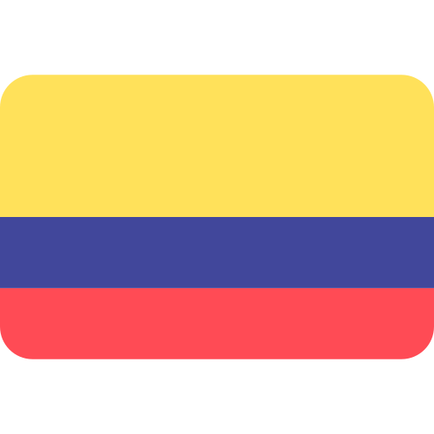
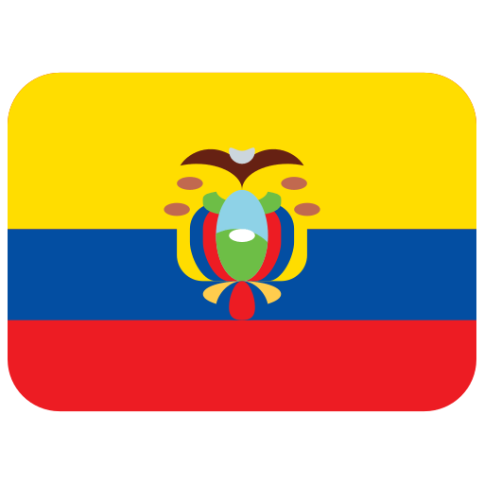
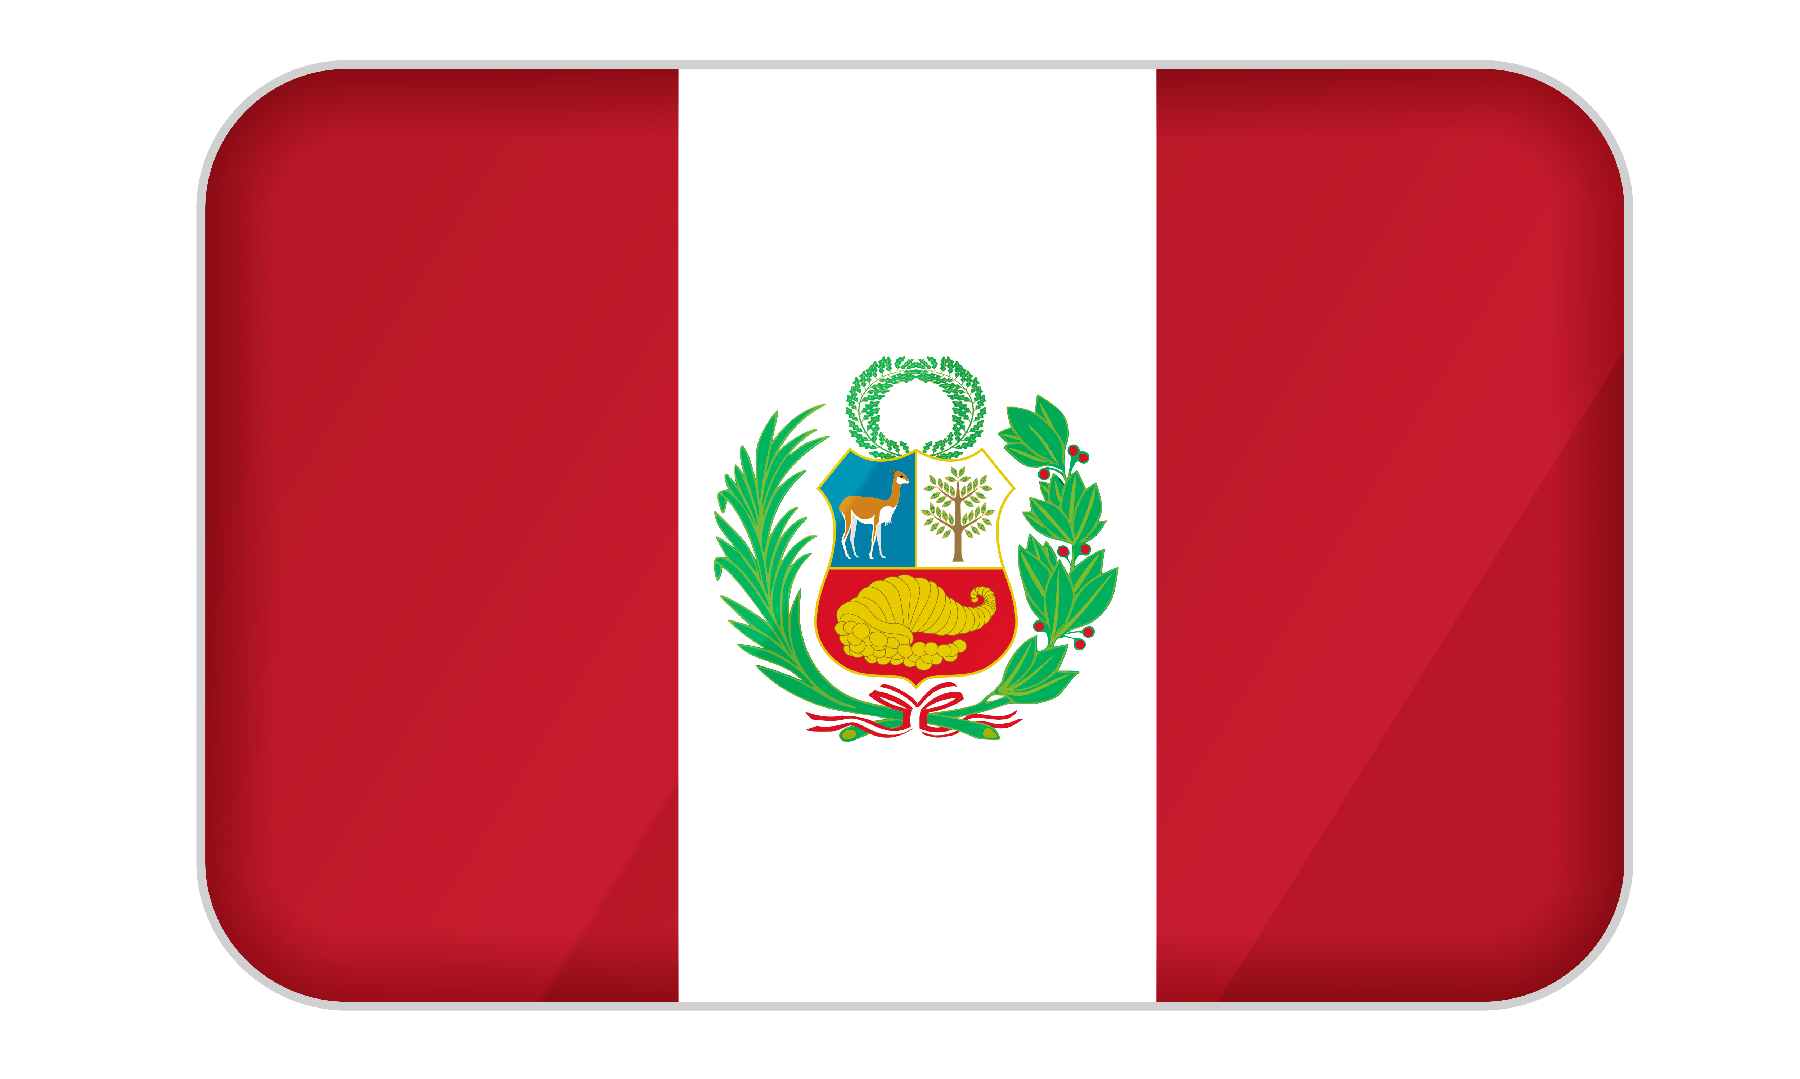
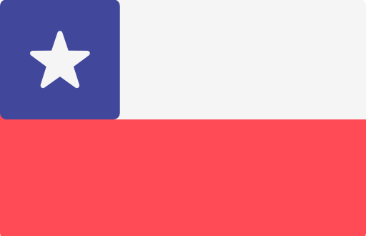
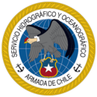

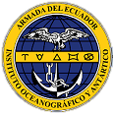
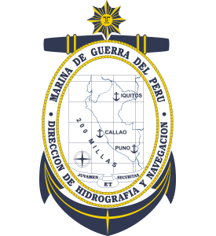

Exercise Pacific Wave
2022
Regional Working Group on Tsunami Warning and Mitigation
in the South East Pacific Region

Slide 2
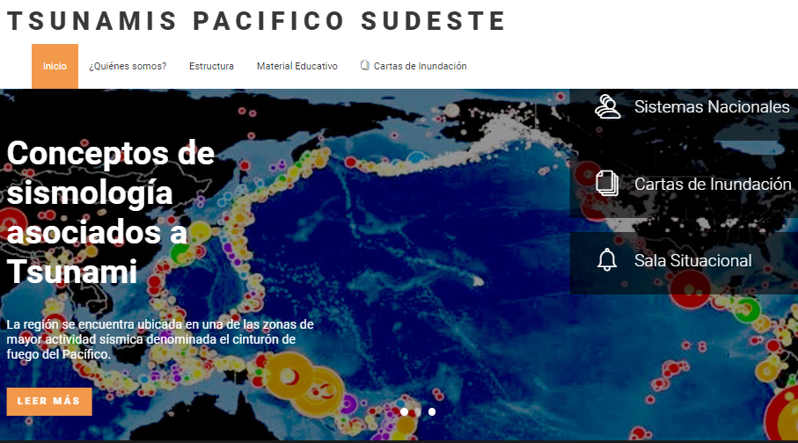
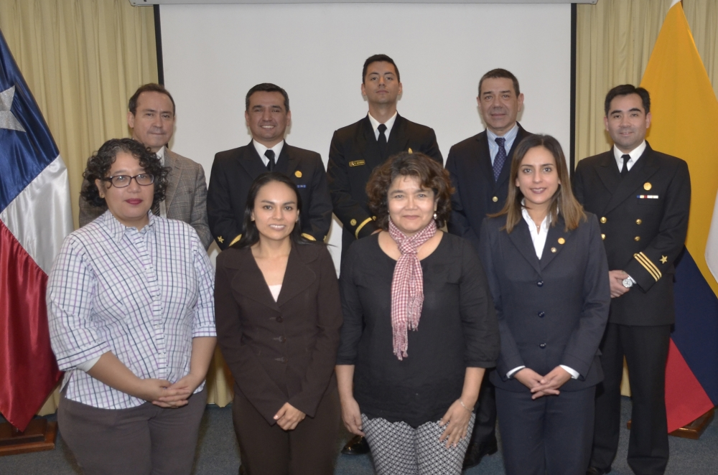
GROUP OVERVIEW
Regional Working Group on Tsunami Warning and Mitigation in the South East Pacific Region.
Member States: Chile, Colombia, Ecuador and Peru.
Within South Pacific Permanent Comission (CPPS).
Main Objectives
    Strengthen Tsunami Early Warning Regional System.
    Gather Educational resources, action plans and operational protocols for the Community.
    PacWave exercise involved NDMO in every member state.
    Promote international cooperation between NDMO and NTWC.

Slide 3
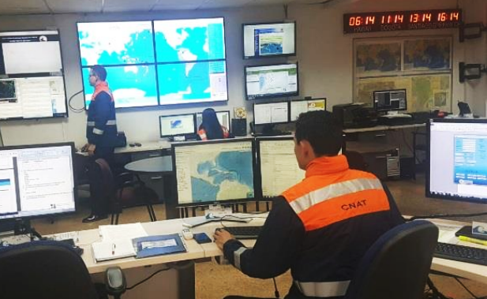
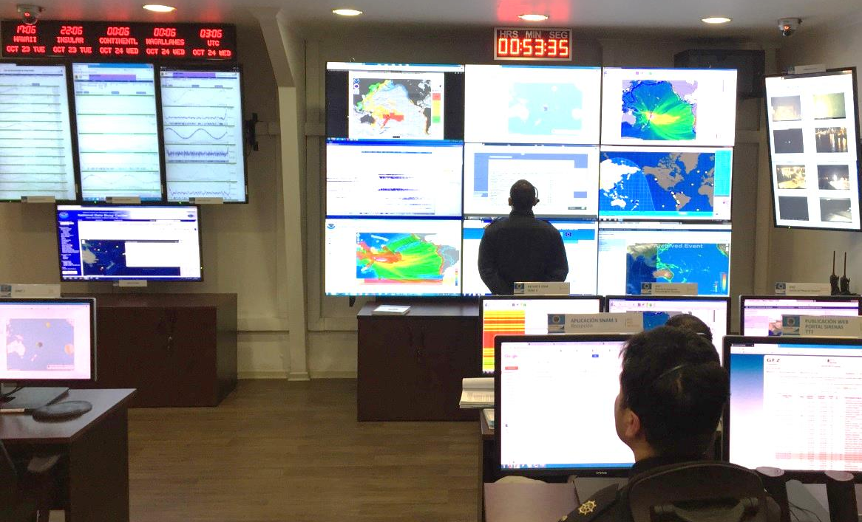
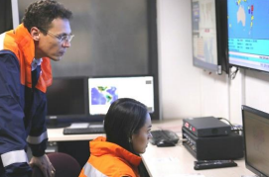
PREVIOUS EXPERIENCE
PacWave18
    Regional exercise:
    October 24th 2018: Starting at 02:00 UTC (Chile’s NTWC acted as PTWC, using TSUCAT for bulletin preparation).
    Scenario: Magnitude 9.0 Earthquake near Tonga.
    Each country NTWC and NDMO did exercises focused on near field events.
    Involved limited evacuation of some coastal comunities.
    Tested full operational protocols:
      Emergency initial evaluation.
      Tsunami treath assessment.
      Tsunami monitoring.
      Treath increase.
      Treath cancellation.

Slide 4
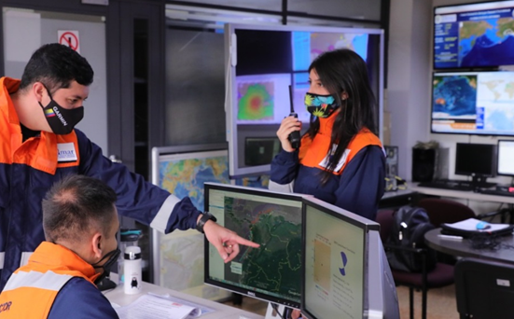
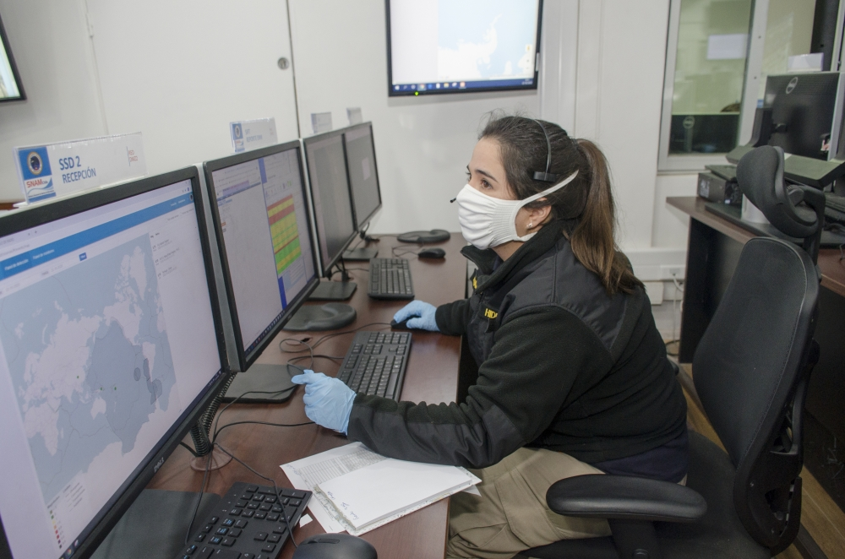
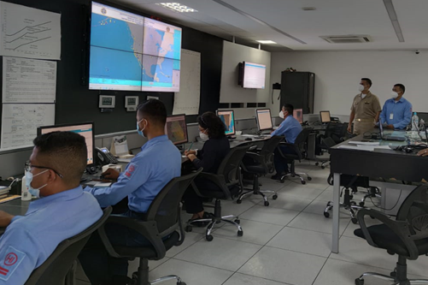
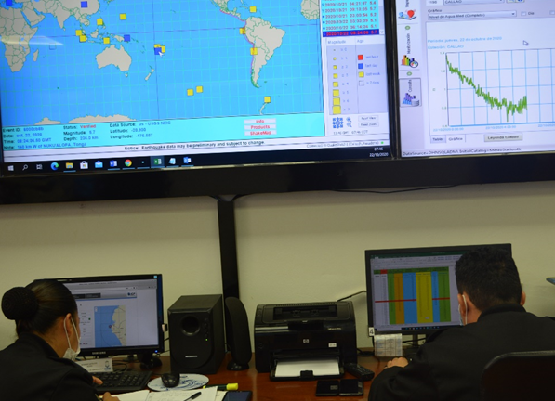
PREVIOUS EXPERIENCE
PacWave 2020
    Regional exercise:
    October 22th 2020: Starting at 12:00 UTC (Peru’s NTWC acted as PTWC ).
    Scenario: Magnitude 9.0 Earthquake near Tonga scenario.
    First hour of regional exercise carried out in real time, later compressed time was simulated to train the full cicle of operational protocol.
    Tested regional communication updated protocol based on Pacwave 2018 and regional exercise 2019:
      Standarized Tide gauge reports.
      Available real time modeling results.
      Real time blog to share NTWC bulletins.
      Satellite Communication test performed during the exercise.
    Involved limited coastal comunities evacuation.

Slide 5
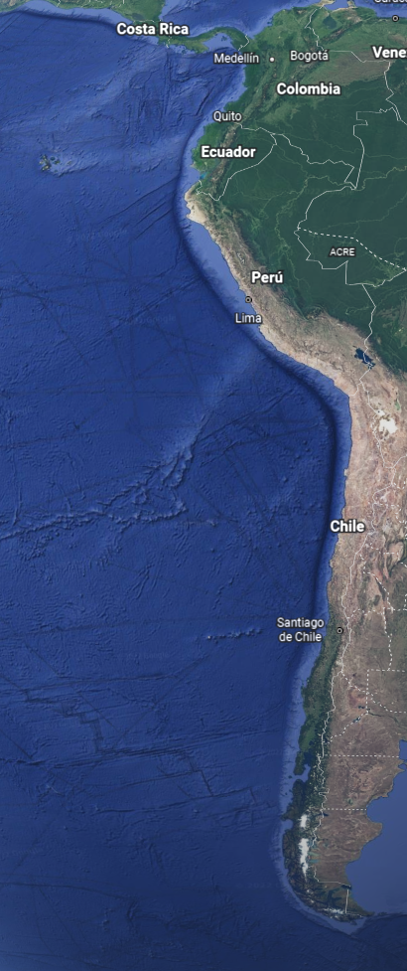
PACWAVE22
Planned exercises and activities
    Second half Oct. 2022.
    Two-phase Regional exercise:
        Epicenter near Chile – Peru Border (Colombia and Ecuador will participate only from their NTWC).
        Epicenter near Colombia – Ecuador Border. (Chile and Peru will participate only from their NTWC)
      Promote NTWC – NDMO Coordination.
      Limited coastal comunities evacuation.
      Strengthen communication protocols between NTWC based on Tonga Event lessons.
      Full operational protocol testing including sharing of Tide Gauge data.

Slide 6
PACWAVE22
Planned exercises and
activities
    Each country will also host a National Level Operational exercises to test their own objectives.
Capacity Building workshop: “Sea Level Data Sharing: Tools for an effective Regional Emergency Response”, Sep. 27th-30th. CHILE (UNESCO/IOC-VLIZ Sponsored).
Scientific meeting of experts affecting southern Peru and northern Chile, Oct. 24th-27th. PERU (UNESCO/IOC Sponsored).

Slide 7
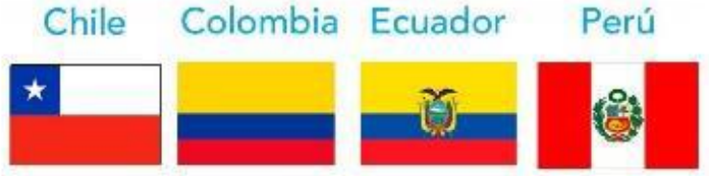
THANK YOU FOR
YOUR ATTENTION

