Slide 1

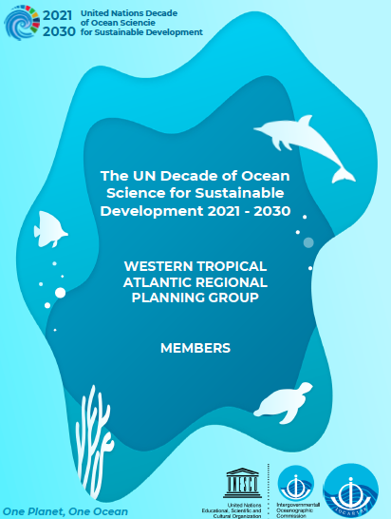
An Ocean Observing and Forecasting System for
the Tropical Americas and Caribbean Region
Doug Wilson
Representing the IOCARIBE Regional Planning Group for A Predicted Ocean
Edgard Cabrera Albert Martis Julio Morell Douglas Wilson
A REGIONAL PLANNING GROUP was formed, an initial workshop was held (November
2020), and during July – October 2021, seven regional co-design workshops were held
with OCEAN DECADE OUTCOME themes.
A PREDICTED OCEAN workshop was held in September 2021 as part of the workshop series.
A regional Ocean Decade Kickoff Conference summarizing the workshops and suggesting
ways forward was held in December 2021.
Included in the Conference Recommendations – Essential Infrastructure WG - was the statement that
“Ocean observations, data management, analysis, models and products, are foundational to our approach to sustainable development.”
Based on Workshop’s co-designed outcomes, Kickoff Conference discussions, and in consultation with the Regional Planning Group, it was recommended to submit a proposal for an Ocean Decade Action in support of An Ocean Observing and Forecasting System for the Tropical Americas and Caribbean Region.

Slide 2
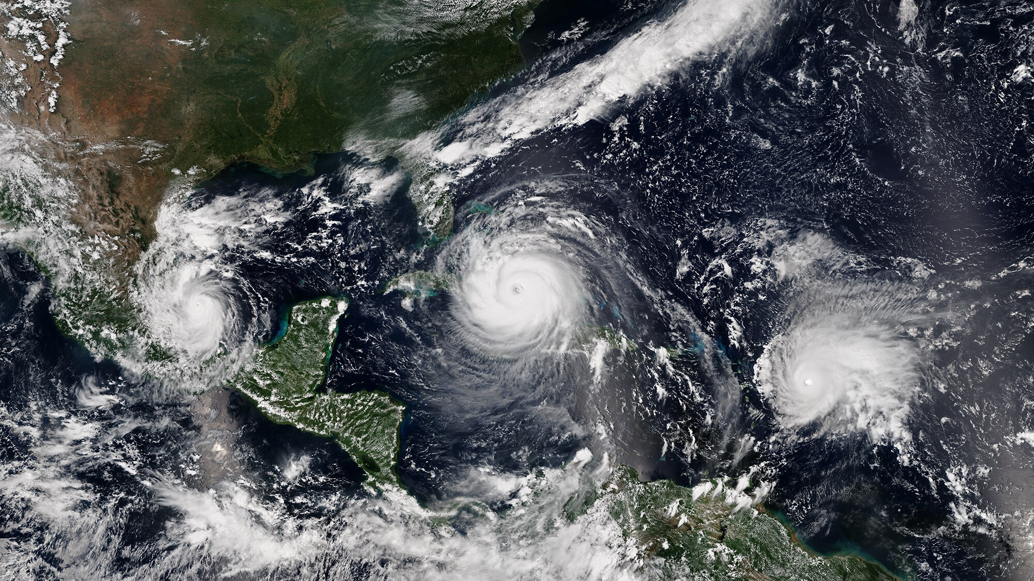

An Ocean Observing and Forecasting System for the
Tropical Americas and Caribbean Region
The Action was endorsed by the UN Ocean Decade Coordination Unit in
September 2022.
The Action is intended to provide a roadmap to a Regional System that meets the original goals of IOCARIBE-GOOS, while considering
Suggestions and ideas from Workshop participants
Advancements in observing system expansion, capabilities, and interest within the region
Evolution of the Global Ocean Observing System and associated Programs
Advances in Ocean Observing technology, methods, and best practices
Lessons learned from the previous IOCARIBE-GOOS experience
Opportunities to collaborate with other UN Decade activities
“During preliminary workshops among constituents in the Tropical Americas and Caribbean (TAC), the need was expressed
for the co-design and operation of a sustained integrated ocean observation and forecasting system for the region that will
provide essential information for the sustainable development, well-being, prosperity and safety of the region’s oceans.
The system will be in alignment with the GOOS 2030 Strategy, using a Value Chain approach, connecting OBSERVATIONS
through DATA MANAGEMENT for use in ANALYSES and MODELS to create APPLICATIONS.”

Slide 3
An Ocean Observing and Forecasting System for the
Tropical Americas and Caribbean Region
Proposed Activities
Dorian forms over St. Thomas, USVI, August 2019
Organize – create organizational and management structure for development and growth
Awareness – educate and engage potential users, contributors, members, and Decade partners
Assess Needs and Assets – utilizing organization, members, and Decade partners
Develop Initial Projects that
  Demonstrate broad regional value
  Utilize Decade Programmes
  Build robust framework for expansion
  Promote data sharing and international cooperation and collaboration

Slide 4
An Ocean Observing and Forecasting System for the
Tropical Americas and Caribbean Region
Proposed next steps:
Form a management and advisory structure based on recommendations of 2020-2021
regional co-design workshops. an initial advisory group for the TAC-OOS consisting
of experts and representatives from organizations expected to participate.
Advisory Group will work regionally along with GOOS Observing Together and GOOS Ocean Observing Co-Design programs to develop a long-term governance and management framework and an initial Strategic Plan.
Framework structure will be composed of both national and organizational decision-makers; groups of regional and non-regional experts on observations, modeling and forecasting, products, and data management activities; and task teams carrying out capacity building, outreach, and education activities.
A high priority will be the promotion of data and product sharing and reciprocal data collection agreements associated with membership in the System, with a task team specifically assigned to this aspect.
Notes:
Problem is that while we have an endorsed proposal, we do not have – and we need to provide - the organizational structure to carry out the proposed activities.

Slide 5
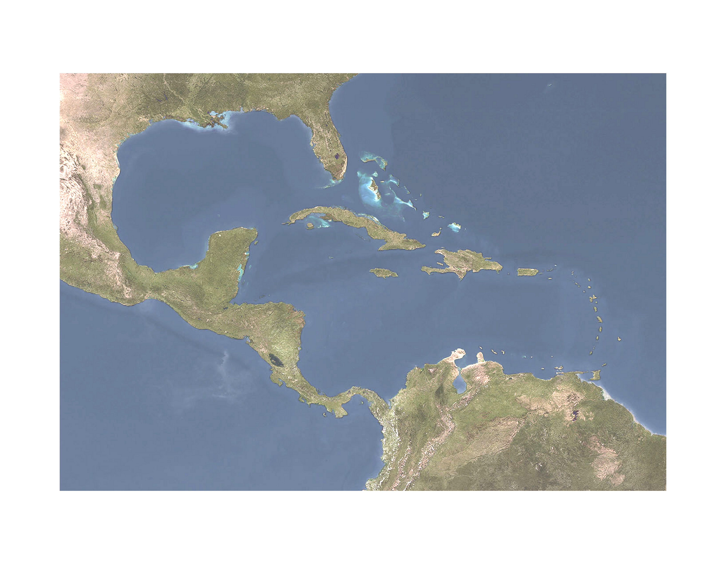
An Ocean Observing and Forecasting System for the
Tropical Americas and Caribbean Region
The Advisory Group will lead in the identification of:
Regional Needs: best done through targeted studies carried out by project-component specific working groups established within the management framework, working with GOOS Ocean Observing Co-Design and Observing Together Programmes
Existing Regional assets
Existing extra-regional contributing assets (including existing Decade Programs)
Gaps; extension of needs and assets identification processes.
Ultimately, a management structure will be established by the partners to take over day-to-day management from IOCARIBE as an independent but affiliated program.
Notes:
Problem is that while we have an endorsed proposal, we do not have – we need to provide - the organizational structure to carry out the proposed activities.

Slide 6

An Ocean Observing and Forecasting System for the
Tropical Americas and Caribbean Region
Develop initial tasks (and corresponding task teams as required)
including outlining initial projects of importance, strategy for their implementation,
and funding sources for initial and long-term sustainability of the Project.
Design and Implementation of a representative ‘skeleton’ demonstration System, using existing assets and filling gaps as necessary, that demonstrates multiple aspects of the system (including data and knowledge sharing), targets Essential Ocean Variables, links to other regional projects, and creates a framework for expansion.
Support the co-design of National Observing and Forecasting Systems along GOOS principles.
Create a robust program of capacity building and training to enable sustainable National Systems and contribute to the success of the Regional System.
Accomplish the integration of related Decade Programs into the TAC-GOOS implementation framework.
Promote data and product sharing and reciprocal data collection agreements associated with membership in the System.
Notes:
Problem is that while we have an endorsed proposal, we do not have – we need to provide - the organizational structure to carry out the proposed activities.

Slide 7
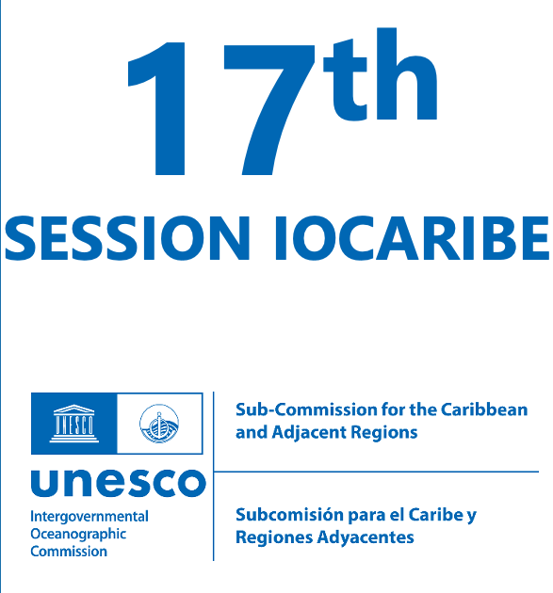
An Ocean Observing and Forecasting System for the
Tropical Americas and Caribbean Region
IOCARIBE XVII:
Continued support for TAC-OOS and other Regional Decade Actions
These are all connected and work together
Endorsement of TAC-OOS as next step in the ‘revitalization’ of IOCARIBE-GOOS
TAC-OOS needs an approved organizational framework – the ability to act
intersessionally - to move forward and take advantage of the wealth of
available supporting opportunities.
Notes:
Problem is that while we have an endorsed proposal, we do not have – we need to provide - the organizational structure to carry out the proposed activities.

