Slide 1
SPC & the work we do in Early Warning
ICG/PTWS-XXX
Nuku’alofa, Tonga
Litea Biukoto
Geoscience, Energy and Maritime Division

Slide 2


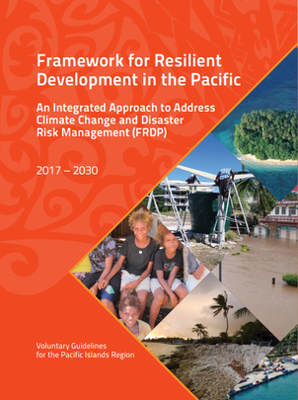

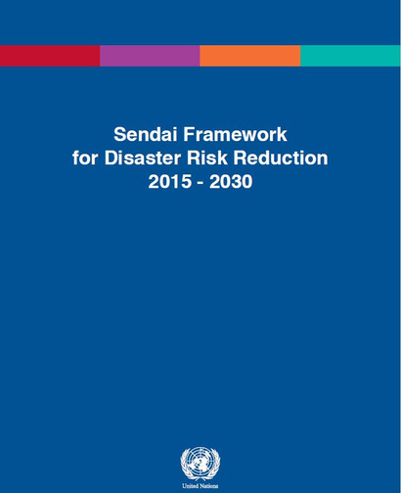
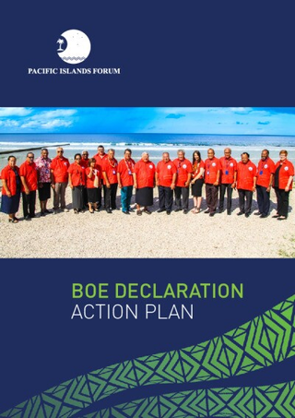
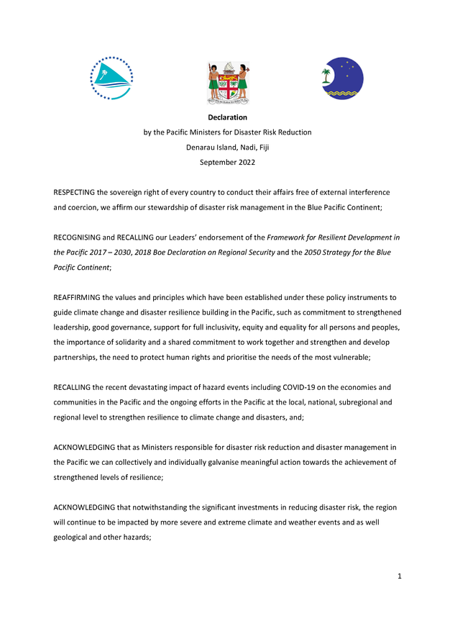
DRM Regional Policy Landscape
2050 Strategy – Long-term vision to secure the future of the Blue Pacific. Climate Change and Disaster key thematic priority
Goal 3 – Strengthened disaster preparedness, response and recovery
2015
2019
September 2022
2016
July 2022
Strategic Focus Area 2: Human Security and Humanitarian Assistance – includes “strengthening humanitarian assistance, disaster preparedness and response”
Declaration of DRR Ministers – includes commitment to strengthened national and regional capabilities in response
Priority 4 – Enhancing disaster preparedness for effective response and to ‘Build Back Better’ in recovery, rehabilitation and reconstruction

Slide 3



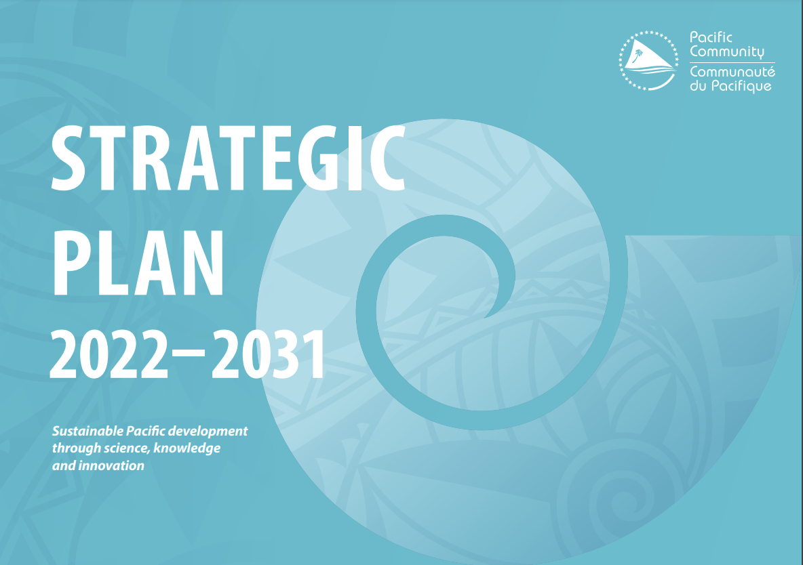
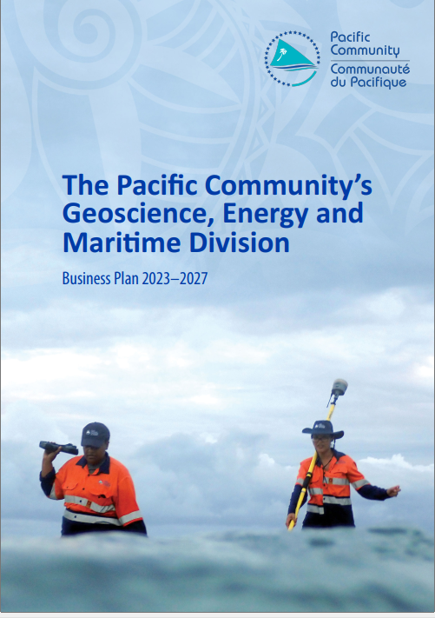




SPC - Integrated Programmatic Approaches to Disaster Risk Management
Disaster and Climate Risk Management
Ocean Services and Management
Earth and Ocean Observation
Water Security
Maritime Transport Services
Sustainable Georesources and Geosurveys
Sustainable Energy Security
Notes:
So WHY SPC?
Our work in SPC supports our members to strengthen their efforts in Disaster Risk Management including being better prepared for and responding to multiple hazards resulting in disasters and having national capability to do this.

Slide 4










How?
Disaster risk knowledge
Detection, observations, monitoring, analysis and forecasting of hazards
Warning dissemination and communication
Preparedness and response capabilities
Hazard assessment
Exposure mapping
Risk assessment
Post disaster assessments
Disaster Statistics
GEDSI considerations
Traditional knowledge
Capacity development & technical support
Science and research
Ocean monitoring
Ocean prediction
Support to Oceania Regional Seismic Network
Science and research
Co-designed user products developed
Impact based forecasts
Dissemination platform
Assess current EWS communications channels​
Establish capacity to set-up and maintain local feedback system
Strengthen on-going preparedness activities​
Support Tsunami Ready
Support coordination mechanism, institutional and operational capacity;
Simulation exercises​ & SOP reviews
Risk informed decision making
Regional collaboration
Review of legal and regulatory frameworks
Partnerships & Collaboration
Adapted from EW4ALL UNDRR
Notes:
SPC is currently supporting members through the work of GEM. Resourcing for these activities comes through different means i.e. regional projects with national activities, bilateral projects where SPC is an implementing partner
Early warning systems need to be part of disaster risk reduction strategies

Slide 5
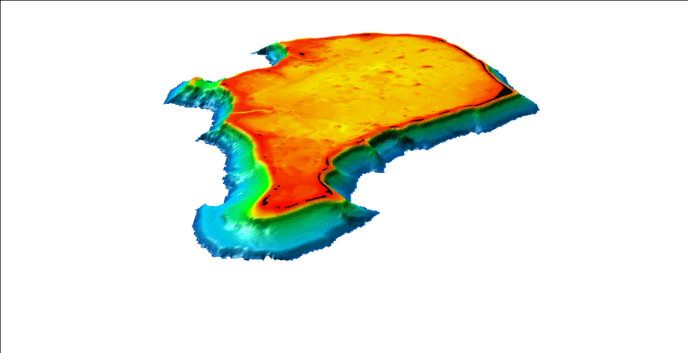
Supporting state of the art baseline data collection
Acquire high resolution topography and bathymetry
negotiate and advocate
Earth and marine observations – in situ and remote
Exposure mapping
Funafuti atoll – TCAP
Damlamian, H
Notes:
Advocating the acquisition of LiDAR but also that we work in data poor settings. The Oceans team have developed approaches to bridge that data dearth noting the limitations around how the products can be used.
This includes aerial photo repository, satellite imagery archive. In situ data collection

Slide 6
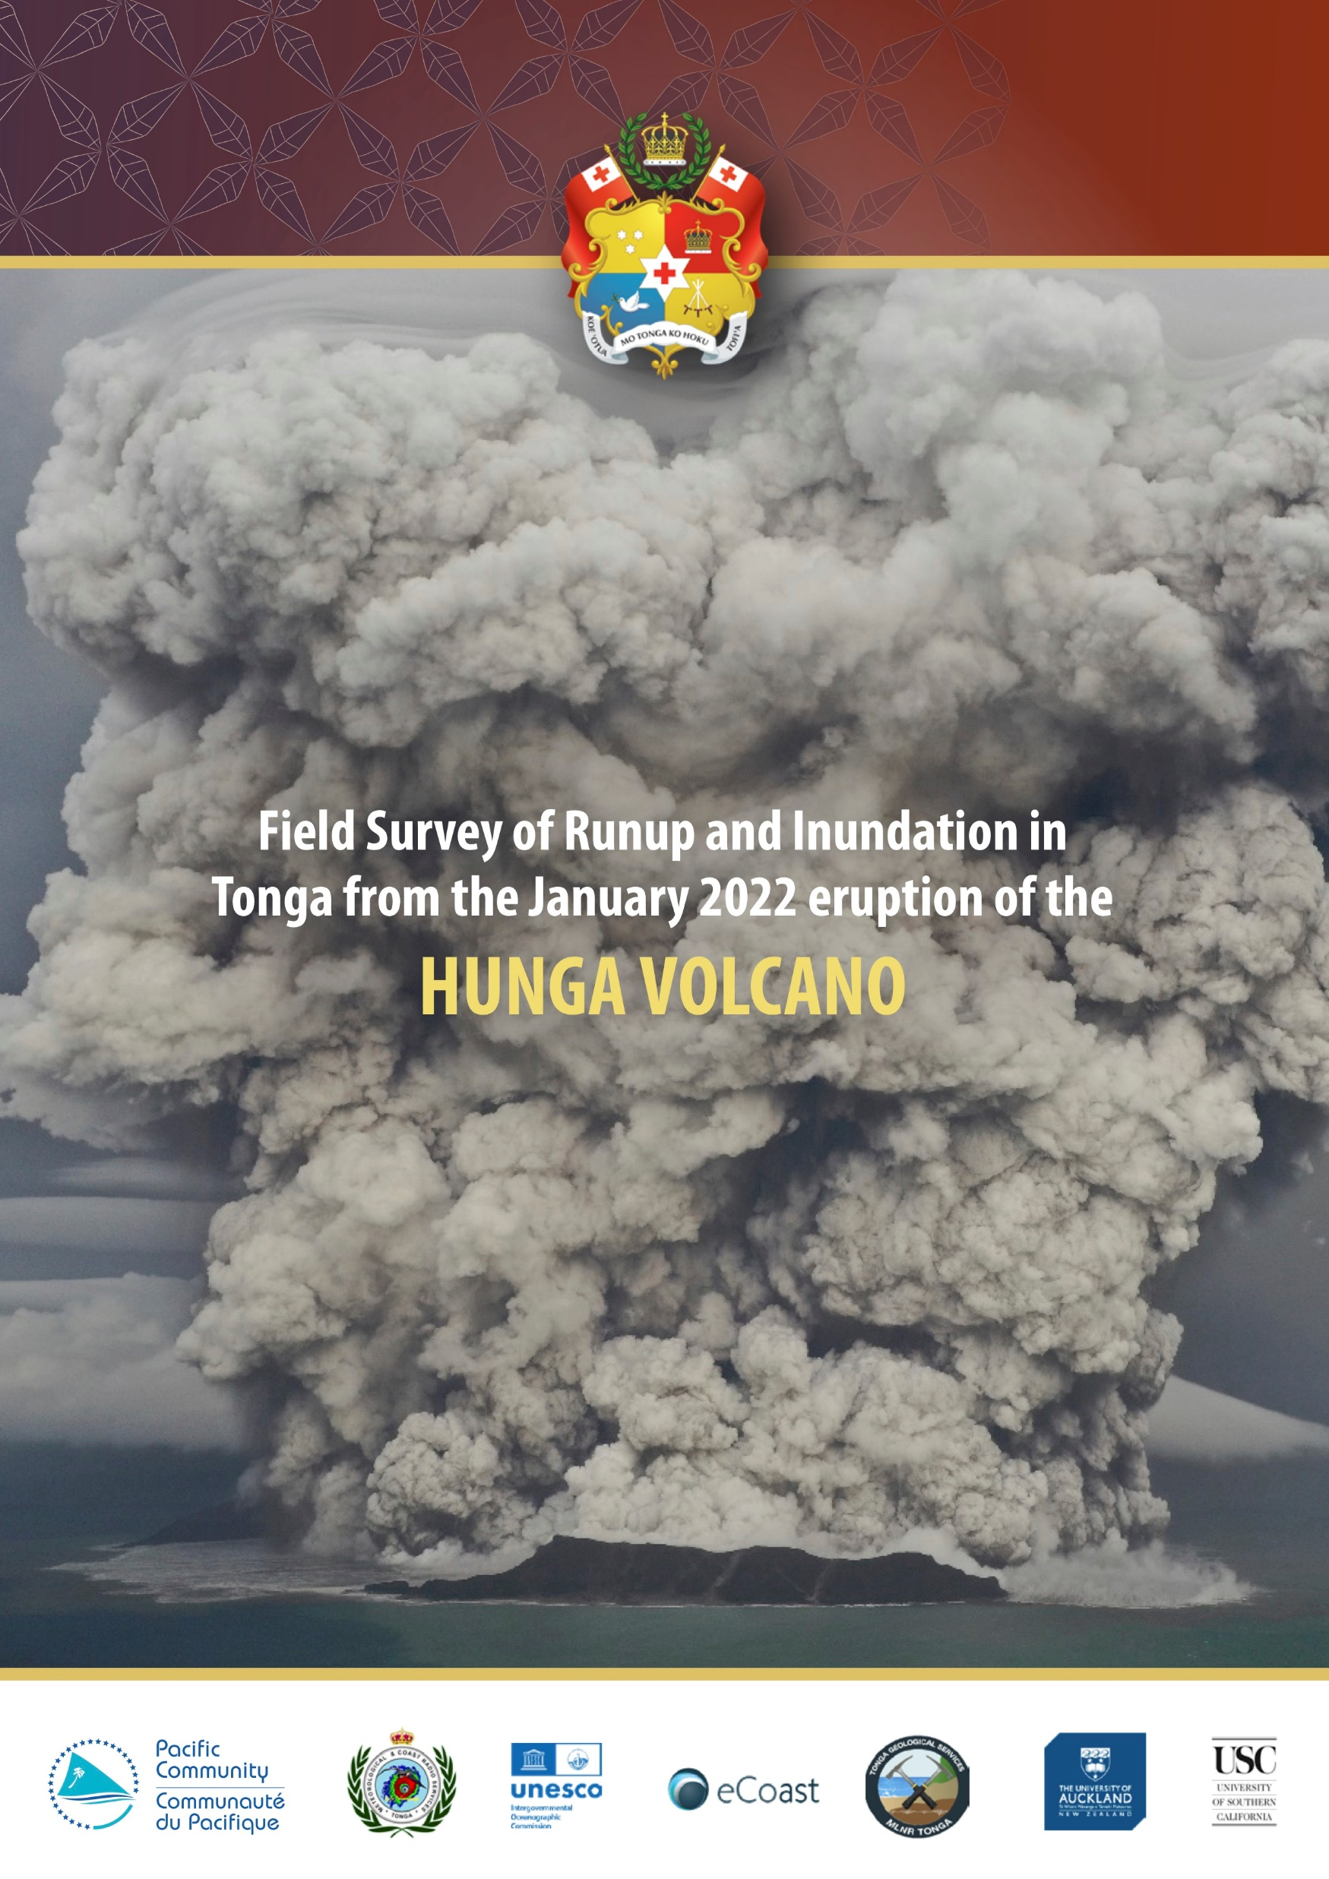
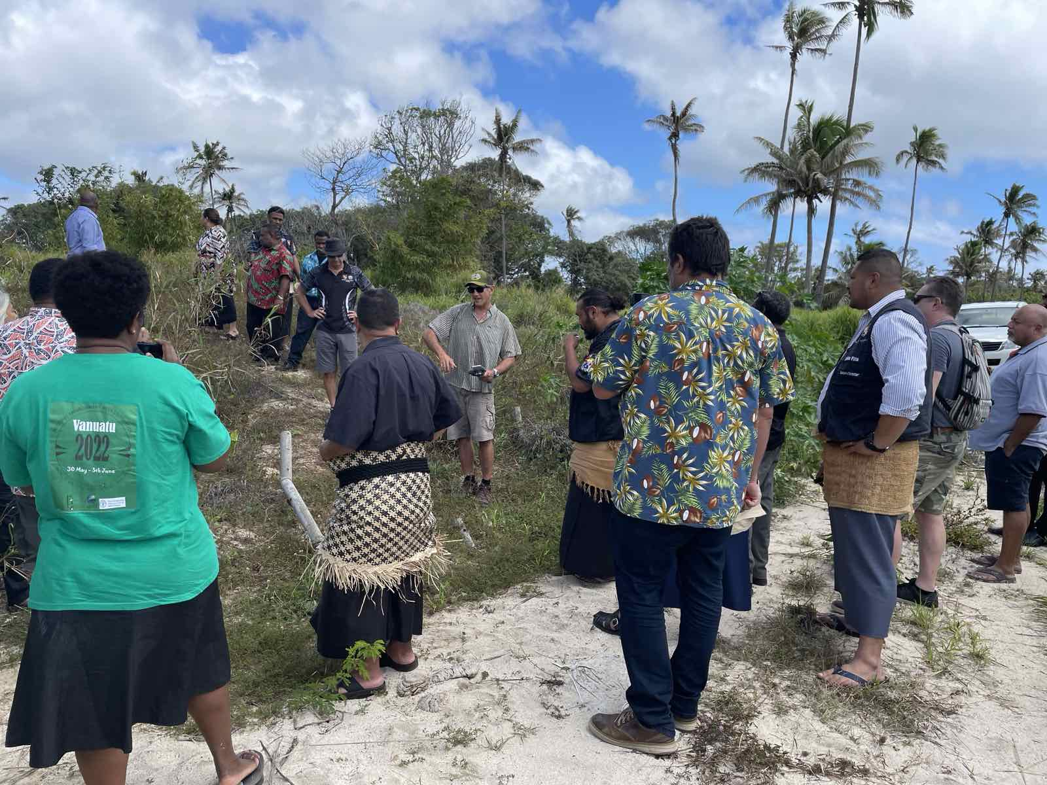
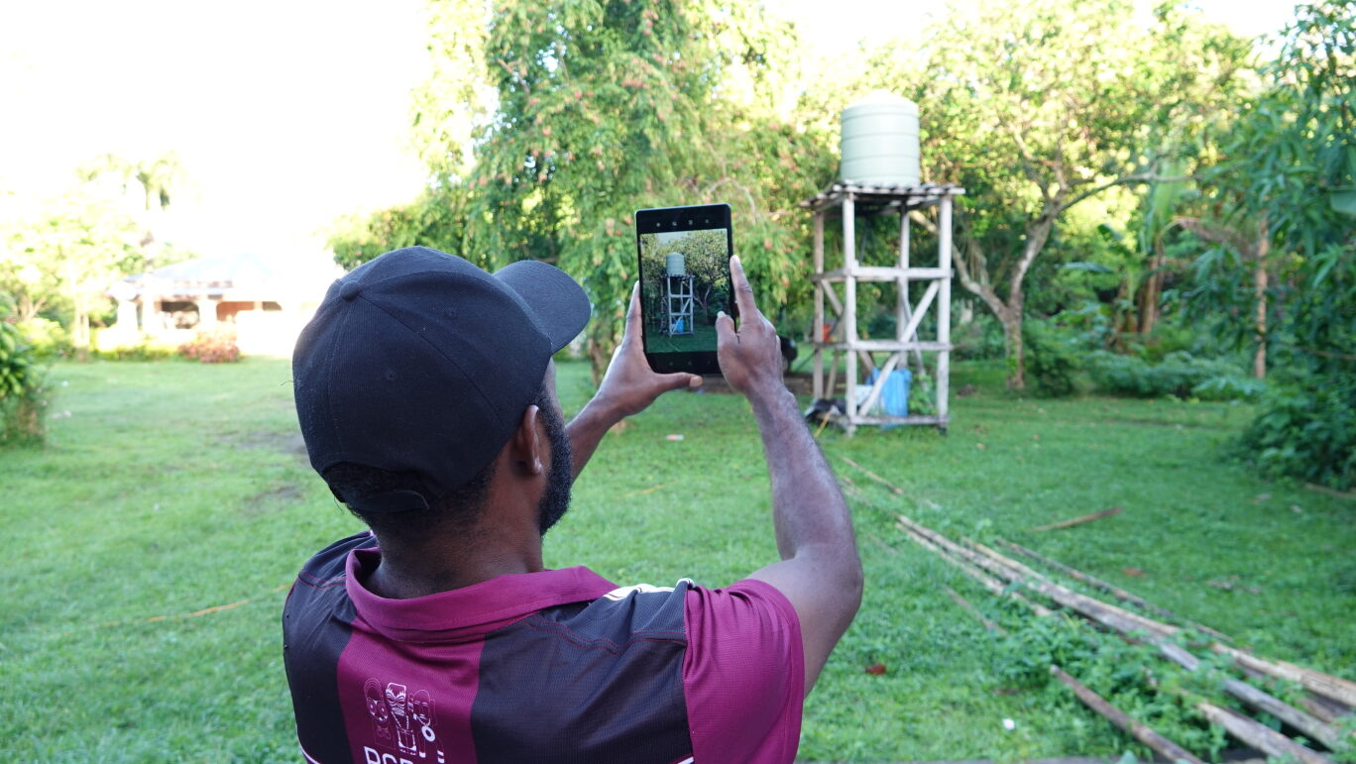
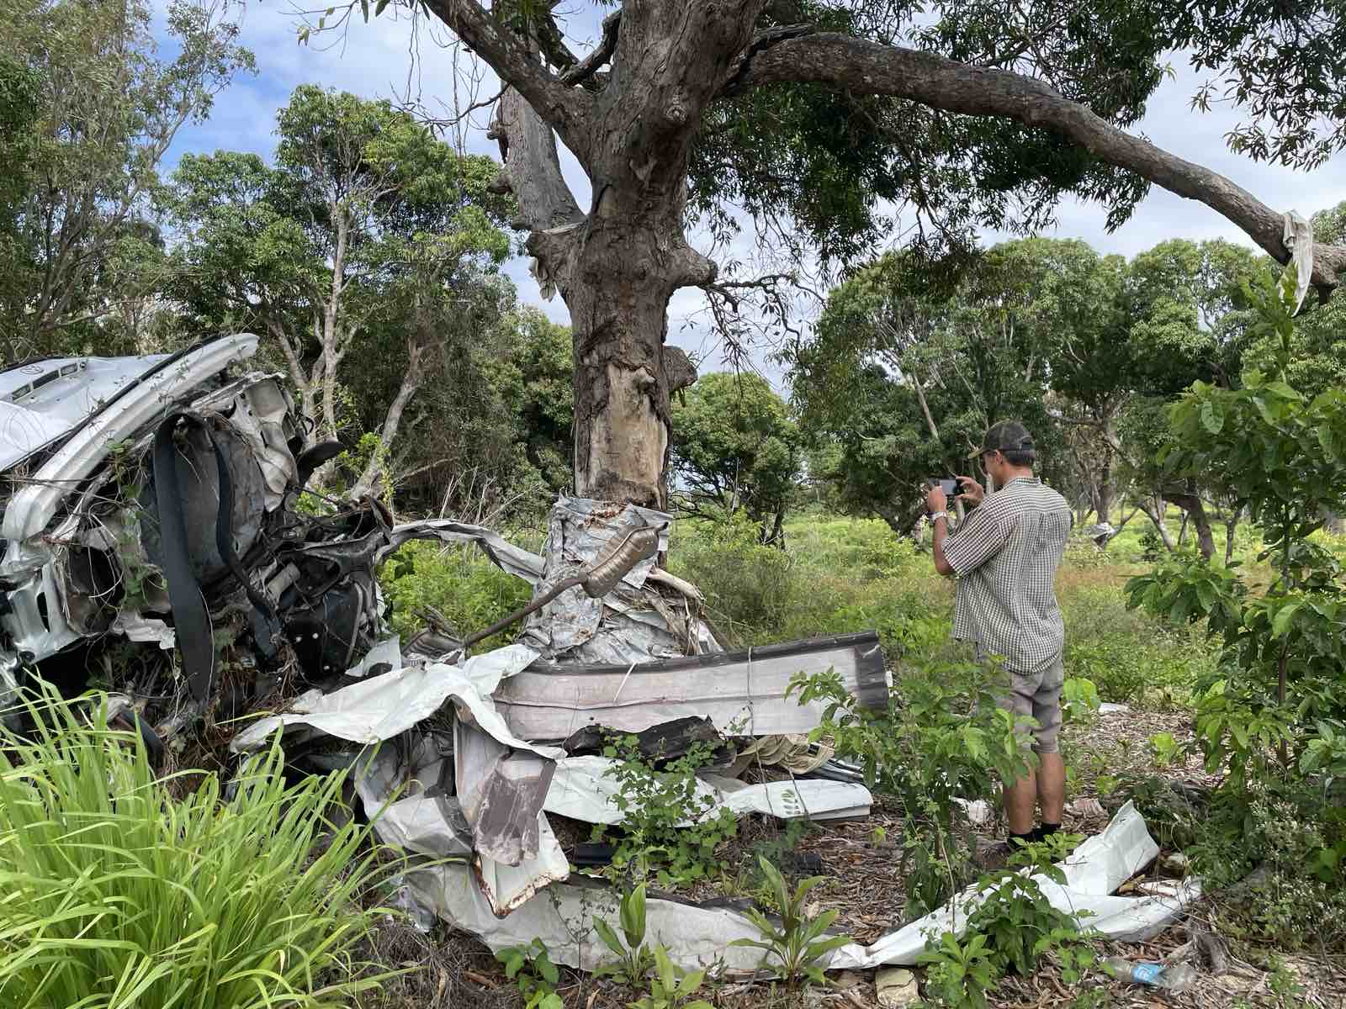
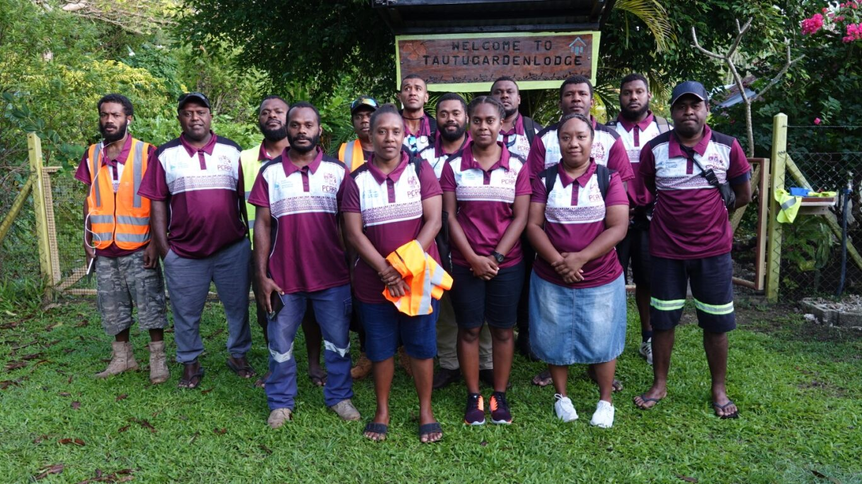
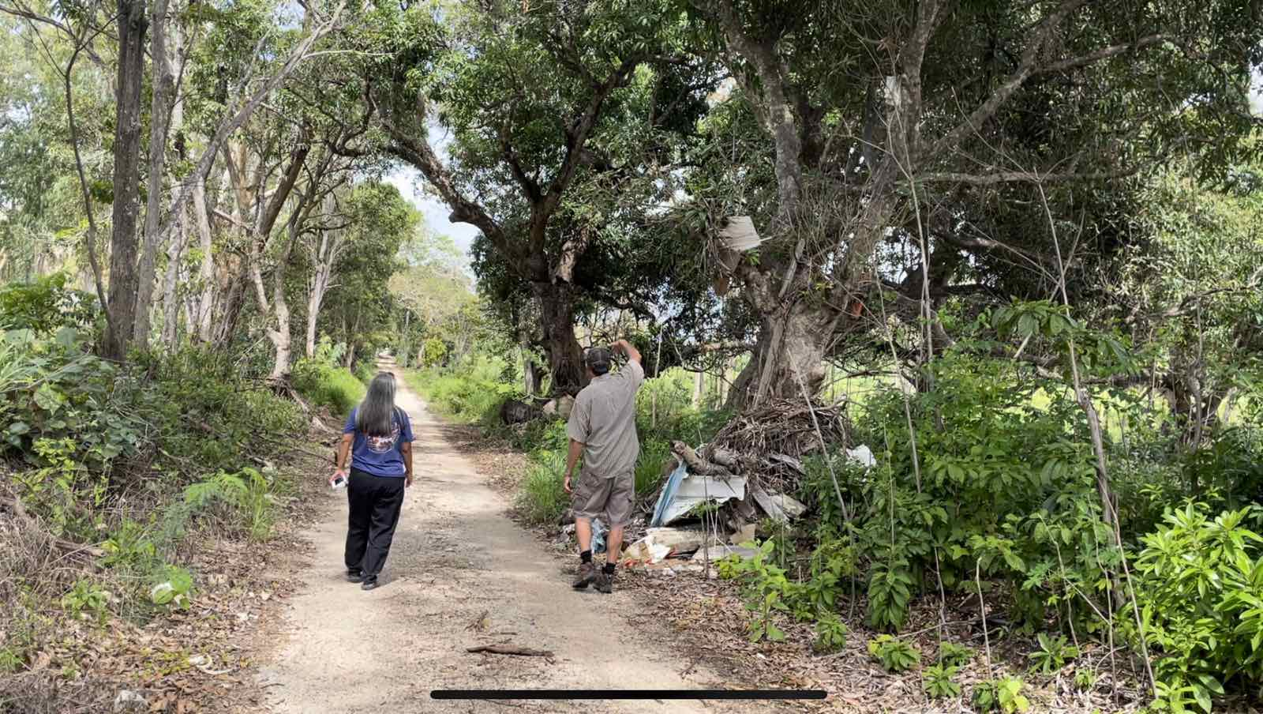
Exposure & Impact Assessments
Lenakel, Vanuatu. 2023 Exposure Data Survey
provide remote training and assistance on post-tsunami field data collection techniques
compile the results of a series of surveys into a technical report.
Field survey guide for PICTs
Notes:
http://itic.ioc-unesco.org/index.php?option=com_content&view=category&layout=blog&id=2709&Itemid=3327

Slide 7
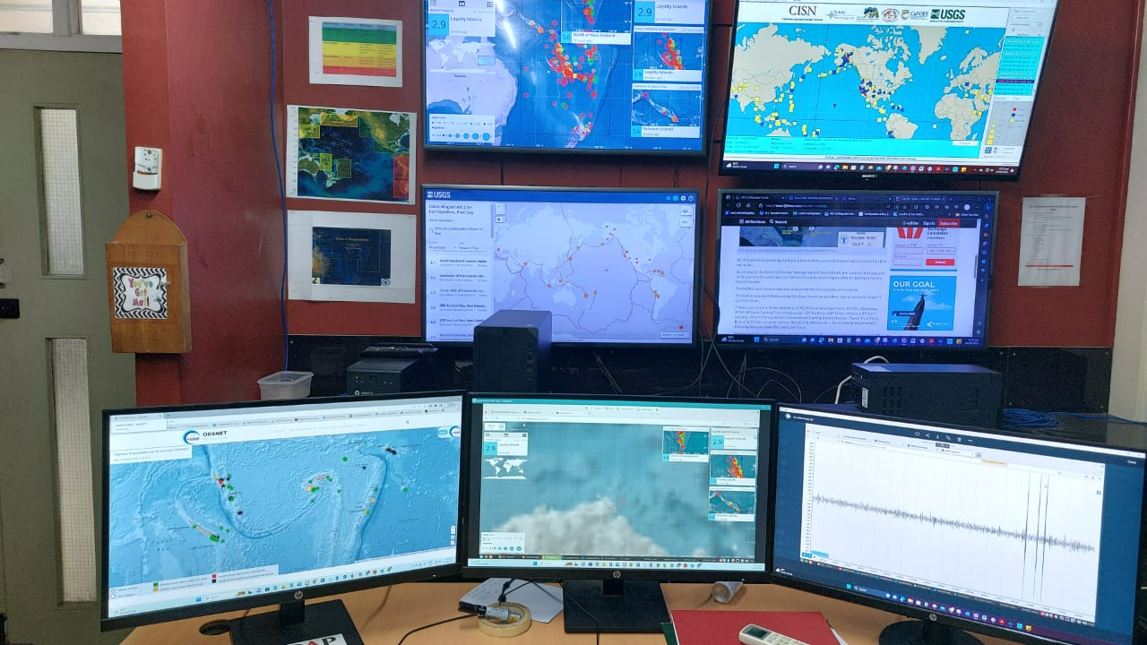
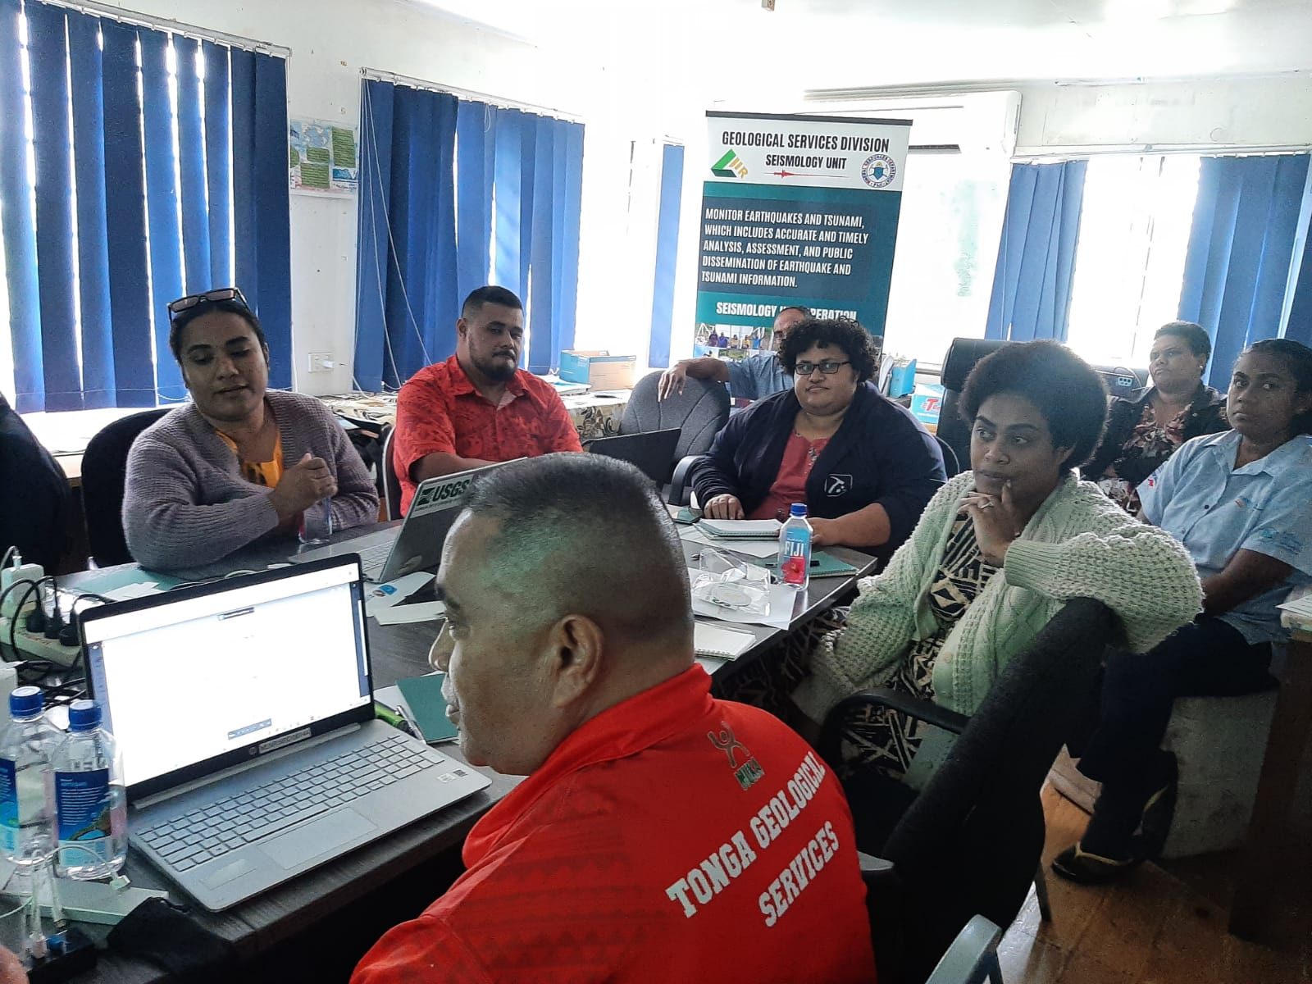
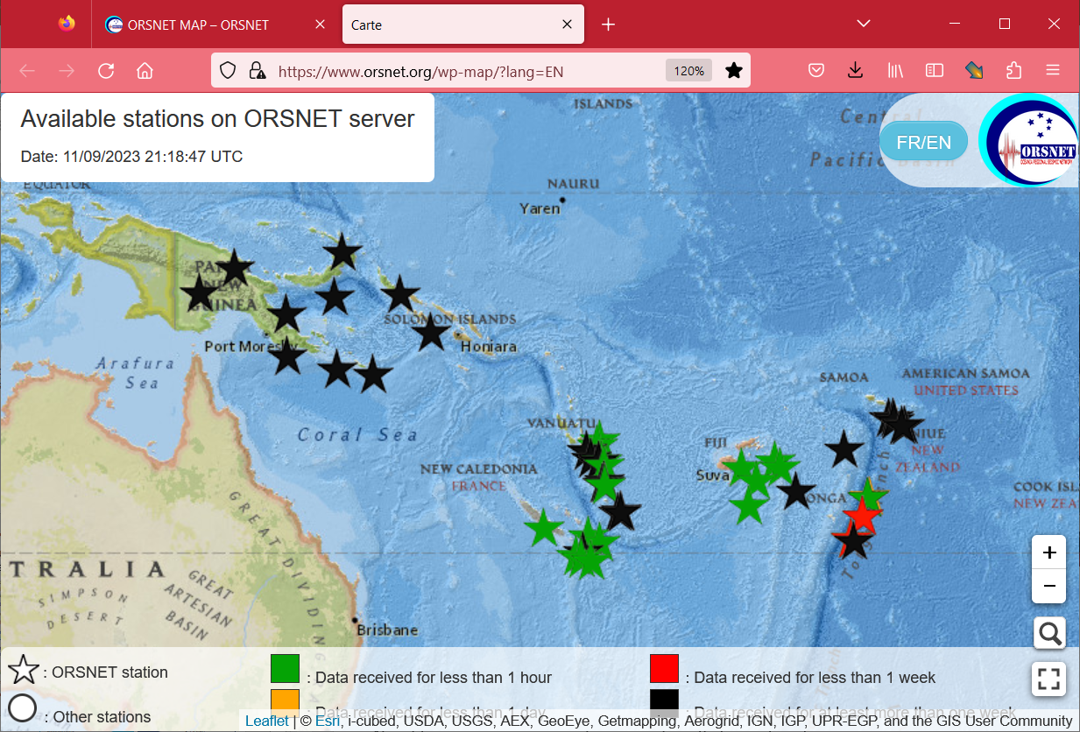
Support to the
Oceania Regional Seismic Network
TA to countries
Review of seismic network => workplan
Workstations and Seiscomp5 Software installed in ORSNET countries
Installation of Server and Back-up at Vanuatu Geohazards Office
Training of Seismic Technicians (60 people)
5 mobile seismic stations procured to be lent out to countries as needed.
Improvement of ORSNET Portal for information dissemination and communications
Draft ORSNET Strategic Plan to be finalised
Value in peer exchanges
Joint programming and smart resourcing with ITIC and UNESCO – IOC. TWC+geohazards+met. service+NDMO+ICT
**Resource mobilisation needed
Notes:
The support to ORSNET is delivered through the Letter of Agreement (LoA) between both agencies. The SPC PREP Consultant, Sylvain Todman, is contracted until 31 August 2023 to support ORSNET deliver on remaining activities that include:
Workstations and Seiscomp5 Software installed in ORSNET countries
All Computer Workstations programmed and sent to the countries with installation completed in Fiji, PNG, Solomons, Samoa and Vanuatu. Only software purchased for Tonga as they will use their national PREP project for hardware. The Workstations are uploaded with Scanloc and Seiscomp5 software that have improved seismic monitoring and detection with increased detection of seismic activity. In addition, the Workstations link the national and regional ORSNET seismic networks so an ORSNET country can also view seismic activity in neighbouring countries. It provides wider regional coverage for seismic data and is a huge step forward in strengthening early warning systems.
Installation of Server and Back-up at Vanuatu Geohazards Office
PREP also procured two Servers to be installed at the ORSNET Secretariat, Vanuatu Geohazards Office, including a back-up Server. Both Servers have been installed at Vanuatu Meteorology & Geohazards Office by Sylvain in July 2023. The Vanuatu Server will be linked to an ORSNET server housed with the Institute of Resources Development (IRD) in Noumea. PREP also supplied some equipment and software to IRD to increase storage capacity of seismic data. IRD also invested in strengthening their seismic monitoring capability through infrastructure upgrade.
Training for Seismic Technicians
Training commenced in July 2023 for around 50 – 60 seismic technicians provided remotely by Sylvain which was just completed last week. This is the final activity delivered by Sylvain under his contract. The issue of handling/sharing national seismic data will be discussed at the next ORSNET meeting with some countries having in place protocols as they also work with other partners in the seismic area.
Development of Standard Operating Procedures for ORSNET’s Mobile Seismic Unit.
PREP also procured 5 mobile seismic stations which have been tested by Fiji Seismology Office. The SOP for deployment of the 5 portable has been finalised a letter was sent out by SPC on behalf of ORSNET making these stations available. If any country would like to access the stations please forward your request to VMGD and copy in SPC.
Improvement of ORSNET Portal for information dissemination and communications
The new ORSNET Portal is now in place so would encourage ORSNET countries to use it.
Develop an ORSNET Strategic Plan
The draft ORSNET Strategic Plan has been shared to all countries for comments. Please request ORSNET members to forward comments by 15 September. This will be a key document that may raise visibility for ORSNET and open the door for more support from development partners. We hope the draft ORSNET Strategic Plan can be approved at a meeting scheduled for November 2023.
Technical Assistance for ORSNET
Sylvain’s contract closed 30 August and we would like to extend all the support he has provided.
The PREP project closes 31 October 2023 however that Bank is interested in continuing to support multi-hazard early warning systems so there may be further support in future.

Slide 8
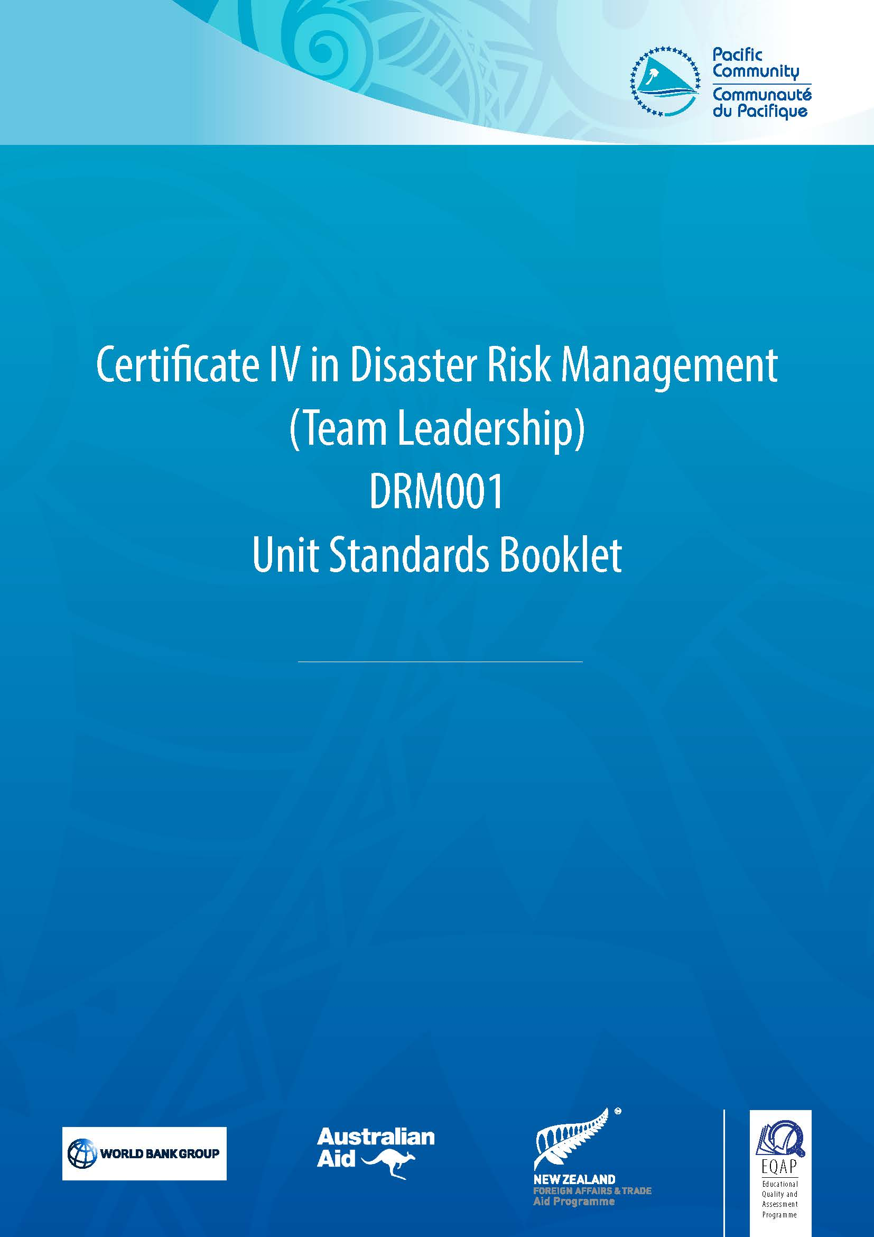
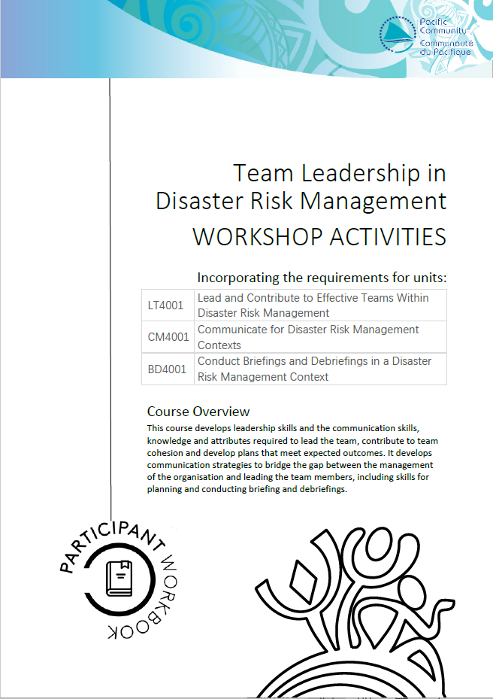
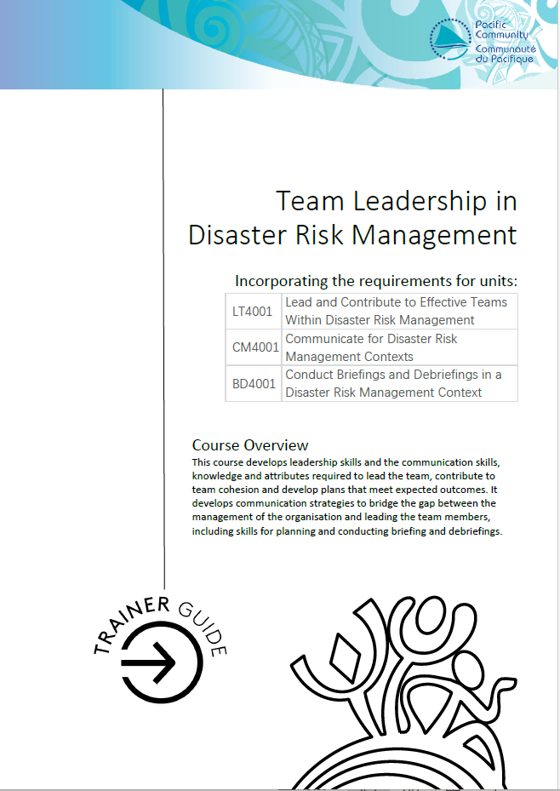
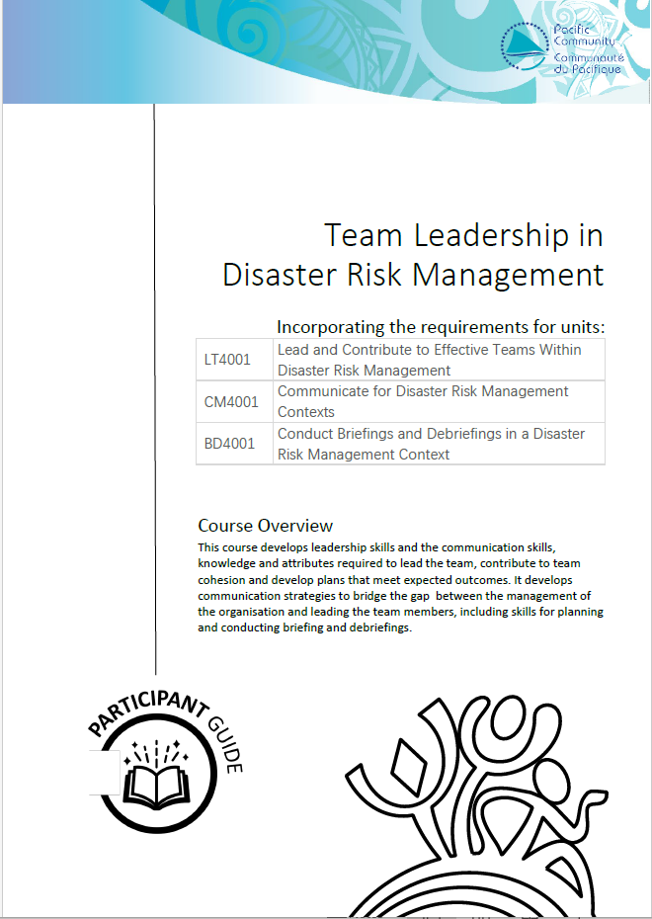

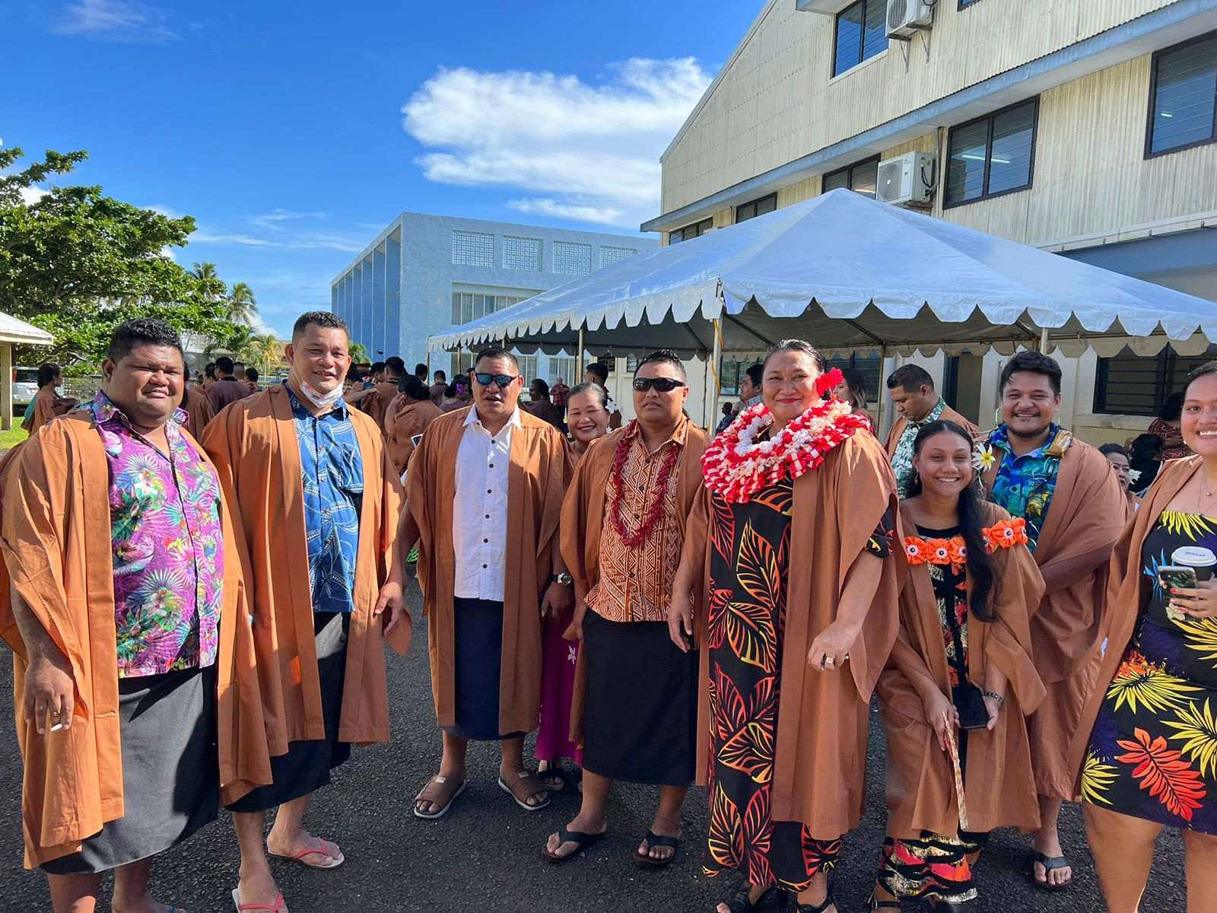
Competency based training
Also being delivered as 5 separate microqualifications
Certificate IV in Disaster Risk Management (Team Leadership) – a few
Apply risk analysis methodology within an incident or disaster management context
Lead and contribute to effective teams in disaster risk management contexts or exercises
Communicate for disaster risk management contexts or exercises
Conduct briefings and debriefings within disaster risk management contexts or exercises
Provide public information and engage with community in disaster risk management contexts or exercises
Work in a team in an emergency operations centre
Manage information in an emergency operations centre
Capacity development includes peer to peer exchanges, mentoring, internships

Slide 9
Where to from here
ORSNET Strategic Plan and sustainable resourcing
Coherent early warning and preparedness initiatives and programmes being rolled out in the Pacific. Find the opportunities!
Support to strengthen incountry risk assessment capacity including the conduct of post disaster assessments *risk informed decisions and investments
Expanding the suite of competency based training

