Slide 1
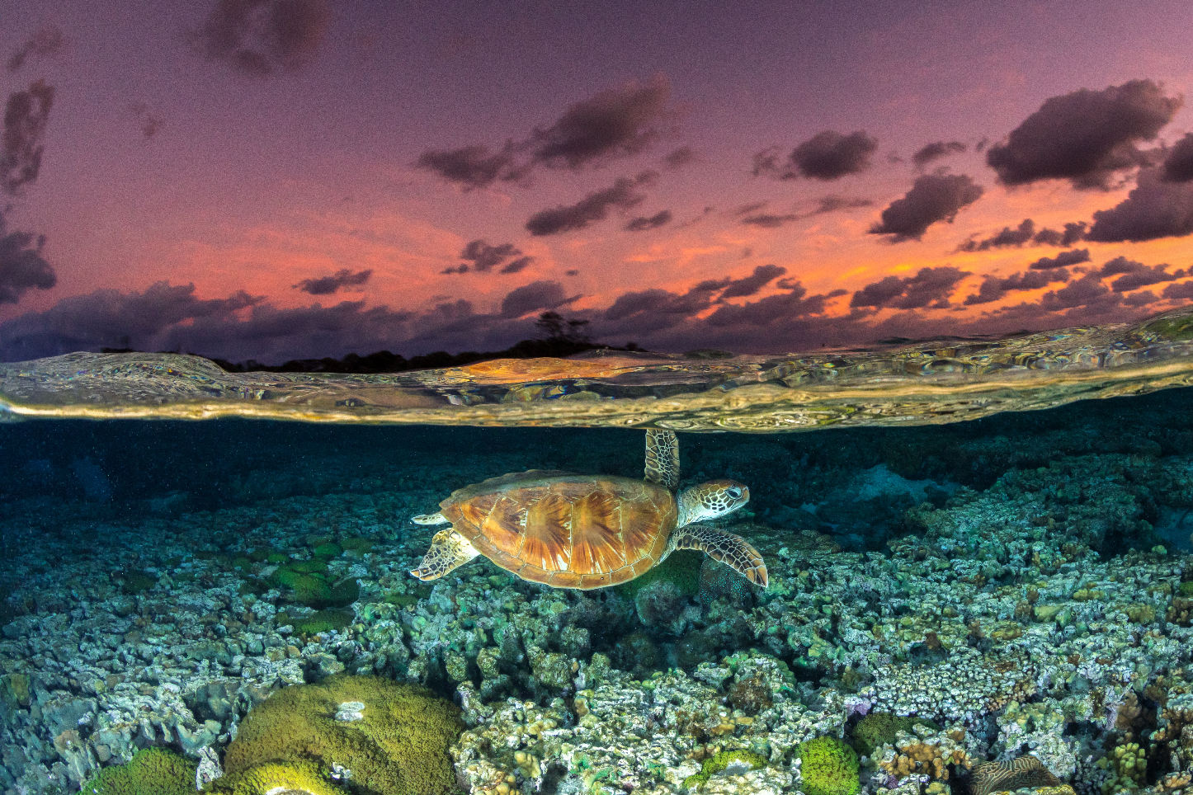

UNITED NATIONS OCEAN DECADE
CAPACITY DEVELOPMENT FACILITY
MARY FRANCES DAVIDSON
COORDINATOR
UN OCEAN DECADE CD FACILITY

Slide 2
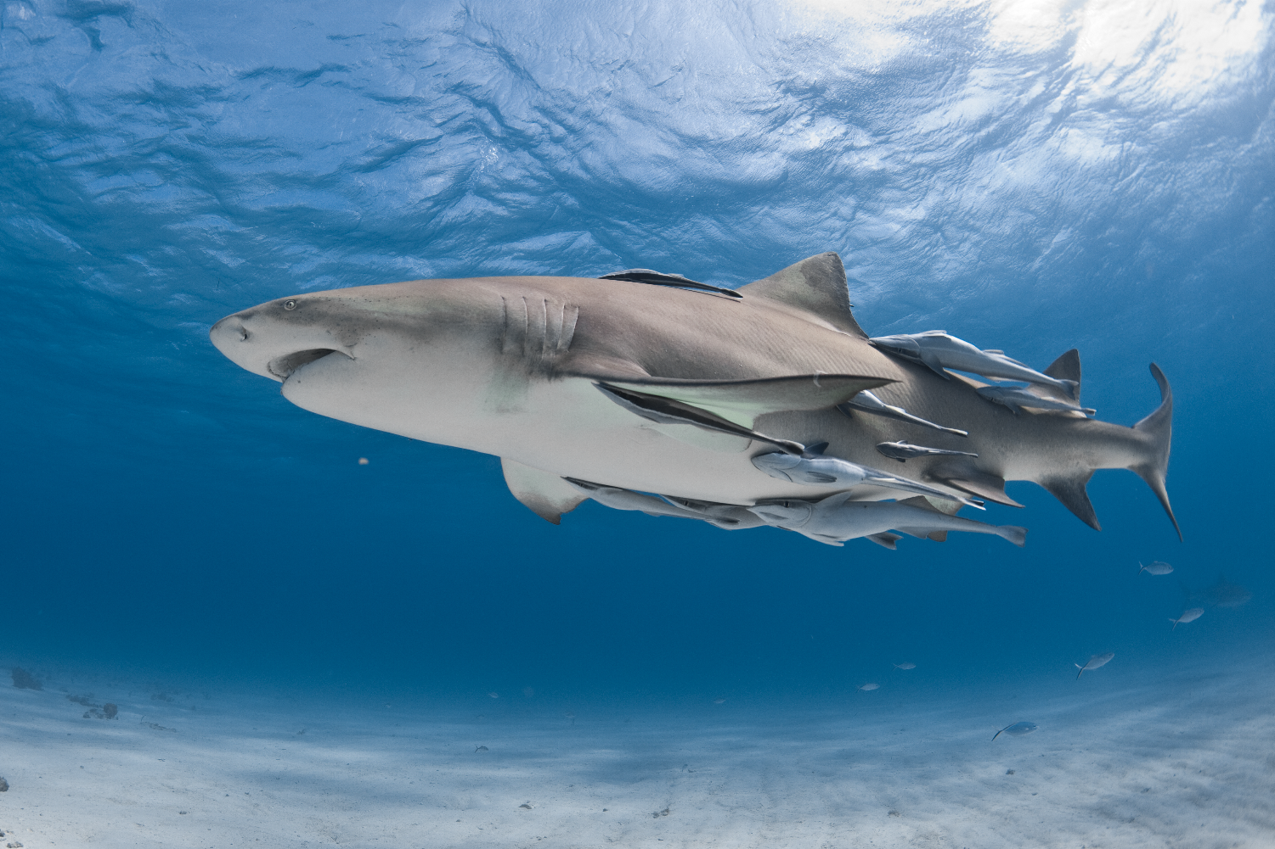
INTRODUCTION TO THE
CAPACITY DEVELOPMENT FACILITY
1

Slide 3
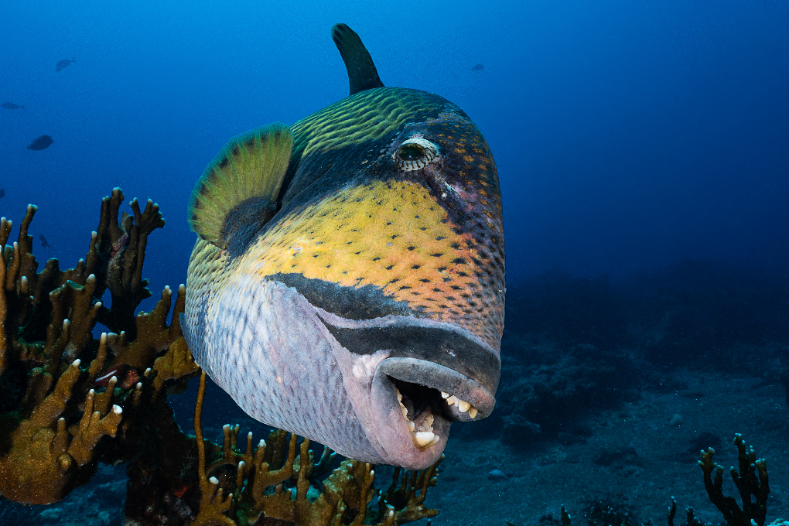
1| INTRODUCTION TO THE CDF
GROUNDING OUR WORK
Support Ocean Decade Challenge 9:
Ensure comprehensive capacity development and equitable access to data, information, knowledge and technology across all aspects of ocean science and for all stakeholders
New mechanism to within the Ocean Decade
Provides a flexible and evolutive means of supporting Capacity Development needs of individuals and institutions involved in the Ocean Decade
Builds on strengths Capacity Development strengths within IOC
Two years of initial support (FUST)
CAPACITY DEVELOPMENT FACILITY

Slide 4
1| INTRODUCTION TO THE CDF
WHO IS THIS FOR?
BENEFICIARIES INCLUDE
Diverse actors interested in submitting proposals for Decade Actions
  Focus on under-represented groups (SIDS and LDCs, ECOPS)
  Partners from industry and civil society.
Proponents of existing endorsed Decade Actions seeking support for capacity development initiatives.
Members of all Decade Actions engaged in the Capacity Development Community of Practice
  Platform for exchange and collaboration on capacity development initiatives.
Funding and in-kind resource providers contributing to the Facility operation
  For those seeing a Decade-led platform to support commonly defined capacity development priorities.
Small Island Developing States
(SIDS)
Least Developed Countries
(LDCs)
Early Career Ocean Professionals
(ECOPs)
CAPACITY DEVELOPMENT FACILITY

Slide 5
INTRODUCTION TO THE CDF
MAIN COMPONENTS OF WORK
SETTING CAPACITY DEVELOPMENT PRIORITIES
FULFILLING CAPACITY DEVELOPMENT NEEDS
EMPOWERING COLLABORATION OF OCEAN DECADE STAKEHOLDERS
SUSTAINABILITY AND POST-2030 LEGACY
CAPACITY DEVELOPMENT FACILITY

Slide 6
IMPLEMENTATION STRATEGY
2
CAPACITY DEVELOPMENT FACILITY

Slide 7
2| IMPLEMENTATION STRATEGY
MAIN WORK COMPONENTS
01
ASSESSMENT OF CAPACITY DEVELOPMENT NEEDS
FOSTER AND MAINTAN A COMMUNITY OF PRACTICE ON CD
03
DEVELOPMENT AND DELIVERY OF CD INITIATIVES
ENHANCE NETWORKS OF SUPPORT AND RESOURCE MOBILISATION FOR CD
04
02
CAPACITY DEVELOPMENT FACILITY

Slide 8
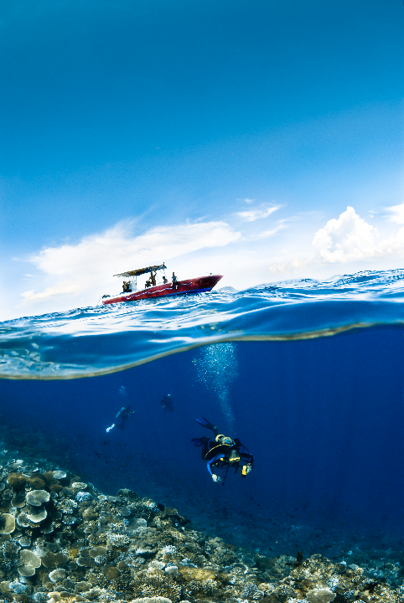
COMPONENT ONE
ASSESSMENT OF CAPACITY NEEDS
GENERAL OBJECTIVE: Identify priority capacity development needs of existing and future proponents of Decade Actions
SPECIFIC OBJECTIVE: Establish priority capacity development needs for key stakeholder groups within the Ocean Decade, with a focus on enhancing skills to stimulate involvement and contribution of SIDS, LCDs, and ECOPs
1.1
EXISTING NEEDS ASSESSMENT STOCKTAKING
1.2
DEVELOP INNOVATIVE TOOLS & CHANNELS FOR CD NEEDS ASSESSMENT
1.3
ESTABLISH PRIORITY THEMES FOR CAPACITY DEVELOPMENT
1.4
ANALYSIS OF EXISTING CD ON OFFER WITHIN OCEAN DECADE ACTIONS, IOC & BEYOND
1.5
CALL FOR CD REQUESTS IN LINE WITH CALL FOR DECADE ACTIONS
1.6
SYSTEMATIC REVIEW AND REVISION OF CD THEMES AND PRIORITIES
CAPACITY DEVELOPMENT FACILITY

Slide 9
COMPONENT TWO
DEVELOPMENT AND DELIVERY OF CD INITIATIVES
GENERAL OBJECTIVE: Delivery of initiatives to meet identified CD needs via the Capacity Development Facility
SPECIFIC OBJECTIVE: Establish connections between partners with priority capacity development needs and existing initiatives within IOC, Ocean Decade Actions, and beyond
SPECIFIC OBJECTIVE: Develop and deliver new capacity development initiatives to fill gaps
2.1
ESTABLISH A STEERING GROUP
2.2
SURVEY TO ESTABLISH SUPPLY OF EXISTING CD INITIATIVES IN LINE WITH DEMANDS
2.3
NEEDS/SUPPLY MATCHMAKING
2.4
MAPPING AND GAP ANALYSIS
2.5
ADAPTING EXISTING CD INITIATIVES TO FILL GAPS
2.6
DEVELOP NEW CD INITIATIVES TO FILL IDENTIFIED GAPS
CAPACITY DEVELOPMENT FACILITY

Slide 10
COMPONENT THREE
FOSTER AND MAINTAIN A COMMUNITY OF PRACTICE ON CAPACITY DEVELOPMENT
GENERAL OBJECTIVE: Facilitate the Ocean Decade Community of Practice on Capacity Development via the Ocean Decade Network
SPECIFIC OBJECTIVE: Develop an annual workplan for the CD CoP and deliver results accordingly
3.1
CREATE A WEB PRESENCE FOR THE CDF ON EXISTING OCEAN DECADE PLATFORMS
3.2
OFFICIAL LAUNCH OF THE CDF
3.3
DEVELOP PROMOTIONAL MATERIALS FOR THE CDF
3.4
CD COMMUNITY OF PRACTICE WORKPLAN
3.5
ACTIVELY ENGAGE WITH EXISTING CD NETWORKS
CAPACITY DEVELOPMENT FACILITY

Slide 11
COMPONENT FOUR
ENHANCE NETWORKS OF SUPPORT AND RESOURCE MOBILISAIOTN FOR CD
GENERAL OBJECTIVE: Ensure the sustainability of the Capacity Development Facility’s impact throughout the Ocean Decade, and beyond
SPECIFIC OBJECTIVE: Resources secured to continue operation of the CDF beyond the initial 24-month funding
SPECIFIC OBJECTIVE: Develop a resource mobilisation strategy and operational plan
4.1
DEVELOP BUDGET AMBITIONS FOR CDF BASED ON RESULTS FRAMEWORK
4.2
DRAFT RESOURCE MOBILISAITON STRATEGY
4.3
ESTABLISH LIST OF POTENTIAL PARTNERS
4.4
DRAFT POST-2030, UPSCALING STRATEGY
4.5
ESTABLISH NEW PARTNERSHIP AGREEMTNS AND IN-KIND CONTRIBUTIONS
CAPACITY DEVELOPMENT FACILITY

Slide 12
PROGRESS TO DATE
3
CAPACITY DEVELOPMENT FACILITY

Slide 13

3| PROGRESS TO DATE
CDF LAUNCH
CDF Official Launch
13 December 2023 at UNESCO headquarters
Parallel to the UNDOALOS meeting
  International Symposium of the United Nations Regular Process on strengthening the ocean science-policy interface
News item about the CDF Launch is available here:
  https://oceandecade.org/news/new-ocean-decade-capacity-development-facility-skills-knowledge-for-sustainable-ocean-solutions/
CAPACITY DEVELOPMENT FACILITY

Slide 14
3| PROGRESS TO DATE
WORK TO ESTABLISH CD THEMES
STOCKTAKING
FOCUS GROUPS
EXISTING CD NEEDS ANALYSIS FROM DECADE ACTIONS & DCCS/OS
VISION 2030 BACKGROUND DOCUMENTS
RAW INPUT FROM DECADE PROGRAMMES
4 FOCUS GROUPS HELD NOVEMEBR 2023
ALL PROGRAMME LEADS, DCCS & DCOS INVITED
ORGANISED BY DECADE CHALLENGE ADRESSED
JAMBOARDS
INITIAL ANALYSIS
IN PARALELL TO FOCUS GROUPS
IDENTIFIED NEEDS RELATED TO SCIENTIFIC, TECHNICAL, DATA CD AS WELL AS OTHER SKILLS
FOCUS ON SIDS, LDCS, AND ECOPS
INPUT FROM STOCKTAKING, FOCUS GROUPS, JAMBOARDS, AND DIRECT COVERSATIONS
450+ ROW ”LONGLIST” OF NEEDS
GROUPED (SCIENCE/DATA/PRO SKILLS/CONDITIONS)
CODED BY GENERAL THEMES
CAPACITY DEVELOPMENT FACILITY

Slide 15
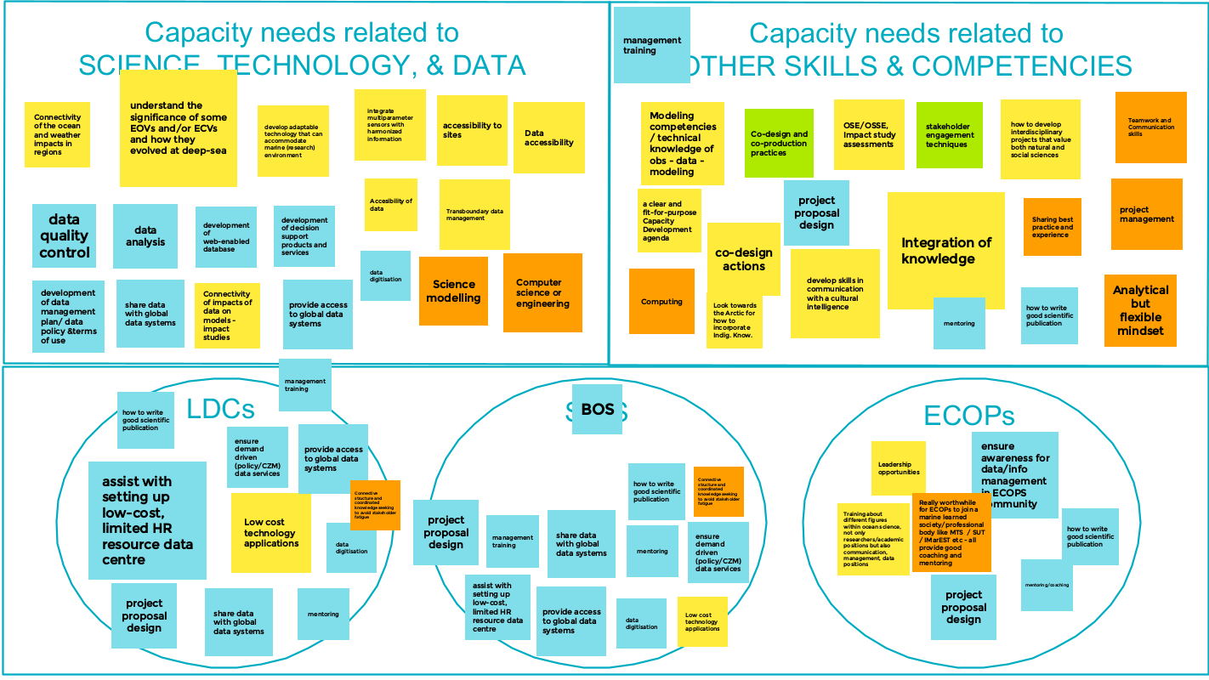

Slide 16
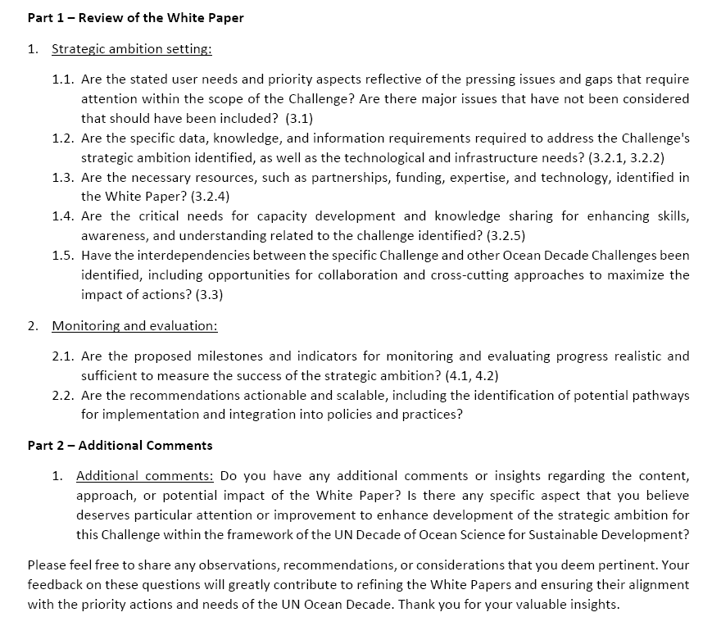

3| PROGRESS TO DATE
VISION 2030, WORKING GROUP 9
Targets: Ocean Decade Community (Actions, DCCs, DCOs, DIPs, Task Forces and teams), IOC staff, IOC regional offices, IOC National Focal Points, DAB, co-chairs networks and institutions (once we send out the survey please share among your networks).
The survey will be available from end of January until mid-February
CAPACITY DEVELOPMENT FACILITY

Slide 17
3| PROGRESS TO DATE
INITIAL IDENTIFICATION OF CD THEMES & SUB-THEMES
  OCEAN-CLIMATE NEXUS
MARINE POLLUTION
DATA GATHERING, SHARING & MANAGEMENT
01
Mapping & modelling ocean-climate interactions
Marine CO₂ removal
Ocean acidification
02
Impact of oceans on human health
Measuring cumulative impacts & multiple stressors
03
Low-cost technology and infrastructure solutions for data gathering and management
Data management for Decade Actions, including FAIR and CARE data principles
MARINE BIODIVERSITY
SCIENCE-POLICY INTERFACE
CO-DESIGN
04
05
Stakeholder engagement via transdisciplinar approaches
Engaging Local and Indigenous Knowledge holders
Managing, leading, & financing ocean projects
06
Mapping & modelling biodiveristy
Ecosystem Approaches to Fisheries
Implementing the BBNJ Agreement
eDNA techniques
Science communication
Transdisciplinary approaches
Working with & influencing policy makers
Suatainable Ocean Planning
CAPACITY DEVELOPMENT FACILITY

Slide 18

3| PROGRESS TO DATE
COURSE ON CO-DESIGN, CFDA n.06
Course on Co-design
Builds on pilot course for Africa delivered last year
Phase 1: Hosted on OTGA
Self-paced and general course
long “shelf-life” to potentially use in future trainings
ready to launch by the end of February 2024.
Pre-requisite for further phases.
Phase 2: Specialised training for selected Caribbean SIDS submissions
spring 2024
Phase 3: Specialised training for selected African submissions
late summer-early fall 2024
CAPACITY DEVELOPMENT FACILITY

Slide 19
THE STEERING GROUP
4
CAPACITY DEVELOPMENT FACILITY

Slide 20
| CDF STEERING GROUP
STEERING GROUP MEMBERS
GERT VERREET
Policy Officer, Flanders Department of Economy, Science and Innovation
FUST
ALAN EVANS
Marine Policy and Marine Science Policy Adviser, National Oceanography Centre (UK)
Co-Chair IOC Expert Group on Capacity Development
EVGENIIA KOSTIANAIA
Global Coordinator, UN Ocean Decade ECOP Programme
EDEM MAHU,
Senior Lecturer of Marine Biogeochemistry, University of Ghana
Co-Chair WG 9, Vision 2030
JAQUELINE UKU
Senior Scientist, Kenya Marine Fisheries Research Institute
Africa TaskForce
FRANCOIS BAILET
Senior Legal Officer, UNDOALOS
CHARLOTTE HUDSON,
Director of Lenfest Ocean Program, Pew Charitable Trusts
Decade Advisory Board Member
ANDRICK LAL
Senior Geodetic Surveyor, Pacific Community (SPC)
Pacific Islands DCC
LI LI
Director of International Cooperation Division at the First Institute of Oceanography, Ministry of Natural Resources (China)
Ocean-Climate Nexus DCC
PETER PISSIERSENS
Head, UNESCO/IOC Project Office for IODE
IOC CD COORDINATOR
ANN-KATREIN LESCRAUWAET
Director of International Relations, Flanders Marine Institute
TBD
UN Decade TaskForce for the Caribbean & Latin America
CAPACITY DEVELOPMENT FACILITY
INTRODUCTION TO THE STEERING GROUP

Slide 21

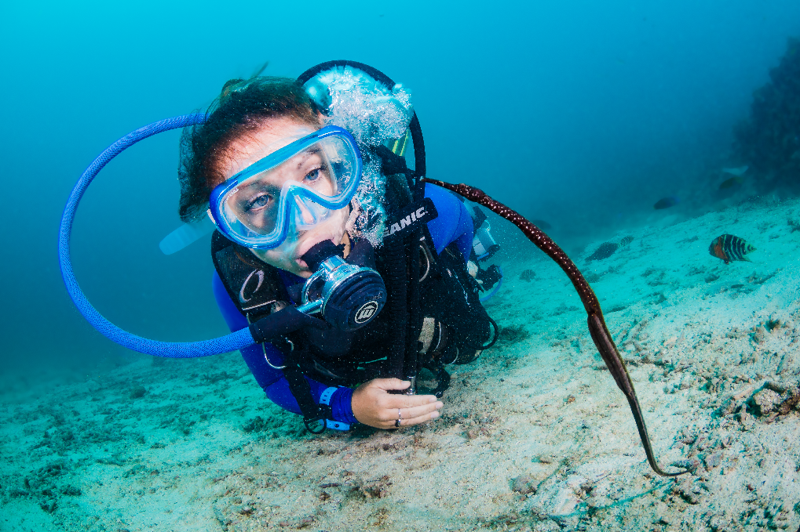
THANK YOU
“Tell me, and I forget, teach me, and I may remember, involve me, and I learn.”
– Benjamin Franklin
CAPACITY DEVELOPMENT FACILITY

