Slide 1
ICG-NEAMTWS Steering Committee
13 May 2024
Towards a Strategic
Implementation Plan?
Sea Level Monitoring Network
for NEAMTWS
Denis Chang Seng, PhD
Programme Specialist and
ICG/NEAMTWS Technical Secretary
CoastWAVE Project Officer
Tsunami Resilience Section
UNESCO IOC

Slide 2
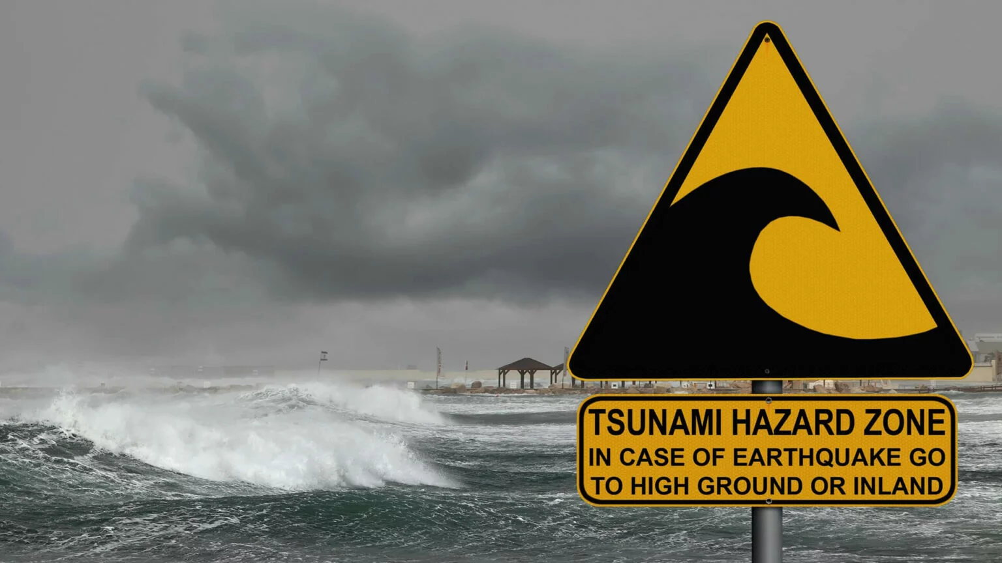
Sea Level Monitoring Network
for NEAMTWS

Slide 3
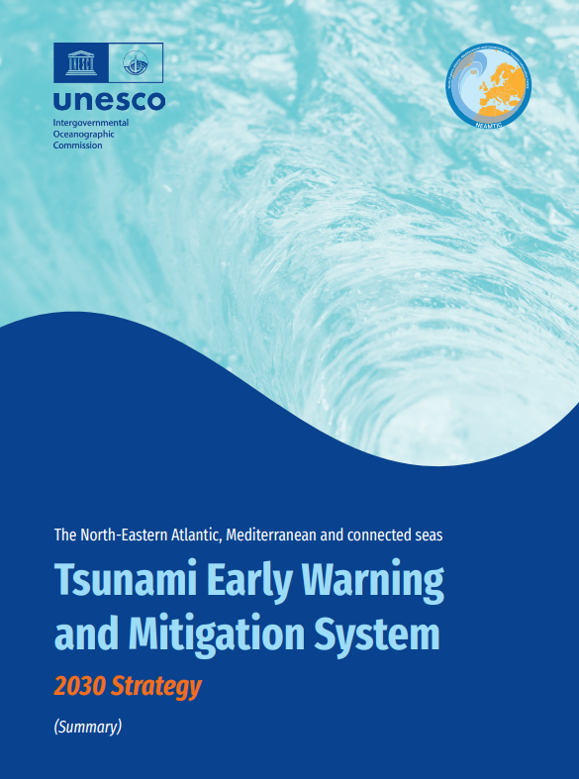
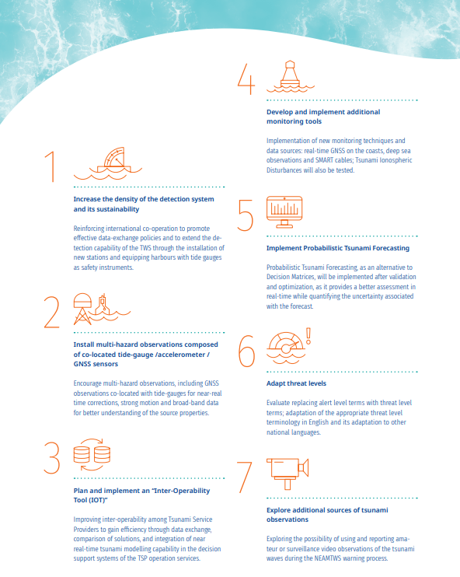

Slide 4
ICG-NEAMTWS 2030 Strategy
Sea Level Networks
Notes
Real time sea-level data are required to confirm whether a tsunami has been generated by an earthquake or to cancel alerts if no tsunami is observed.
Denser networks are required in the areas that are close to the tsunamigenic zones.
Several countries are making efforts to upgrade their national sea level networks, usually as part of a multi-purpose/multi-hazard system approach.
Many existing stations require upgrading to tsunami requirements.
Recent tsunamis have shown that sea-level information is not dense enough even in the areas where potentially tsunamigenic earthquakes occur more frequently.
In complex areas with many islands, an increase in the number of tide gauges in the islands is needed.
Major sea-level gaps in N-Africa

Slide 5
ICG-NEAMTWS 2030 Strategy
Sea Level Networks
Densified Global Sea Level Observing System (GLOSS) network may make relevant contributions to the TWS sea-level monitoring.
Collaboration with offshore observation networks for operational oceanography in the Euro-Mediterranean region (MONGOOS, EuroGOOS), could also be valuable.
The EU Joint Research Centre (JRC) has developed the Inexpensive Device for Sea Level Measurement (IDSL), a low-cost mareograph

Slide 6

Implementation Plan & Steps
Evaluation/ Assessment
Setting Targets : Optimal Design?
Transition Plan: Building on JRC IDSL Experimental Technology
Combining Resources and Efforts: IOC GLOSS (NORMAD Initiative): N-Africa
New Investments (Member States)
Organisation and Planning

Slide 7
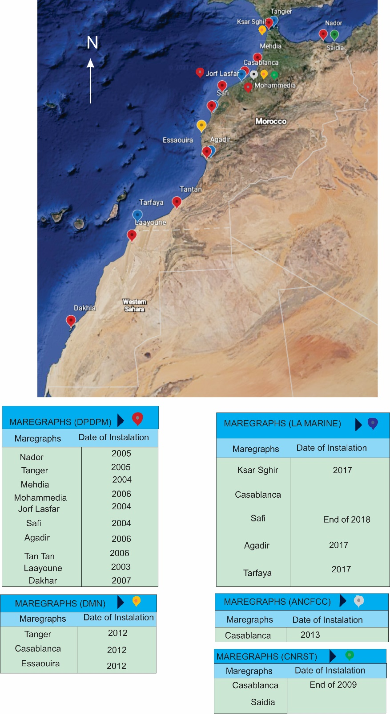
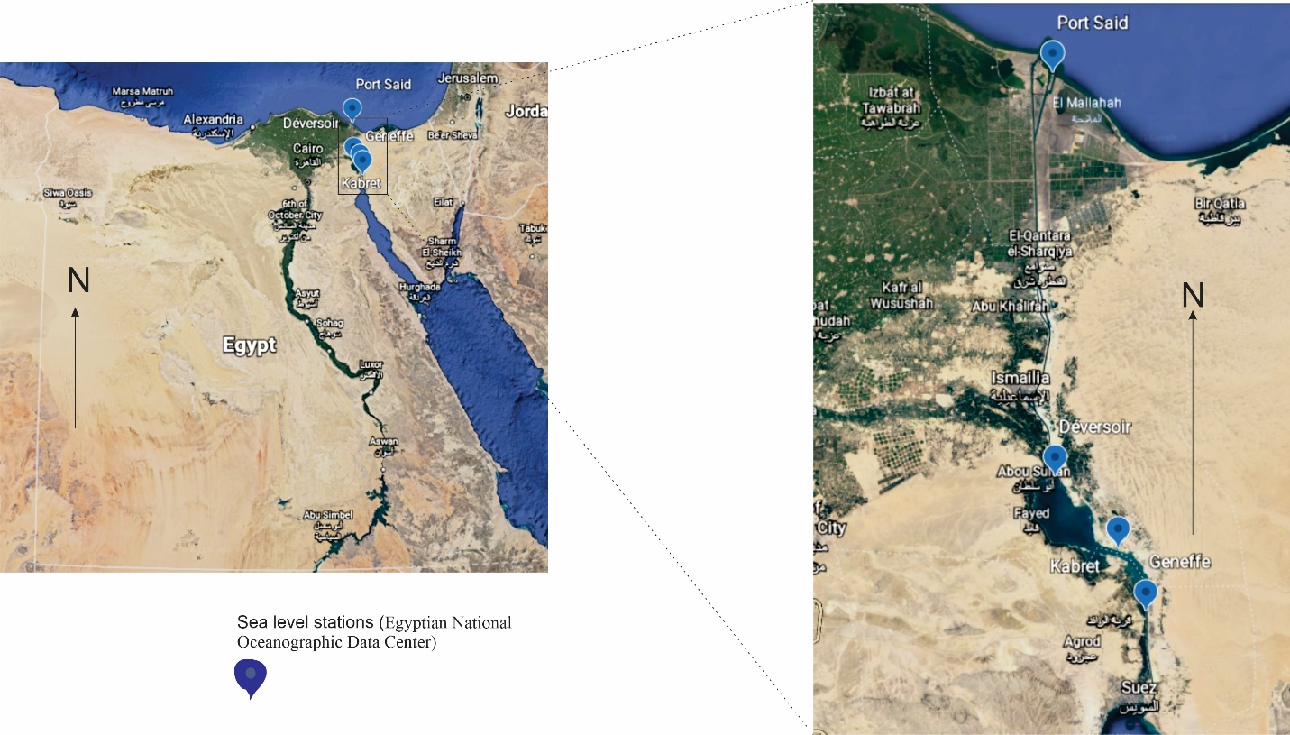
1. Evaluation of Sea Level Network
1. Evaluation of Sea Level Status in N-African countries (IOC UNESCO 2021)

Slide 8
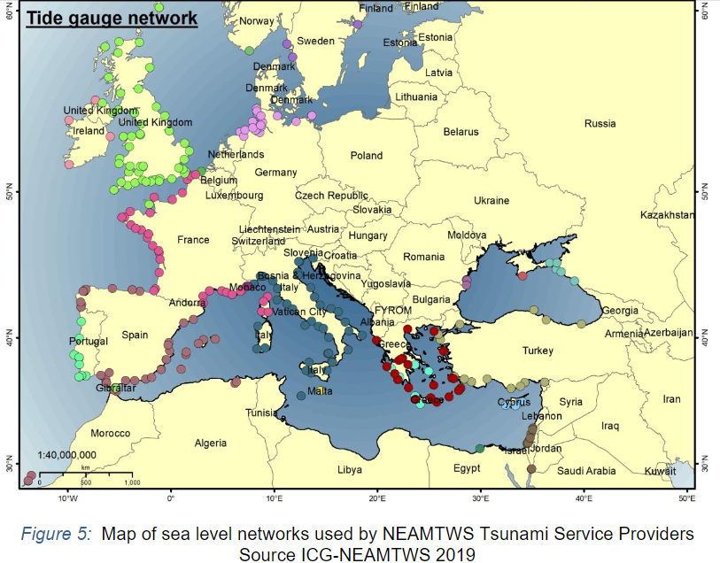
2. Mapping of Existing Operational Sea Level Network for NEAMTWS
2. Update the real-time sea-level map.
  TSPs need to provide real time SL Network data (Location and number) yearly
  IOC/ Tech Secretary. A PhD intern from BMKG to update

Slide 9
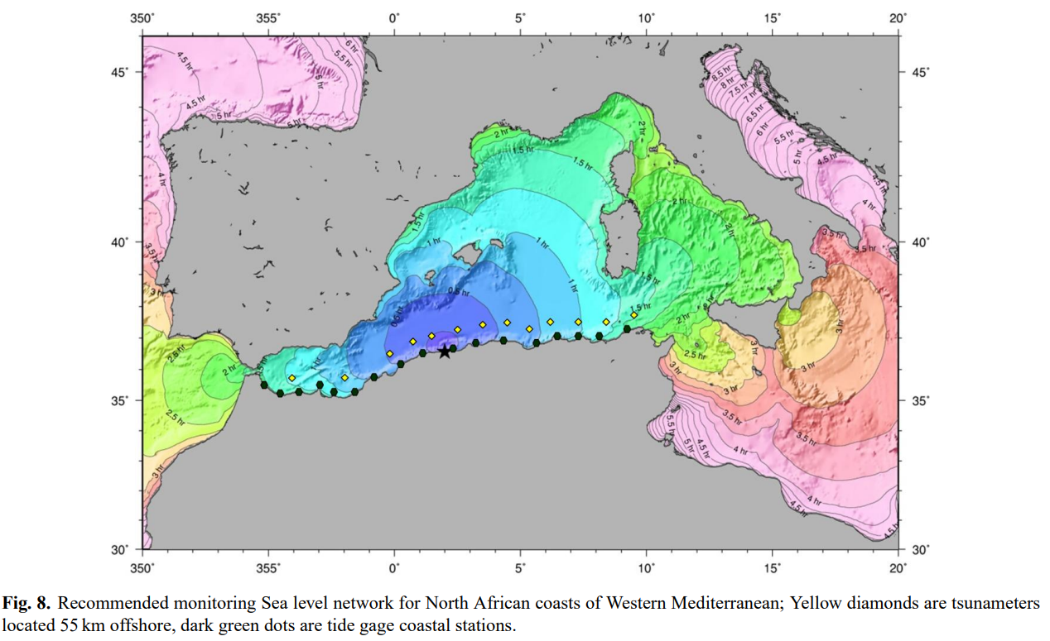
3. Setting a Target
Optimal Sea Level Network For NEAMTWS?
How do we communicate our needs and what is the optimal design SL targets/scenarios?
  In the case of Western Mediterranean, a network of around 17 coastal tide gages and 13 tsunameters located at 50 km along the shore is required to detect and measure nearly all tsunamis generated on the Northern coasts of Africa (F. Schindele´ 1 , A. Loevenbruck2 , and H. Hebert (2008)
New knowledge about optimal sea level network for NEAMTWS?
How to do this assessment? What is needed?
Who?

Slide 10
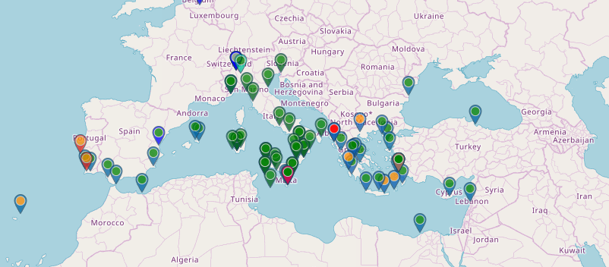
4. IDSL-Inexpensive Device for Sea-Level Measurement (IDSL)
Continue to maintain IDSL as part of CoastWAVE projects as far as we can go. Training and training material already provided, but there is a need to transit to a more robust and sustainable SLD (Affordable).
Stronger connection of WG 2/3 with CoastWAVE 2.0

Slide 11
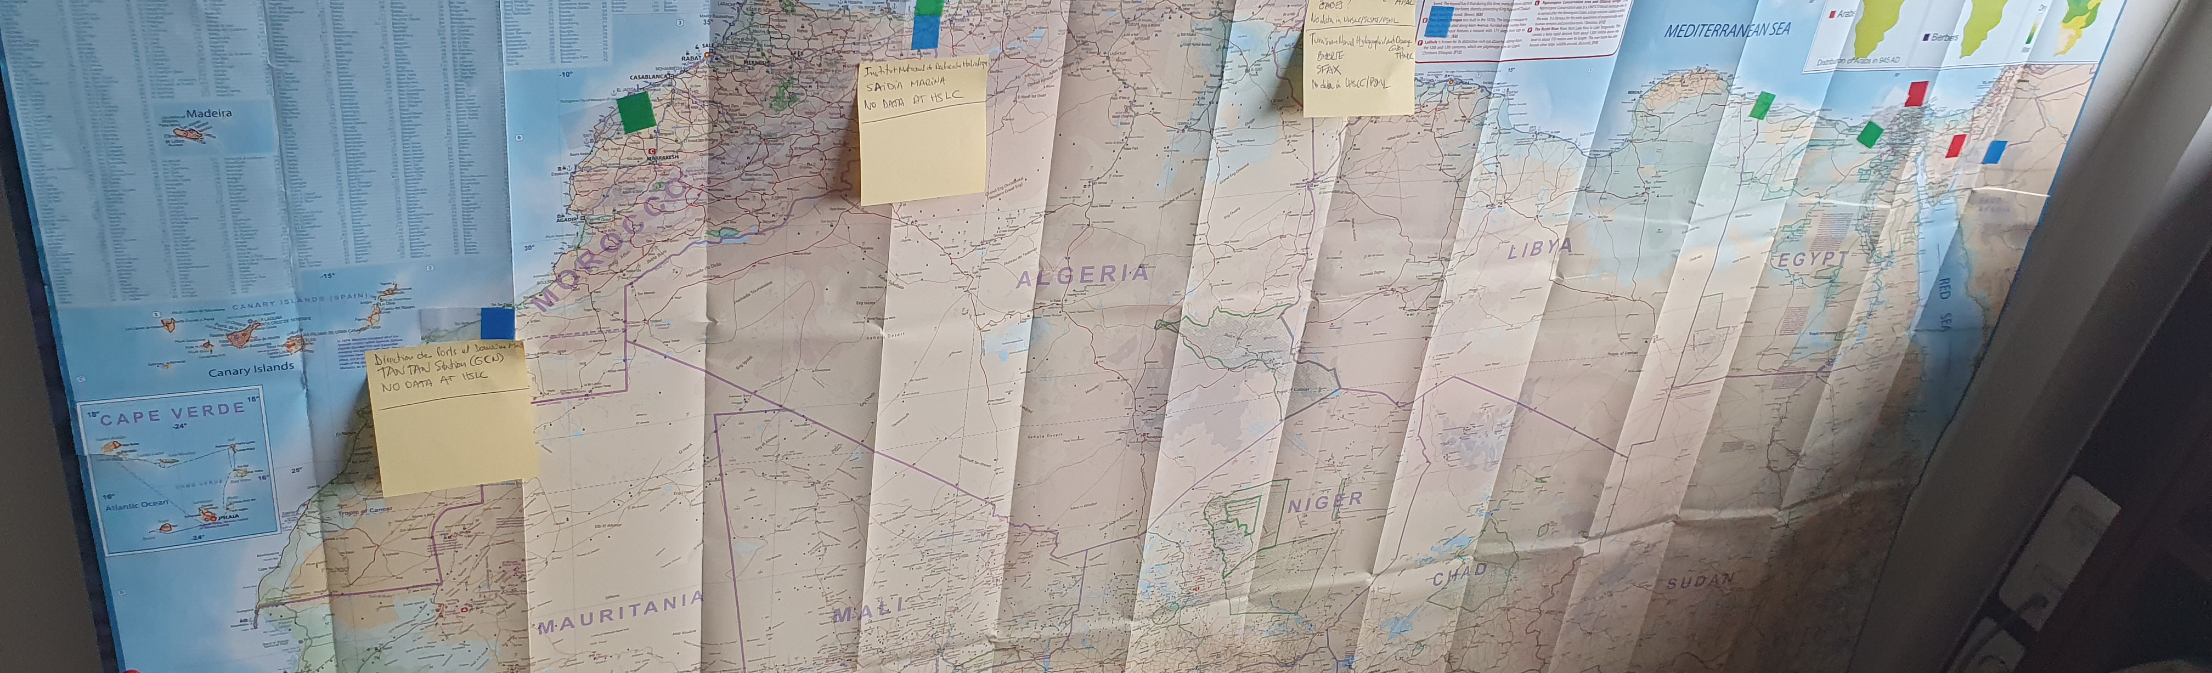
5. IOC GLOSS
Develop GLOSS Core Network
(GCN): Global array of gauges spaced 500-1000 km apart. Geographically balanced. Open ocean locations. Best technology.
GLOSS-North Africa NORAD Funded Initiative (Bernardo Aliaga, Technical Secretary of GLOOS)
GLOSSS stations are being considered for Morocco (Tan Tan) and Egypt (Alexandria,)
The IDSL station in Alexandria installed as part of CoastWAVE project will likely be relocated and will be replaced by a GLOSS Quality station.
Comprehensive regional training envisaged etc.

Slide 12
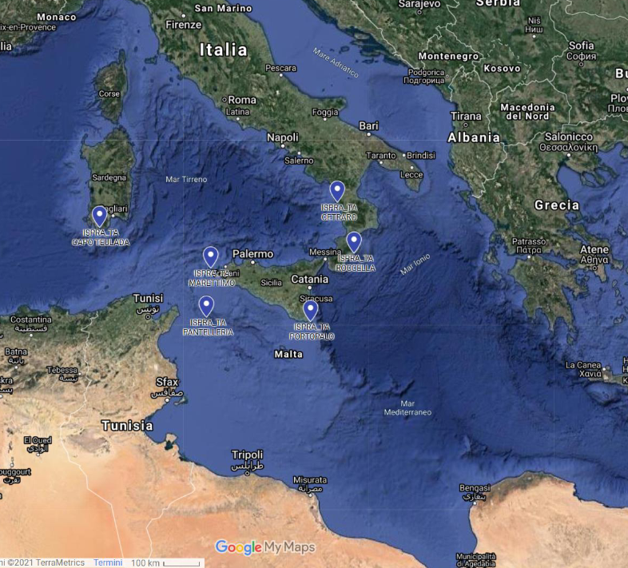
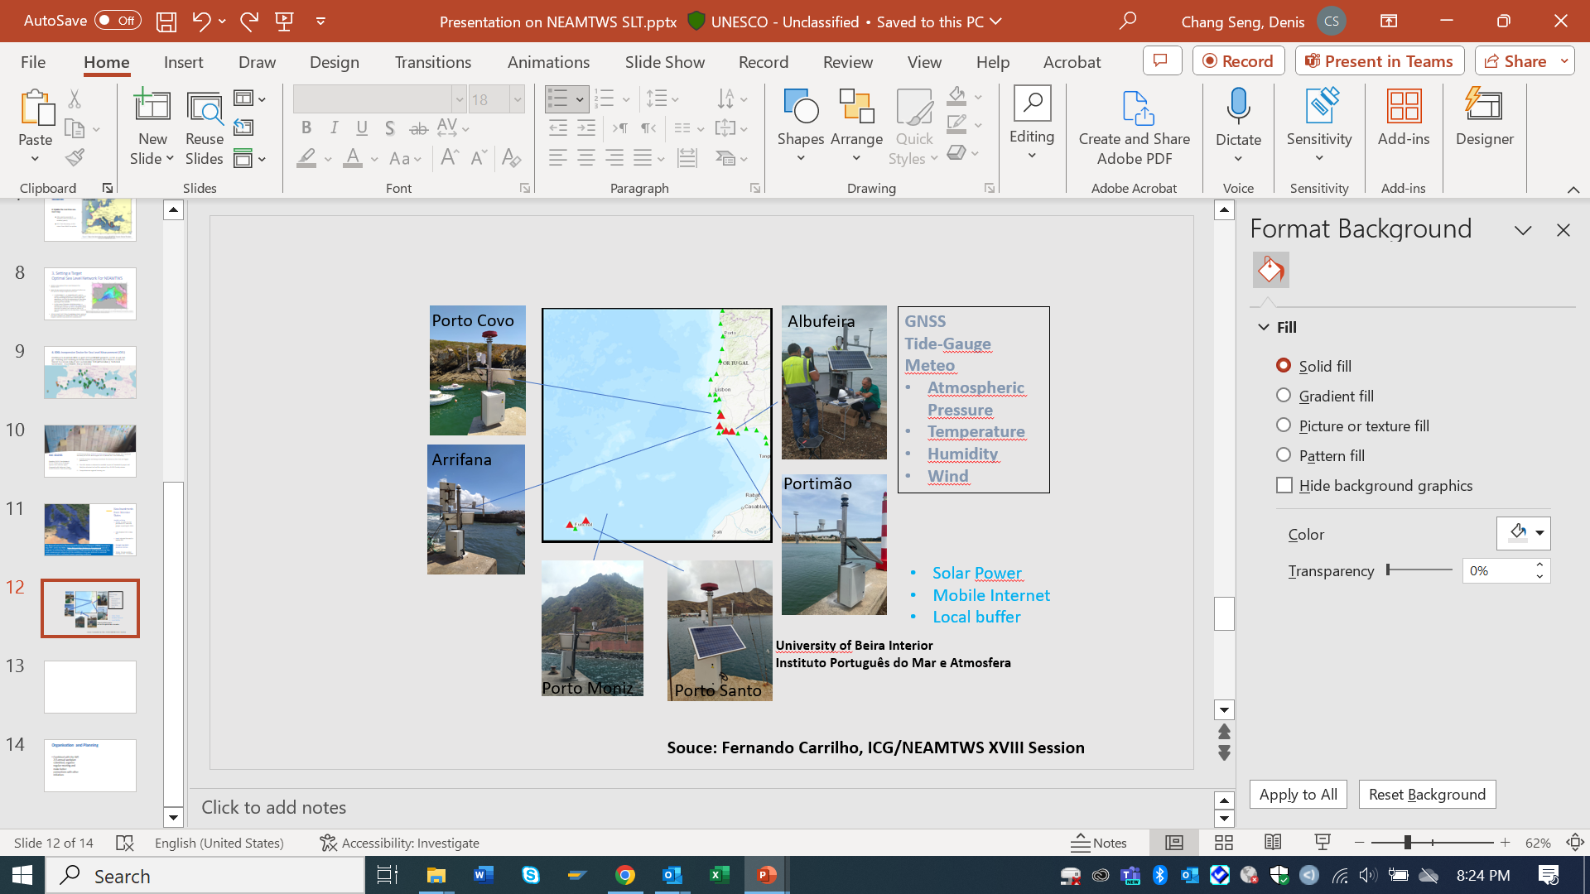
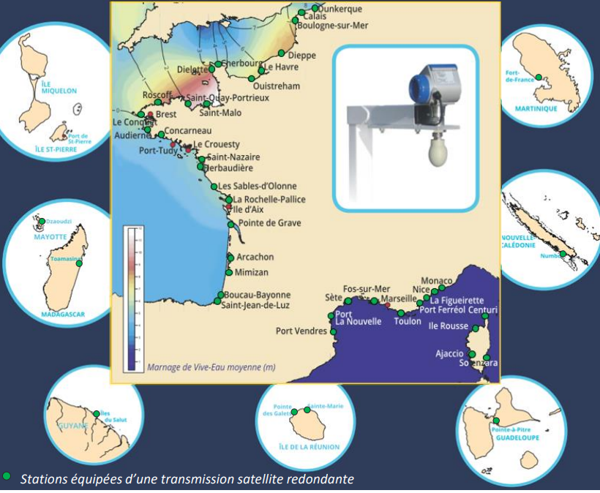
6. New Investments (Member States)
NIEP New tide auges
Notably, including
Italy: Replaced IDSL. 6 New SLS
Israel: Indicated the need to replace IDSL
Portugal: New Multi-parameter Stations installed
Greece: A tender for the purchase of 12 new tide gauges is pending for 2024
Turkey: 20 to be installed starting in 2023. 19 installed ( Comm Didem Cambaz)
France major modernization in 2022 (50) SHOM has secured in 2023 a long term support from French government, to fulfill its mandate
The National Institute for Environmental Protection and Research (ISPRA) launched in May 2021, within the SiAM- Italian National Alert System for Tsunamis framework, a program for enhancing the implementation of high precision and high-frequency long wave measurement network with the installation of six new stations for sea-level measurement able to withstand severe operating conditions

Slide 13
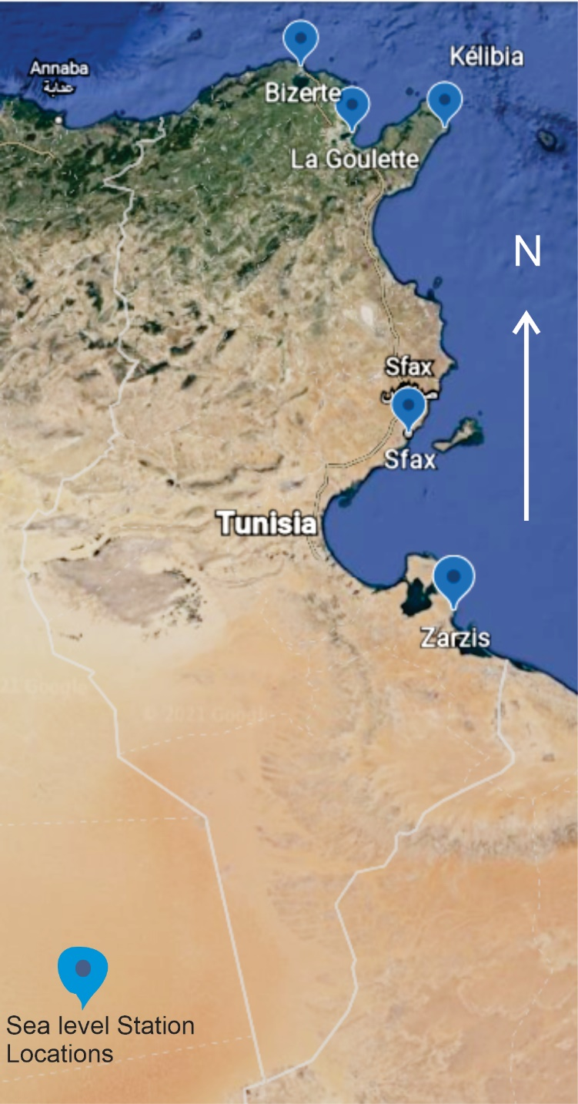
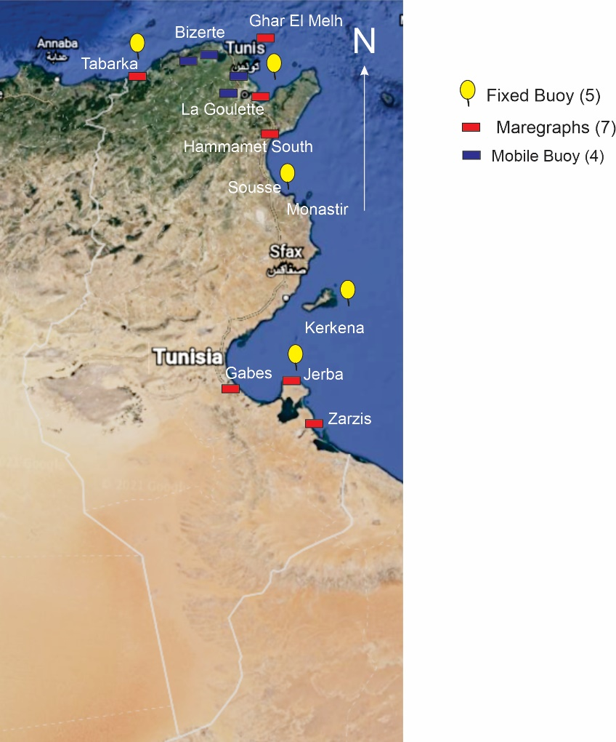
Strengthen Engagement with N-African Countries
Béchir BEJAOUI recently designated as NFP of IOC in Tunisia (Email of 10 April 2024)
Expressed interest in CoastWAVE 2.0 Project
New cooperation Opportunities to:
  Establish TWFP and TNC in Tunisia
  Engage on SL Stations and other activities
Figure 10. Map of TNHOC tide gauges in Tunisia (Saidani, 2007)
Figure 11. Sea level observation system of APAL, Tunisia.

Slide 14
Way Forward
Organisation and Planning
Organize meetings (2 per year) and make stronger connections with other initiatives
Propose a first meeting (Early June and Sep/Oct 2024):
WG 2/3
CoastWAVE 2.0 Component 3
N-Africa Norad Funded GLOSS Project
Countries investing /interested in SL network
MONGOOS, EuroGOOS

