Slide 1

EU Civil Protection Mechanism & Early warnings for all initiative
ICG / NEAM TWS
Auriane Denis-Loupot, Policy Officer
DG ECHO, European Commission

Slide 2
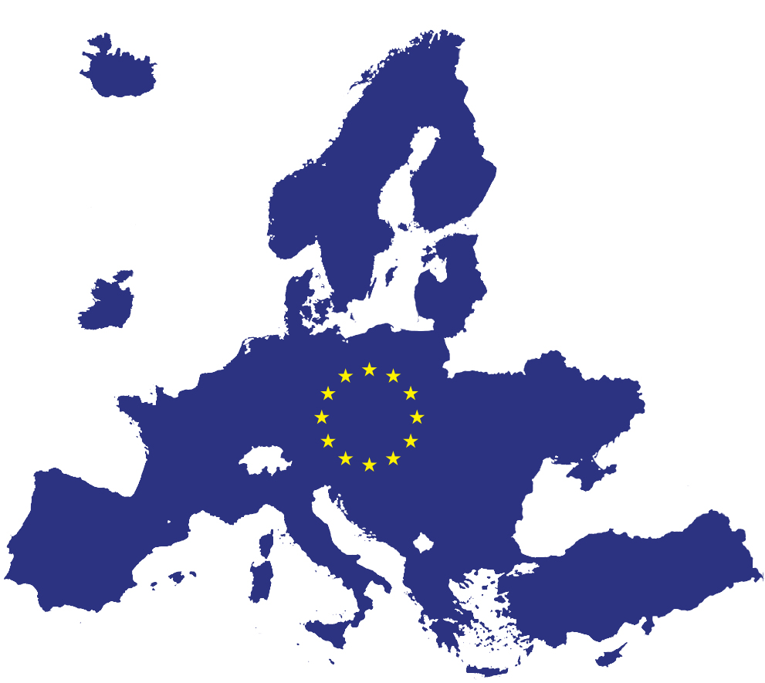









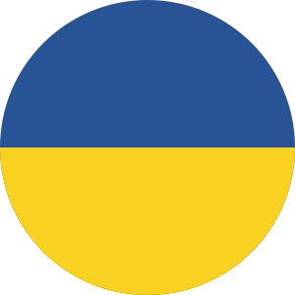
When a disaster strikes, national authorities across the world can activate the EU Civil Protection Mechanism to request coordinated assistance
EU Civil Protection Mechanism
by all EU Member States
10 Participating States

Slide 3
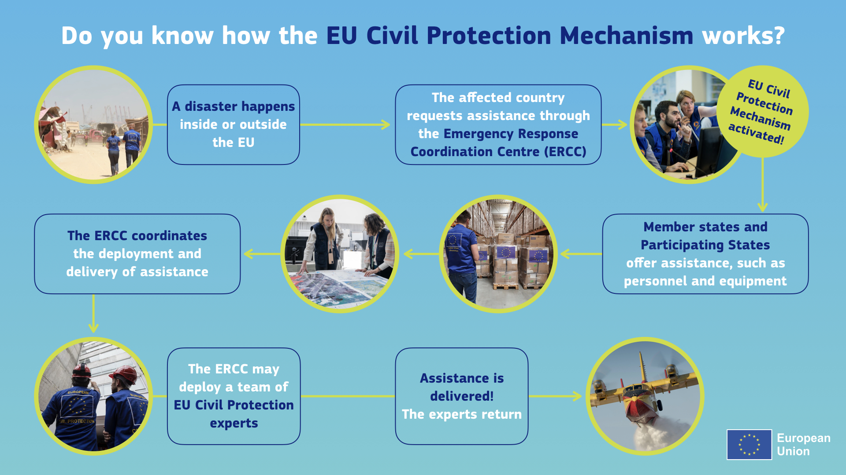
How does the EU Civil Protection Mechanism work?

Slide 4
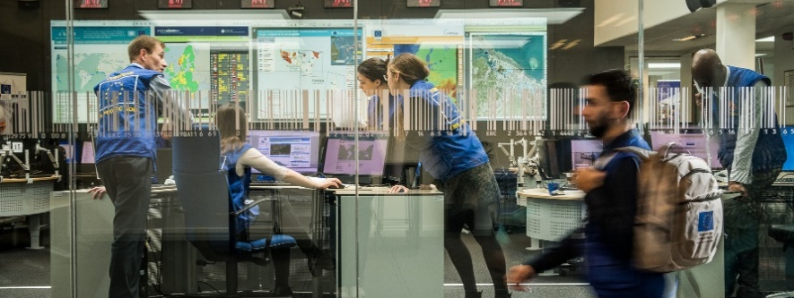
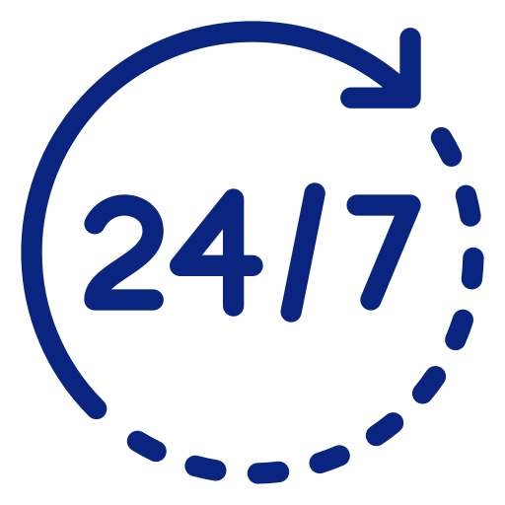

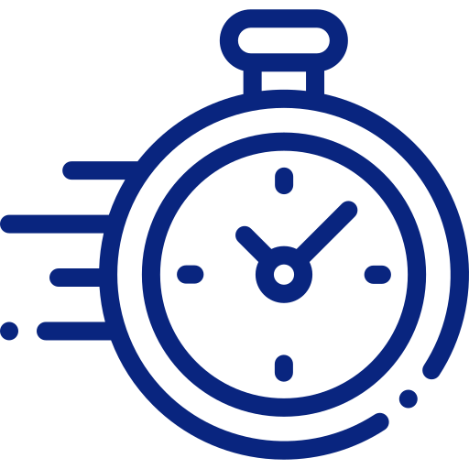

Emergency Response Coordination Centre (ERCC)
Monitors disasters around the globe
Maps disaster risks
Provides real-time information
Coordinates joint European response operations

Slide 5
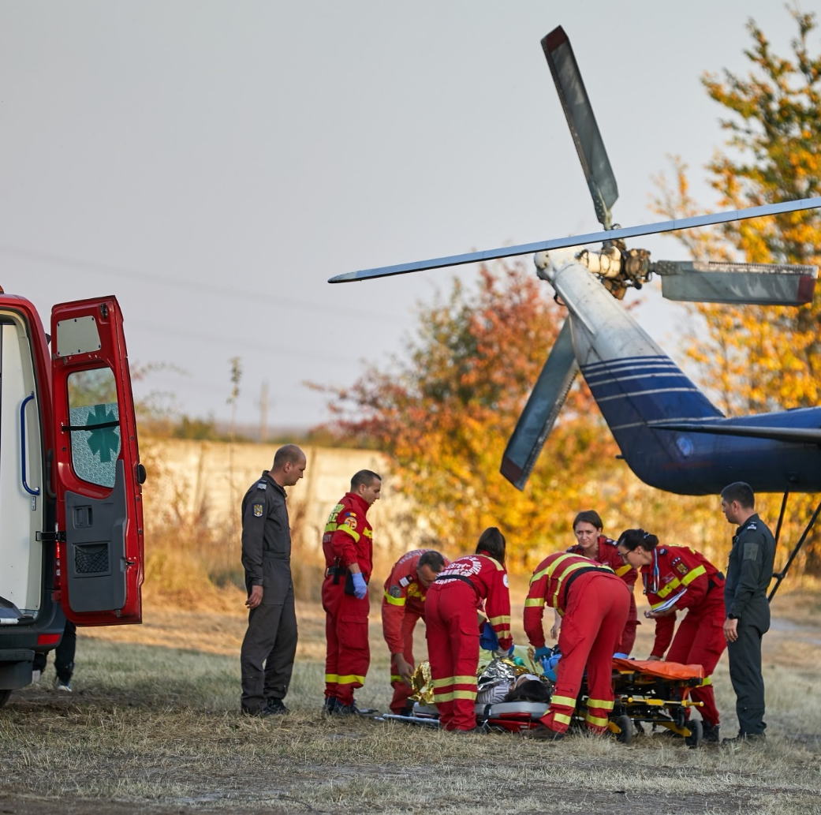
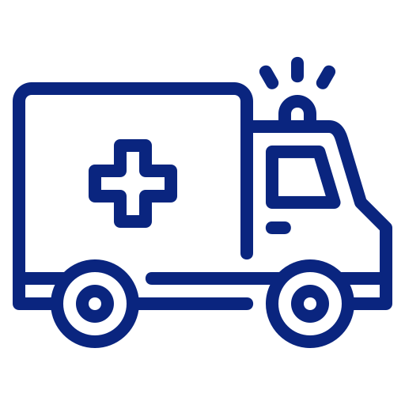









Since its creation in 2001 until October 2024,
the UCPM
has been activated for
766 emergencies

Slide 6
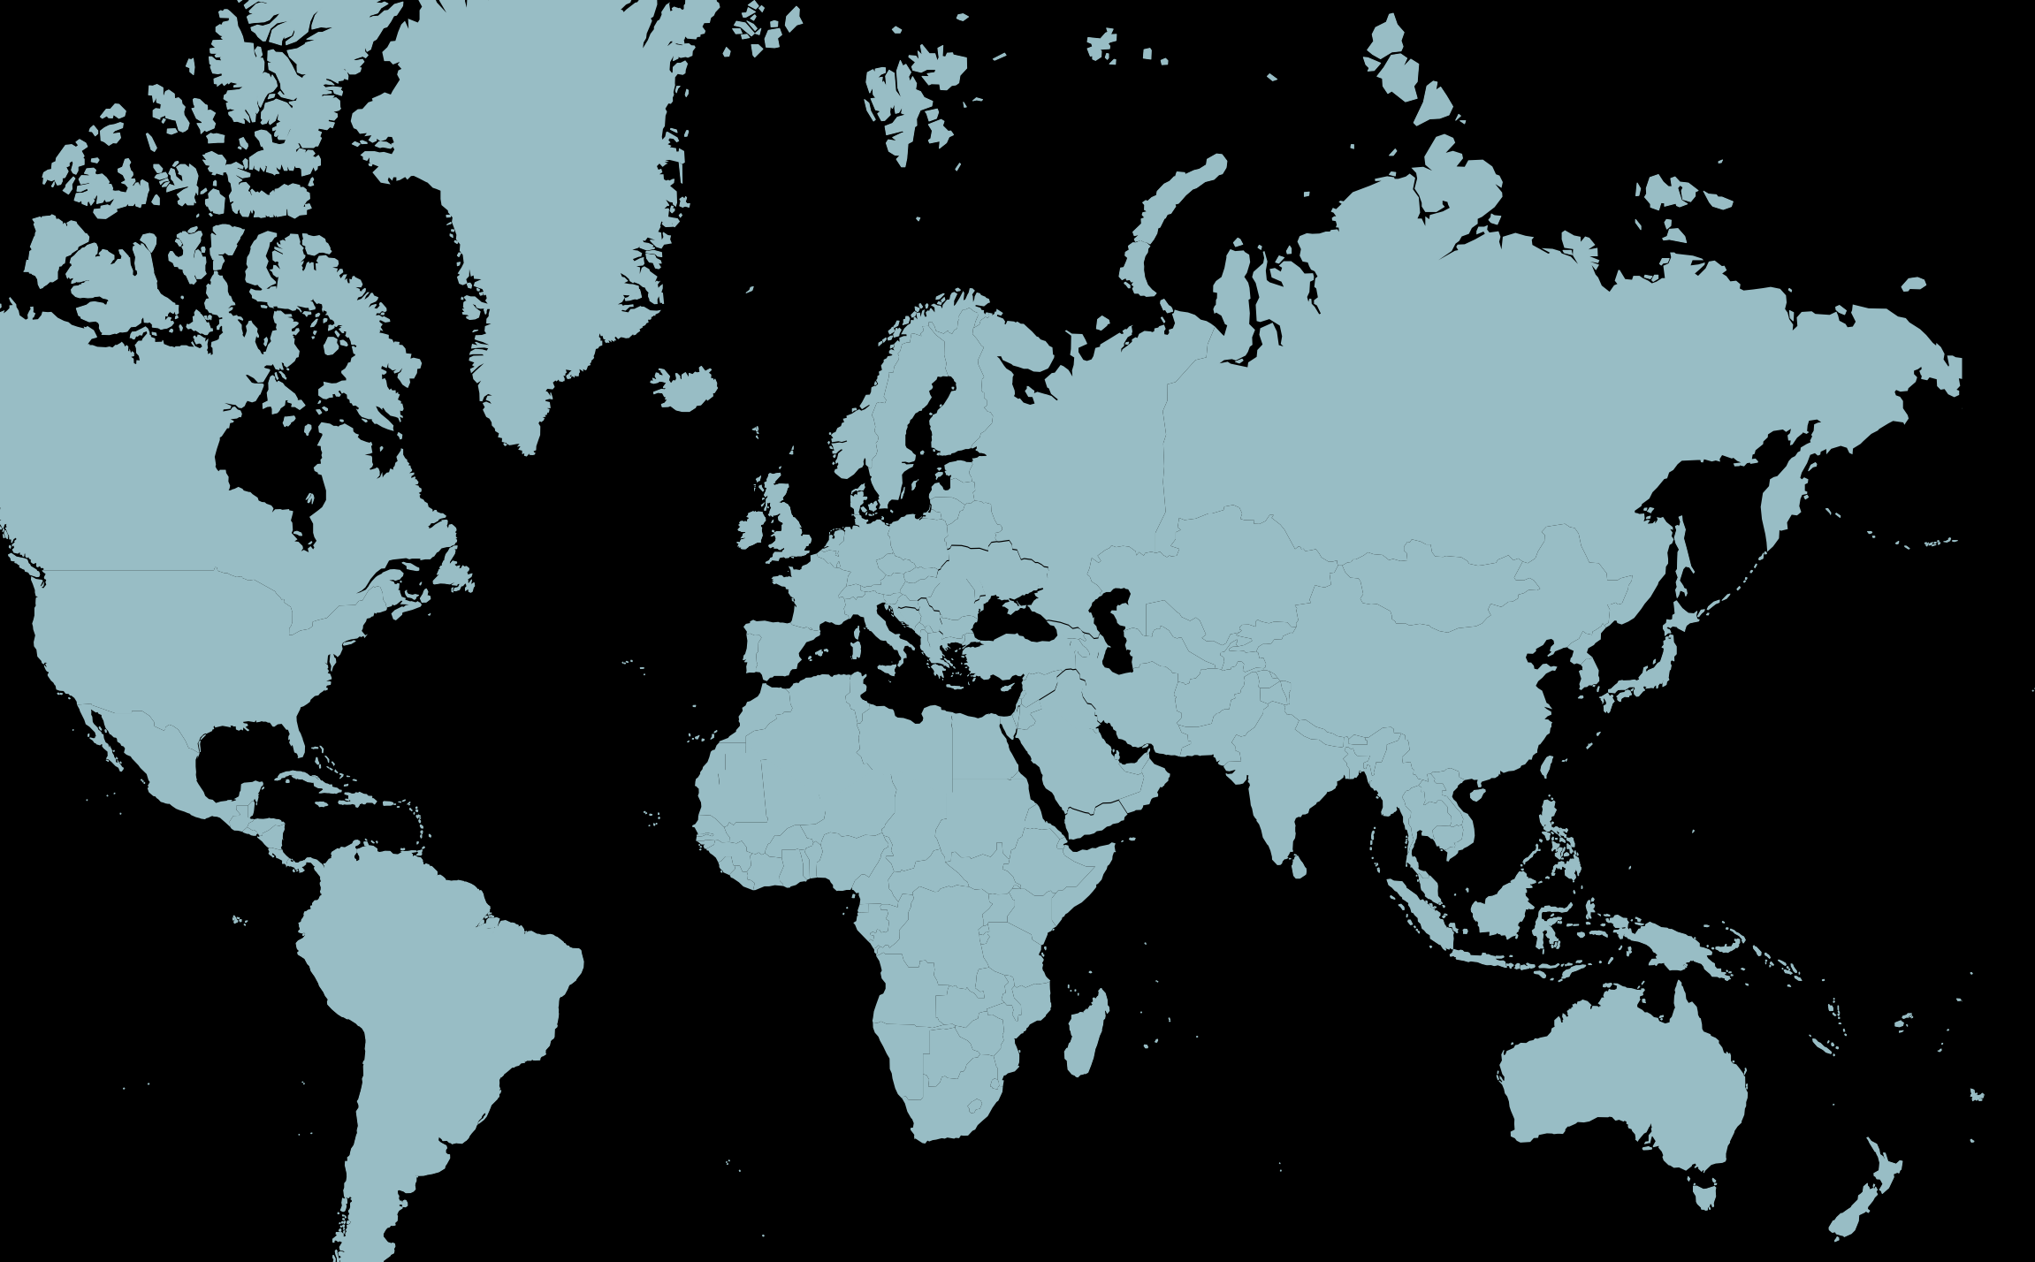

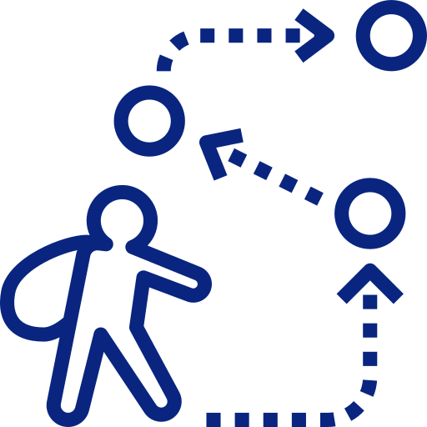







66
activations in 2023
50 requests for assistance from Ukraine
Population
displacement
Volcanic eruption
Conflict
Epidemic/
Pandemic
Storm/ Tropical cyclone
Manmade explosion
Wildfire
Consular support
Preparedness & prevention
Earthquake
Marine pollution
Flood
Medical
Environmental

Slide 7
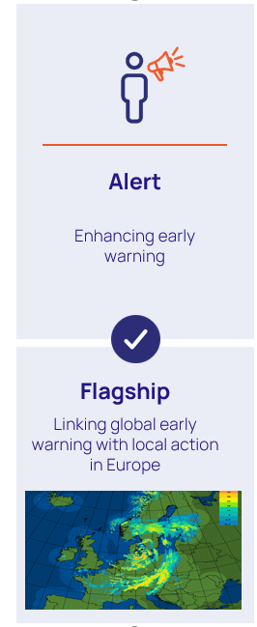

Early Warning Systems in the EU & the UN Early Warnings for All initiative
What is the link between the EU, the UCPM and early warning systems?
The Commission within the UCPM legislative framework has the mandate to support and strengthen Member States efforts to develop and integrate their early warning systems.
Early warning systems are a priority for the EU resilience under the Disaster Resilience Goals (#3).
DG ECHO has been contributing technically and financially to the development of various tools and services to complement MS/PS EWS. The following can be considered as contribution to the UN EW4All initiative.
Launched by the UN, aiming to protect every person on earth with early warning systems by 2027.

Slide 8
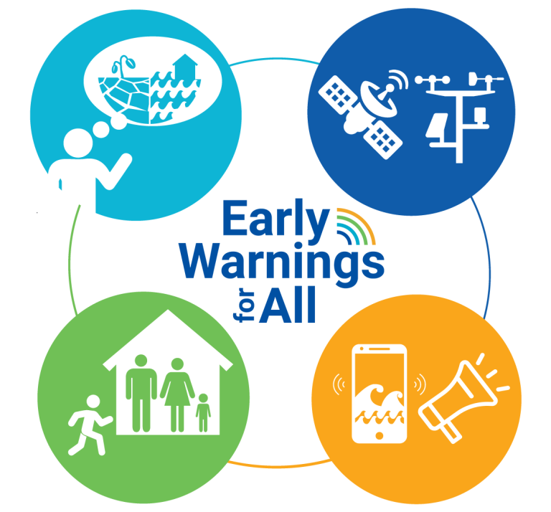
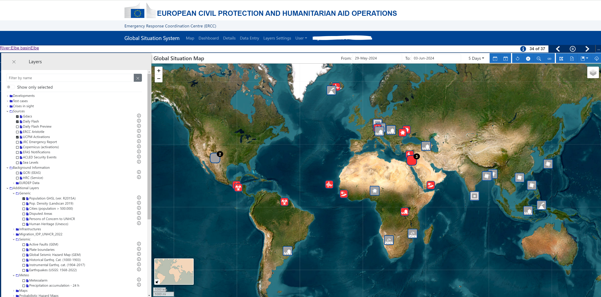






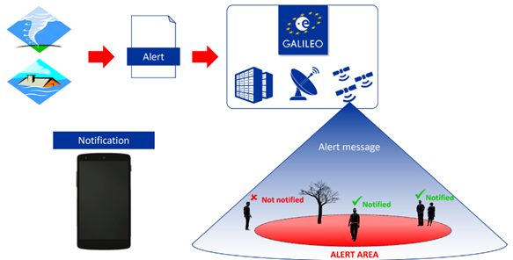
Examples of contributions to EW4All
Monitoring & forecasting of hazards
Understanding risk
GDACS
Copernicus EMS
Aristotle-ENHSP
Global Situation System (GSS)
Preparedness to respond
Emergency Management Service
CoastWAVE projects
Warning dissemination & communication
Galileo Emergency Warning Satellite services (EWSS)
Notes:
Focus on 2, 3 and 4.
Finally, stress that it continues to be essential to focus on the last mile of an EWS, linking early warning with public warning, emergency planning and empowering people by raising awareness and through education. For this the work undertaken at the local level is crucial. That’s why we are funding UNESCO to strengthen the resilience of coastal communities to tsunami and coastal hazards in the North-Eastern Atlantic and Mediterranean region.

Slide 9
Conclusions
EW4ALL is an opportunity to raise awareness on EWS and to accelerate efforts worldwide.
Feedback on how to better support and improve early warning systems for UCPM MS/PS is very important, please share with us.
Looking to the near future: upcoming EU preparedness strategy.

Slide 10
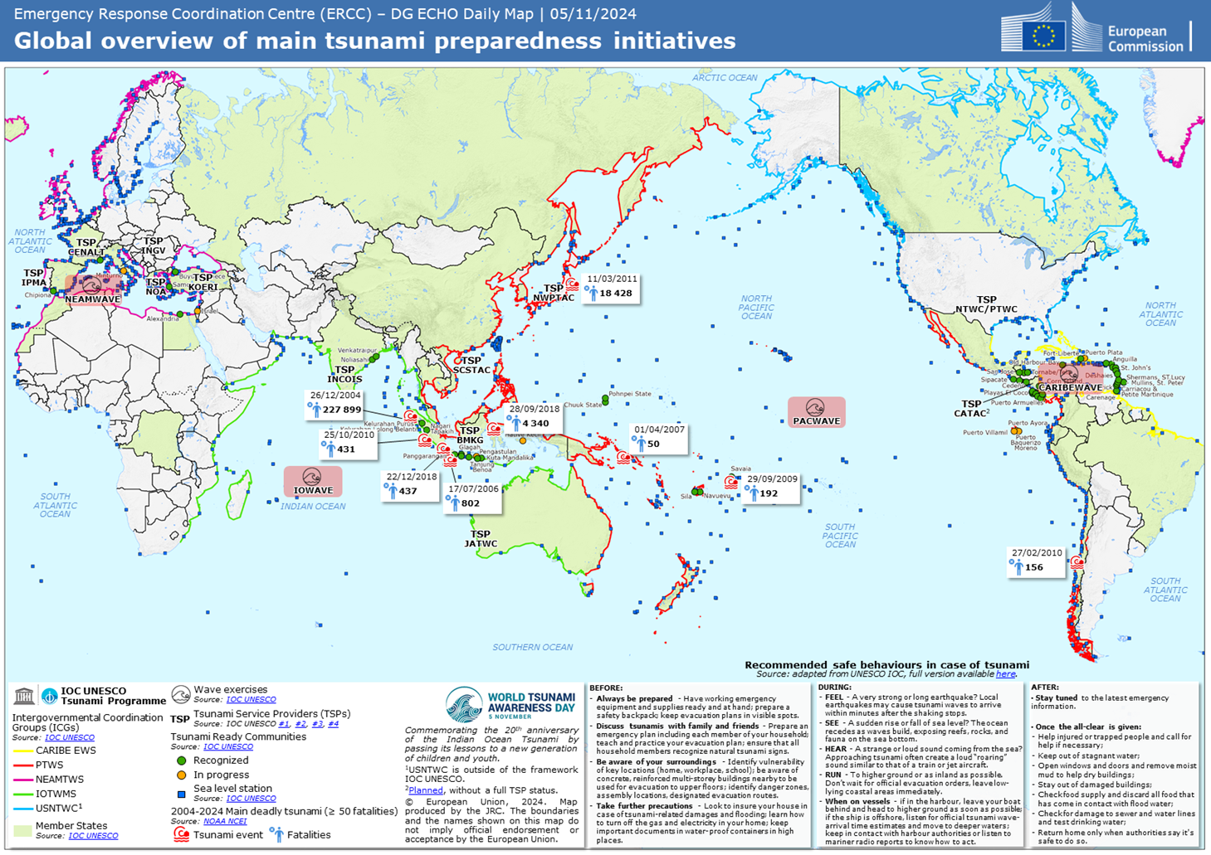
Thank you
© European Union 2023
Unless otherwise noted the reuse of this presentation is authorised under the CC BY 4.0 license. For any use or reproduction of elements that are not owned by the EU, permission may need to be sought directly from the respective right holders.
Notes:
Update/add/delete parts of the copy right notice where appropriate.
More information: https://myintracomm.ec.europa.eu/corp/intellectual-property/Documents/2019_Reuse-guidelines%28CC-BY%29.pdf

