Slide 1
TOWS-WG Task Team on Tsunami Watch Operations Meeting – February 21-22, 2025
Development of
PTWC Maritime NAVAREA Products for the Pacific Region
Chip McCreery
Director, PTWC

Slide 2
Background
Maritime tsunami products were requested of TSPs in all ocean basins through the TOWS-WG by the IHO’s World-Wide Navigational Warning System (WWNWS) to aid to their NAVAREA Coordinators in advising ships at sea about potential tsunami hazards when ships are approaching ports that may be affected.
Some general guidelines on the content and procedures for TSP implementation were constructed with input from the WWNWS.
Within the PTWS, PTWC agreed to be the only TSP to implement these products since it covers the entire PTWS service area.
A test on the dissemination of these products was conducted during the Pacwave 24 exercise (results reported yesterday)
PTWC developed the software and a draft guide on the products to include as an annex to the User’s Guide for PTWC Products for the PTWS
Some final questions regarding the products and their procedures were addressed in a call with representatives of the WWNWS on February 6, 2025
With approval from the TOWS-WG, PTWC will brief the ICG/PTWS on these products in their next meeting in April and decide on a date to implement this service.

Slide 3
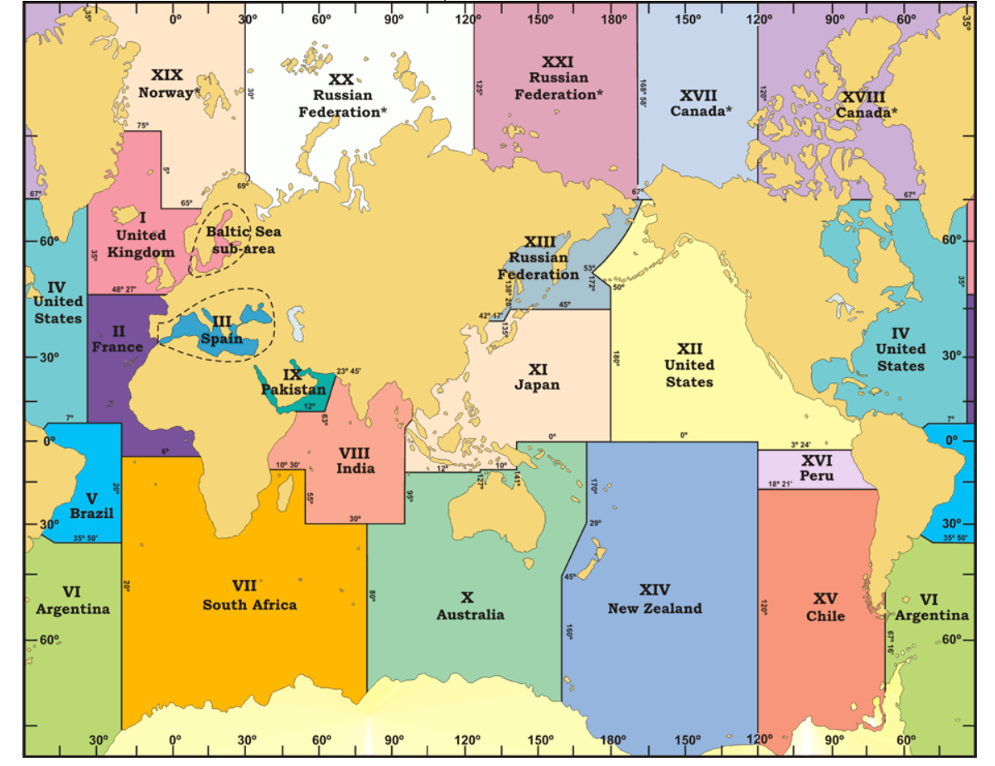
Global NAVAREAS (unofficial)

Slide 4
Countries Responsible for the Pacific-Region NAVAREAS
ID | Description | Country Responsible
VI | Southwest Atlantic | Argentina
X | Southwest Pacific | Australia
XI | Western Pacific | Japan
XII | Northeast Pacific | USA
XIII | Western North Pacific | Russian Federation
XIV | Central South Pacific | New Zealand
XV | Eastern Central Pacific | Chile
XVI | Southeastern Pacific | Peru

Slide 5
ID | Countries or Territories or Places with Adjacent NAVAREA Coasts
VI | Uruguay, Argentina, Antarctica (68.6°W to 20°W)
X | Australia, Antarctica (80°E to 160°E), Papua New Guinea, Solomon Islands, Vanuatu, New Caledonia, Nauru
XI | Japan, Guam, Northern Marianas, China, Taiwan, Philippines, DPR of Korea, Republic of Korea, Vietnam, Cambodia, Thailand, Malaysia, Singapore, Indonesia, Brunei, Palau, Chuuk, Pohnpei, Marshall Islands, Wake Island, Kiribati (Gilbert Islands with North Latitude), and Kosrae
XII | Hawaii, Northwestern Hawaiian Islands, Ecuador, Colombia, Panama, Costa Rica, Nicaragua, Honduras, El Salvador, Guatemala, Mexico, US West Coast, Canada (British Columbia), Alaska, Howland and Baker, Johnston Atoll, Palmyra Island, Midway Island, Kiribati (Line Islands with North Latitude), Tuvalu (North Latitude)
XIII | Russia
XIV | New Zealand, Antarctica (160°E to 120°W), Tonga, Fiji, Samoa, American Samoa, Niue, Wallis and Futuna, Cook Islands, French Polynesia, Kermadec Islands, Jarvis Island, Tuvalu (South Latitude), Kiribati (Phoenix Islands), Kiribati (Gilbert Islands – South Latitude), Kiribati (Line Islands – South Latitude), Pitcairn Islands, and Tokelau
XV | Chile, Antarctica (120°W to 68.6°W)
XVI | Peru

Slide 6
Key Information about PTWC Pacific Region Maritime Messages
PTWC is a Tsunami Service Provider for the Pacific Tsunami Warning and Mitigation System of UNESCO/IOC. In this role, PTWC issues operational tsunami products as advice to the Member States of the PTWS regarding potential and confirmed tsunami threats.
The Maritime Message would be issued following a large earthquake when tsunami amplitudes are forecast to be 0.3m or larger (hazardous size) along any coasts in the Pacific or its marginal seas.
It would name the affected NAVAREAS and countries or territories or places adjacent to those NAVAREAS that have a forecast of 0.3m or greater.
The Maritime Message would be updated and re-issued if the tsunami forecast changes.
A Final Maritime Message would be issued when PTWC issues its final advice product for the PTWS.
Content of the Maritime Messages was made very concise.
Maritime Messages would be disseminated only by email.

Slide 7
Sample Timeline for a Pacific-Crossing Tsunami
Day | Time (UTC) | Elapsed (min) | PTWS Message Number | Maritime Message Number | Message Type and Description
02/04 | 1844 | 0 | - | - | Earthquake occurs
 | 1850 | 6 | 1 |  | PTWS threat message with potential coastal tsunami threat
 | 1910 | 26 | 2 | - | PTWS threat message with quantitative regional tsunami forecast
 |  |  | - | 1 | Maritime threat message for NAVAREAS XII and XVI
 | 1925 | 41 | 3 | - | PTWS message with quantitative Pacific-wide tsunami forecast
 |  |  | - | 2 | Maritime threat message for NAVAREAS X, XI, XII, XIV, XV, and XVI
02/04- 02/05 | 2025-1425 | 101-1241 | 4-22 | - | Hourly PTWS threat messages reporting tsunami amplitudes on sea-level gauges
02/05 | 1525 | 1301 | 23 | - | PTWS final threat message
 |  |  | - | 3 | Maritime final message

Slide 8
Sample Regional Tsunami Forecast in a PTWC Threat Message for the PTWS
TEST... TSUNAMI THREAT FORECAST...UPDATED ...TEST
-------------------------------------------------
* THIS IS A TEST MESSAGE. TSUNAMI WAVES REACHING MORE THAN 3
METERS ABOVE THE TIDE LEVEL ARE POSSIBLE ALONG SOME COASTS
OF
EL SALVADOR... AND GUATEMALA.
* THIS IS A TEST MESSAGE. TSUNAMI WAVES REACHING 1 TO 3 METERS
ABOVE THE TIDE LEVEL ARE POSSIBLE ALONG SOME COASTS OF
COSTA RICA... ECUADOR... MEXICO... NICARAGUA... PANAMA...
AND PERU.
* THIS IS A TEST MESSAGE. TSUNAMI WAVES REACHING 0.3 TO 1
METERS ABOVE THE TIDE LEVEL ARE POSSIBLE FOR SOME COASTS OF
COLOMBIA.

Slide 9
Corresponding PTWC Pacific Maritime Message
MARITIME TSUNAMI THREAT MESSAGE NUMBER 01
NWS PACIFIC TSUNAMI WARNING CENTER HONOLULU HI
1853 UTC TUE FEB 4 2025
THIS MESSAGE IS FOR NAVAREA XII, AND NAVAREA XVI.
A TSUNAMI THREAT IS OCCURING.
A TSUNAMI MAY HAVE BEEN GENERATED BY AN EARTHQUAKE WITH A
PRELIMINARY MAGNITUDE OF 8.6 THAT OCCURRED NEAR THE COAST OF
GUATEMALA AT 1844 UTC ON TUESDAY FEBRUARY 4 2025.
HAZARDOUS TSUNAMI WAVES ARE FORECAST FOR SOME COASTS OF COLOMBIA,
COSTA RICA, ECUADOR, EL SALVADOR, GUATEMALA, MEXICO, NICARAGUA,
PANAMA, AND PERU.
TSUNAMI WAVES ARE NOT A HAZARD TO SHIPS IN DEEP WATER BUT CAN
CAUSE STRONG CURRENTS AND RAPID SEA LEVEL CHANGES IN SHALLOW
WATER AS WELL AS INUNDATION OF THE COAST.
SHIPS APPROACHING THE COAST SHOULD CONSULT LOCAL AUTHORITIES
REGARDING LOCAL CONDITIONS AND ADVICES.

Slide 10
Sample Pacific-Wide Tsunami Forecast in a PTWC Threat Message for the PTWS
TEST... TSUNAMI THREAT FORECAST...UPDATED ...TEST
-------------------------------------------------
* THIS IS A TEST MESSAGE. TSUNAMI WAVES REACHING MORE THAN 3
METERS ABOVE THE TIDE LEVEL ARE POSSIBLE ALONG SOME COASTS
OF
EL SALVADOR... GUATEMALA... AND MEXICO.
* THIS IS A TEST MESSAGE. TSUNAMI WAVES REACHING 1 TO 3 METERS
ABOVE THE TIDE LEVEL ARE POSSIBLE ALONG SOME COASTS OF
ANTARCTICA... COSTA RICA... ECUADOR... AND NICARAGUA.
* THIS IS A TEST MESSAGE. TSUNAMI WAVES REACHING 0.3 TO 1
METERS ABOVE THE TIDE LEVEL ARE POSSIBLE FOR SOME COASTS OF
AMERICAN SAMOA... AUSTRALIA... CHILE... COLOMBIA... COOK
ISLANDS... FIJI... FRENCH POLYNESIA... HAWAII...
INDONESIA... JAPAN... KERMADEC ISLANDS... KIRIBATI...
MARSHALL ISLANDS... NEW CALEDONIA... NEW ZEALAND...
NIUE... NORTHWESTERN HAWAIIAN ISLANDS... PANAMA... PAPUA
NEW GUINEA... PERU... PITCAIRN ISLANDS... SAMOA... SOLOMON
ISLANDS... TOKELAU... TONGA... VANUATU... AND WALLIS AND
FUTUNA.

Slide 11
Corresponding PTWC Pacific Maritime Message
MARITIME TSUNAMI THREAT MESSAGE NUMBER 02
NWS PACIFIC TSUNAMI WARNING CENTER HONOLULU HI
1905 UTC TUE FEB 4 2025
THIS MESSAGE IS FOR NAVAREA X, NAVAREA XI, NAVAREA XII, NAVAREA
XIV, NAVAREA XV, AND NAVAREA XVI.
A TSUNAMI THREAT IS OCCURING.
A TSUNAMI WAS GENERATED BY AN EARTHQUAKE WITH A PRELIMINARY
MAGNITUDE OF 8.6 THAT OCCURRED NEAR THE COAST OF GUATEMALA
AT 1844 UTC ON TUESDAY FEBRUARY 4 2025.
HAZARDOUS TSUNAMI WAVES ARE FORECAST FOR SOME COASTS OF AMERICAN
SAMOA, ANTARCTICA, AUSTRALIA, CHILE, COLOMBIA, COOK ISLANDS,
COSTA RICA, ECUADOR, EL SALVADOR, FIJI, FRENCH POLYNESIA,
GUATEMALA, HAWAII, INDONESIA, JAPAN, KERMADEC ISLANDS, KIRIBATI,
MARSHALL ISLANDS, MEXICO, NEW CALEDONIA, NEW ZEALAND, NICARAGUA,
NIUE, NORTHWESTERN HAWAIIAN ISLANDS, PANAMA, PAPUA NEW GUINEA,
PERU, PITCAIRN ISLANDS, SAMOA, SOLOMON ISLANDS, TOKELAU, TONGA,
VANUATU, AND WALLIS AND FUTUNA.
TSUNAMI WAVES ARE NOT A HAZARD TO SHIPS IN DEEP WATER BUT CAN
CAUSE STRONG CURRENTS AND RAPID SEA LEVEL CHANGES IN SHALLOW
WATER AS WELL AS INUNDATION OF THE COAST.
SHIPS APPROACHING THE COAST SHOULD CONSULT LOCAL AUTHORITIES
REGARDING LOCAL CONDITIONS AND ADVICES.

Slide 12
Final PTWC Pacific Maritime Message
MARITIME TSUNAMI THREAT MESSAGE NUMBER 03
NWS PACIFIC TSUNAMI WARNING CENTER HONOLULU HI
1525 UTC TUE FEB 5 2025
THIS MESSAGE IS FOR NAVAREA X, NAVAREA XI, NAVAREA XII, NAVAREA
XIV, NAVAREA XV, AND NAVAREA XVI.
THE TSUNAMI THREAT HAS NOW LARGELY PASSED.
THE TSUNAMI THREAT FROM AN EARTHQUAKE WITH A PRELIMINARY
MAGNITUDE OF 8.6 THAT OCCURRED NEAR THE COAST OF GUATEMALA
AT 1844 UTC ON TUESDAY FEBRUARY 4 2025 HAS NOW LARGELY PASSED.
HOWEVER, SHIPS APPROACHING THE COAST SHOULD STILL CONSULT LOCAL
AUTHORITIES REGARDING LOCAL CONDITIONS AND ADVICES.

Slide 13
Some Key Questions from the 02/06/25 call with WWNWS
Is anything else needed in the message content? None requested at this time.
Is one or two messages at the beginning enough for an event that could last more than 24 hours? Yes, ships entering an affected NAVAREA will receive the message when they enter the affected NAVAREA as long as a final message has not yet been issued. There is also a 500 km extension around all NAVAREAS for receiving products.
Should messages be sent directly to the NAVAREA Coordinators or through that country’s National Tsunami Warning Center and Tsunami Warning Focal Point? Yes, the message can be sent directly to NAVAREA Coordinators as well as to their country TWFPs and NTWCs.
Should dissemination be to all seven Pacific NAVAREA Coordinators or just the NAVAREA Coordinators of the affected NAVAREAs? Just to the NAVAREA Coordinators of the affected NAVAREAs.

