Slide 1


Tsunami Ready in
Indian Ocean
Ardito M KODIJAT
UNESCO-IOC Indian Ocean Tsunami Information Centre
National Professional Officer DRR (SC/IOC)
Disaster Risk Reduction and Tsunami Information Unit
UNESCO Office Jakarta
a.kodijat@unesco.org

Slide 2
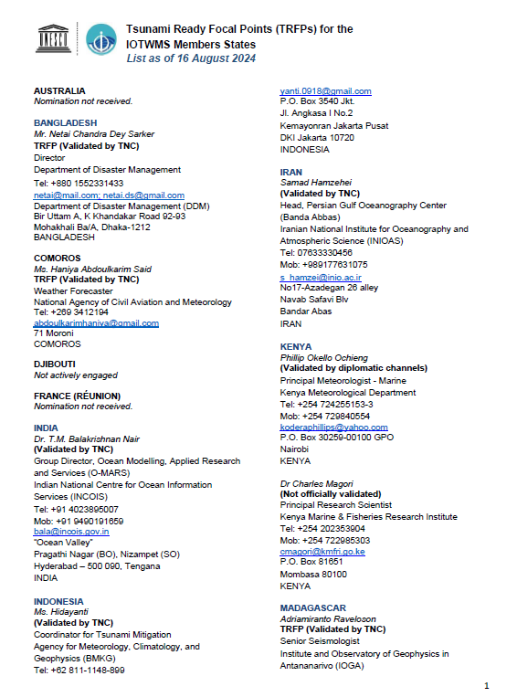
Tsunami Ready Focal Point
WG-3 Tsunami Ready Implementation
(Revised TOR-14 ICG/IOTWMS)
Mrs Suci Dewi Anugrah (Indonesia)
20 Tsunami Ready Focal Point of 27 Member States

Slide 3
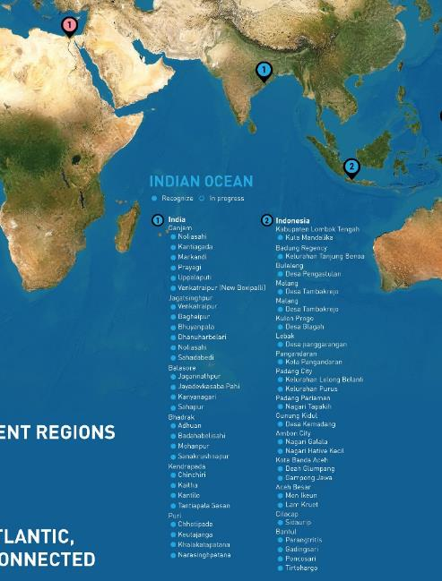
Tsunami Ready in Indian Ocean
  Tsunami Ready in Indian Ocean
In 2024, In India, 24 villages received the UNESCO-IOC Tsunami Ready Recognition, and 2 villages received the renewal:
In addition to the 9 communities already recognized, there are 13 new UNESCO-IOC Tsunami Ready villages recognized in Indonesia (2023-2024).
Nagari Tapakih
Pengastulan
Galala
Hative Kecil
Deah Glumpang
Gampong Jawa
Lam Kruet
Mon Ikeun
Sidaurip
Parangtritis,
Tirtohargo,
Poncosari, and
Gadingsari
Balasore District
Jayadevkasaba Pahi Village,
Jagannathpur Village,
Kanyanagari Village,
Sahapur Village,
Bhadrak District
Mohanpur Village,
Sanakrushnapur Village,
Adhuan Village,
Badahabelisahi Village, B
Ganjam District
Kantiagada Village,
Markandi Village,
Prayagi Village,
Uppalaputi Village,
Venkatraipur (New Baxipalli) Village,
Jagatsinghpur District
Bahgeipur Village,
Bhuyanpala Village,
Dhanaharbelari Village,
Noliasahi Village,
Shadabedi Village,
Kendrapada District
Chinchiri Village,
Kaitha Village,
Kantilo Village,
Tantiapala_Sasan Village,
Puri District
Chhotipada Village,
Keutajanga Village,
Khalakatapatana Village,
Narasinghpatana Village,
https://tsunamireadyviewer.ioc-tsunami.org/

Slide 4
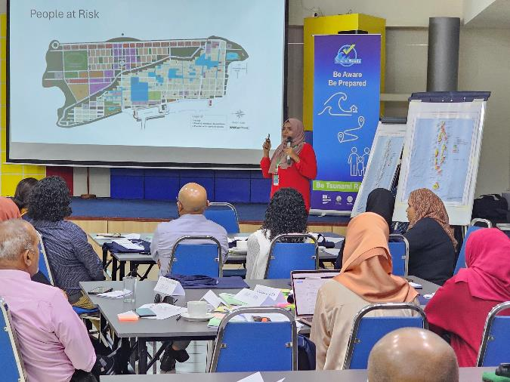
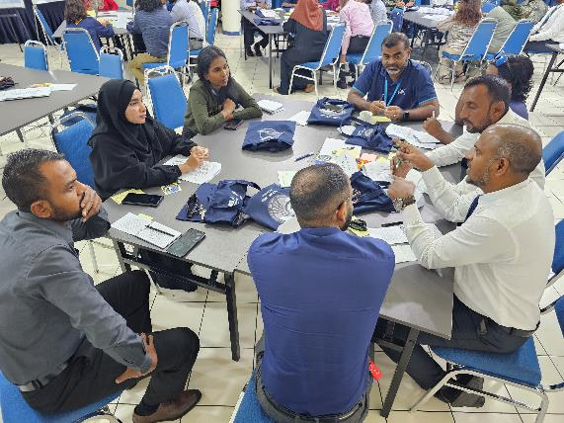
Tsunami Ready in Indian Ocean
  Tsunami Ready Facilitator Training in Indonesia (2023)
  Tsunami Ready Field Verification Workshop in Indonesia (2023)
  National Tsunami Ready Training in Seychelles (2023)
  National Tsunami Ready Training in Timor-Leste (2023)
  National Tsunami Ready Training in Maldives (2024)
  Tsunami Hazard and Inundation Map for NWIO (India, Iran, Pakistan, Oman, and UAE) Pilot Communities for Tsunami Ready (2024) ➔ UNESCAP
  Regional Tsunami Ready Training/workshop in Hyderabad (2025 – April)

Slide 5
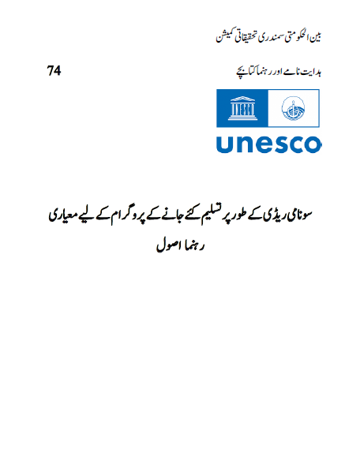

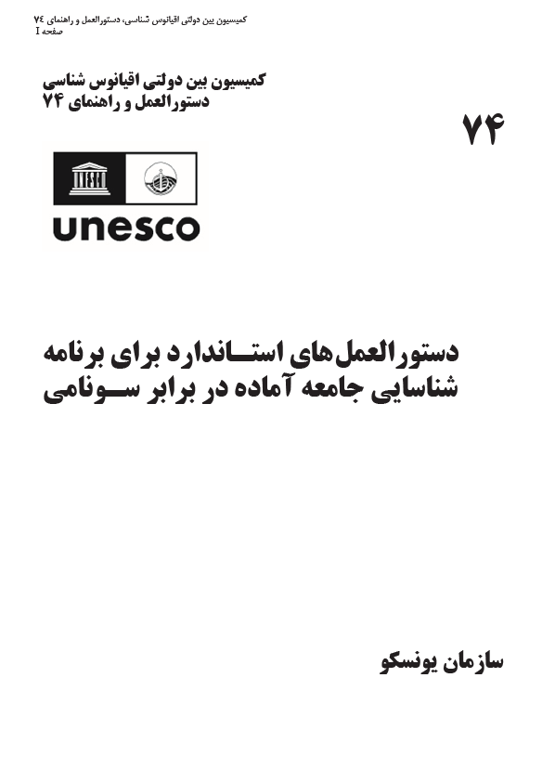

Tsunami Ready in Indian Ocean
  Translation of MG74 and MG82 (2024)
Urdu Language (Pakistan)
Farsi Language (Iran)

Slide 6
Tsunami Ready in Indian Ocean
  National Tsunami Ready Recognition
  Indonesia and India
  The community received the certificate from the NTRB while the UNESCO-IOC Recognition is in process
  The recognition is in the National / local language
  National Tsunami Ready Board
  Existing coordination mechanism
  Adding the function of TR in the role and responsibility of the existing coordination body

Slide 7







Thank you
Follow us
iotic.ioc-unesco.org
www.iotsunami.org
facebook.com/iotsunami
Ardito M. KODIJAT
a.kodijat@unesco.org
iotsunami
@iotsunami
UNESCO-IOC Indian Ocean Tsunami Information Centre
IOTIC-BMKG Programme Office
Disaster Risk Reduction and Tsunami Information Unit
UNESCO Jakarta Office
youtube.com/iotsunami
iotic@unesco.org

