Slide 1
ICG/PTWS-XXXI Session
8 - 11 April 2025
3.4 TOWS-WG REPORT
Report of the TOWS-WG 18th Session
NISHIMAE Yuji
Chair of ICG/PTWS

Slide 2
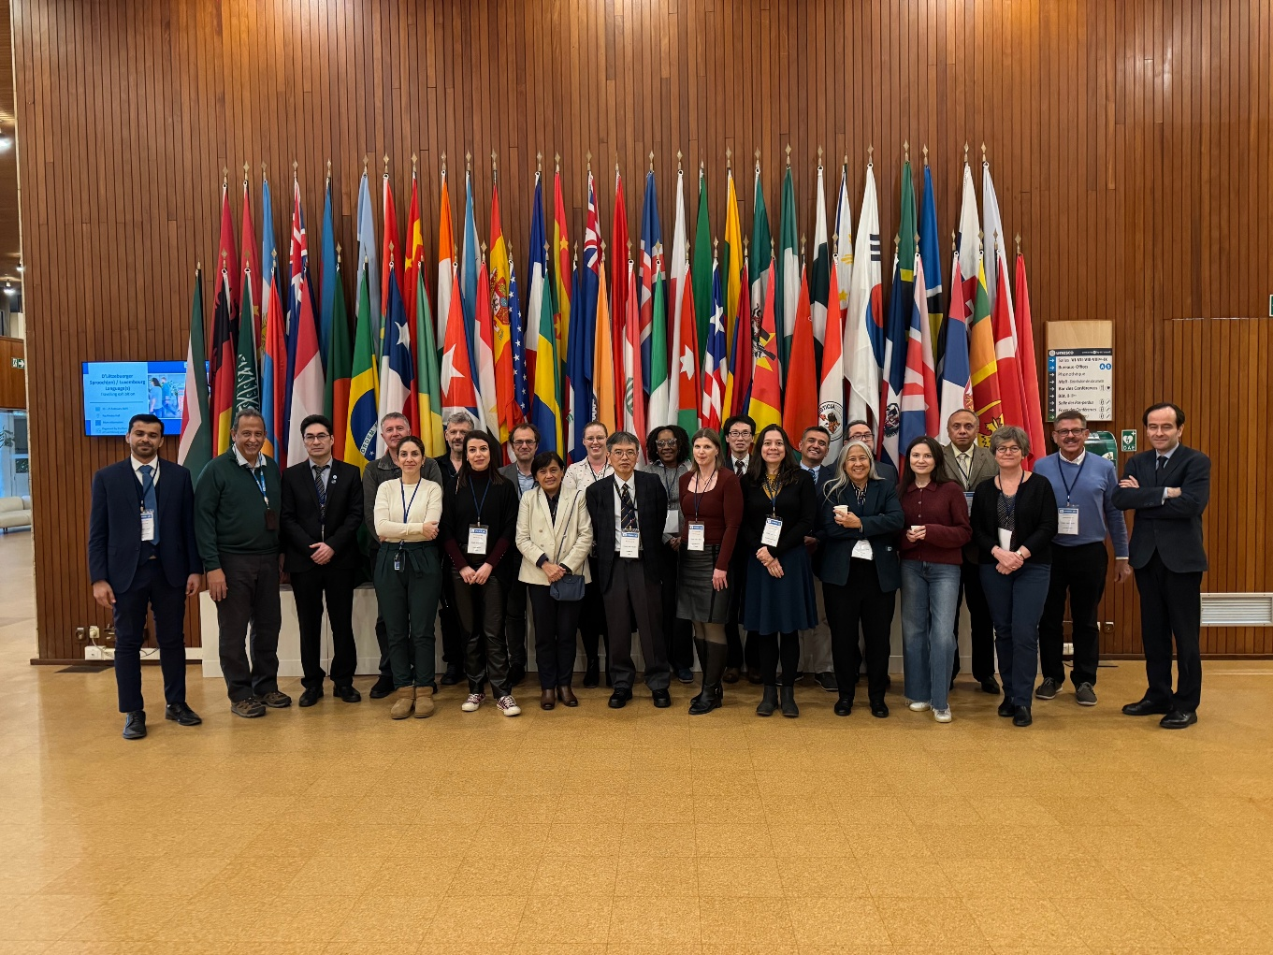
TOWS-WG XVIII Session and TT meetings
20 February
TOWS Joint Task Team Meeting (TT DMP and TT TWO)
21 – 22 February
TT on Disaster Management and Preparedness meeting
TT on Tsunami Watch Operation meeting
24 – 25 February
TOWS-WG XVIII Session

Slide 3
Important Recommendations related to the ICG/PTWS
1. Sea Level Observations
2. Non-Seismic Tsunamis
4. UN Ocean Decade Tsunami Programme
5. Tsunami Ready Recognition Programme
3. Tsunami Forecasting and Tsunami Bulletins from TSPs

Slide 4
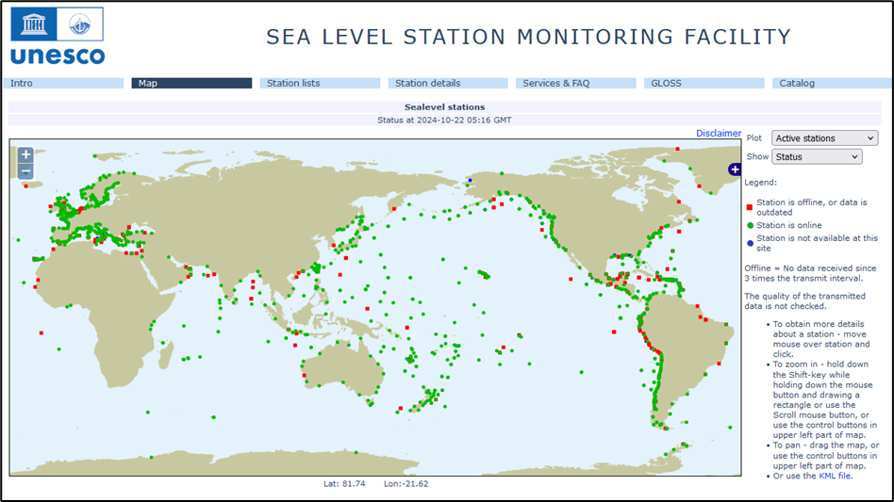
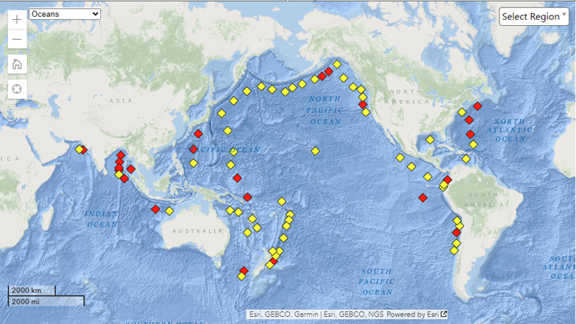
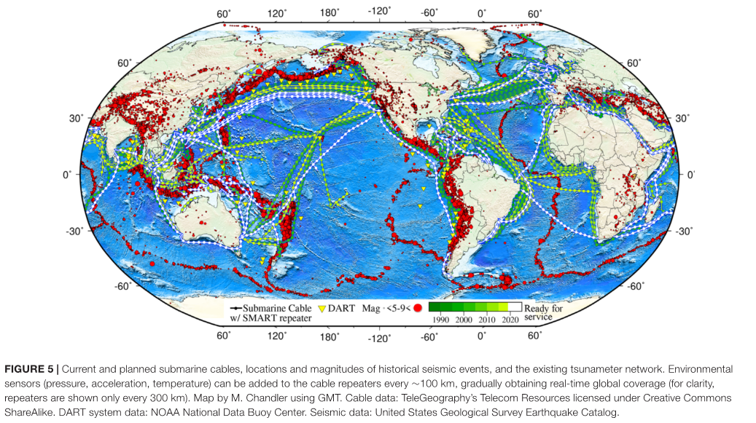
from UNESCO Sea Level Monitoring Station Facility Map
1. Sea Level Observations
The Group recommended the IOC Assembly at its 33rd session in 2025
to request the IOC Member States to prioritize installation/deployment of additional coastal tide gauges and tsunami detection/observation systems in regions under high tsunami risk with priority areas with known coverage gaps (in alphabetical order: Aegean Sea, Caribbean Sea (West, North and South-East), Indian Ocean (East and North), North Africa, Philippine Sea, Solomon Sea, South China Sea, Timor Sea, and Yellow Sea), to ensure tsunami detection and verification as early as possible;
to encourage the IOC Member States to monitor the health of their sea level gauges that are used for detecting and monitoring tsunamis, to restore them as quickly as possible when they fail, add sea level gauges when possible and share their data in real time, in places identified by their ICG as gaps;
The Group recommended
Member States to consider deployment of sea level gauges close to each identified volcano with tsunamigenic potential, with real-time continuous data transmission and 1 sec sampling - 1cm accuracy for automatic detection purposes;
Member States to invest more in offshore seismic and sea-level detection and observation instrumentation, such as Tsunameter/DART®/GPS buoys/cabled systems (e.g. SMART Cables), where possible, with multi-hazard observational capabilities, serving the needs of earthquake seismology, meteorology and oceanography;
DART® (Deep-ocean Assessment and Reporting of Tsunamis)
NOAA National Data Buoy Center (https://www.ndbc.noaa.gov/)
SMART Cables (Angove et. Al (2019))

Slide 5

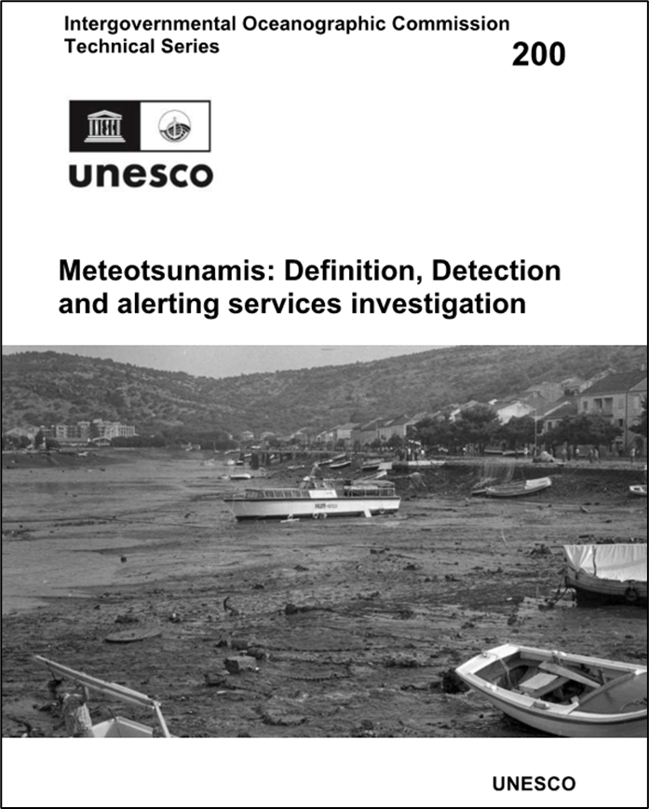
2. Non-Seismic Tsunamis
The Group recommended the IOC Assembly at its 33rd session in 2025 instruct the regional ICGs:
to develop SOPs for volcanoes with a tsunamigenic potential within their Earthquake Source Zone (ESZ);
The Group recommended the IOC Assembly at its 33rd session in 2025 recommend the regional ICGs:
to create relationships between National Meteorological and Hydrological Services (NMHS) and TSPs/NTWCs in order to ensure that tsunami-specific instrumentation including Tsunameters/DART® and ocean cable systems are correctly monitored and utilized for detection of meteotsunami;
The Group instructed the TT-TWO to
conduct and present to TOWS-WG at its next session the result of a study on which areas met the Ocean Decade Tsunami Programme (ODTP) requirement of tsunami confirmation within 10 minutes or less of origin for the most at-risk coastlines, with reference to the sea-level stations available in the IOC’s Sea Level Station Monitoring Facility;
include tsunamis generated by the submarine and subaerial landslides in its work programme and engage with the landslide hazard and early-warning scientific and operational community to address the requirements of the first objective of the ODTP to develop the warning systems’ capability to issue actionable and timely tsunami warnings for tsunamis from all identified sources to 100 percent of coasts at risk;

Slide 6
3. Tsunami Forecasting and Tsunami Bulletins from TSPs
The Group recommended the IOC Assembly at its 33rd session in 2025 instruct the regional ICGs:
Establishing arrangements among Tsunami Service Providers (TSP) within each ICG to ensure that service provision is ensured at all times for the full Area of Service of the ICG;
that dissemination of the specialized TSP bulletins for the maritime community is tested in CARIBE-EWS, IOTWMS and NEAMTWS by at least one TSP either through the planned communication tests or tsunami exercises;
that full operational implementation of TSP bulletins for the maritime community by at least one TSP in each ICG takes place in 2025;
The Group recommended the IOC Assembly at its 33rd session in 2025 recommend the regional ICGs:
continuation of the investigation and the possibility to adopt tsunami forecasting methods, including probabilistic methodologies, toward impact-based forecasting, that could also assist post-disaster response, recovery and needs assessment processes;
The Group recommended Member States NTWC:
to work with national and local emergency management authorities to define the criteria for and institutions in charge of issuing the All-Clear message;

Slide 7
3. Tsunami Forecasting and Tsunami Bulletins from TSPs (continued)
Common Alerting Protocol
The Group recalled that the Common Alerting Protocol (CAP) is the international standard format for emergency alerting and public warning, designed for all hazards, which can be used for exchanging multi-hazard emergency alerts and public warnings over all kinds of information and communications technology;
The Group also noted that CAP is now widely used in EWS and 91% of the world’s population lives in a country that is implementing CAP;
The Group recognized that the advancement of CAP implementation globally represents a significant milestone in the Early Warnings for All (EW4All) initiative, and the fact that CAP can be considered as the bridge connecting “observations, monitoring, analysis and forecasting” to “warning dissemination and communication”, and that WMO is able to provide any assistance that may be required in this regard;
The Group further instructed the TT-TWO to:
develop in collaboration with the WMO a global CAP template for TSPs to facilitate dissemination of bulletins from TSPs to NTWCs, between TSPs of different basins, and for public TSP bulletins, to be presented and approved by the TOWS-WG at its next session;

Slide 8
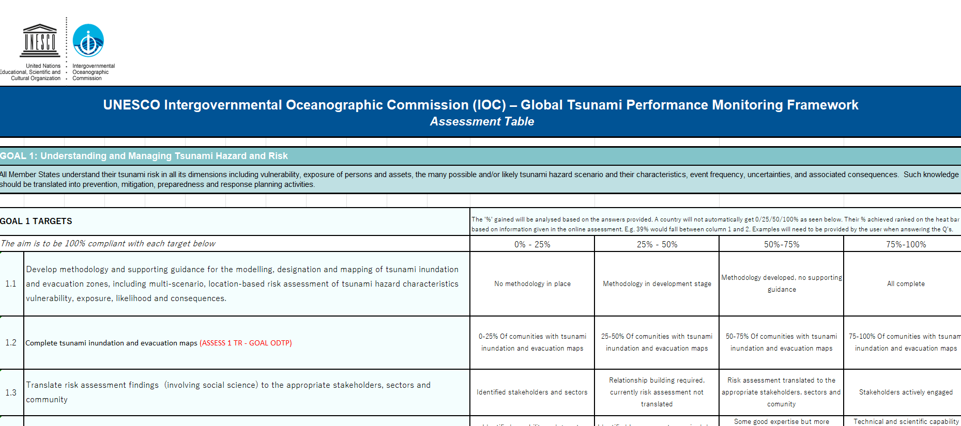
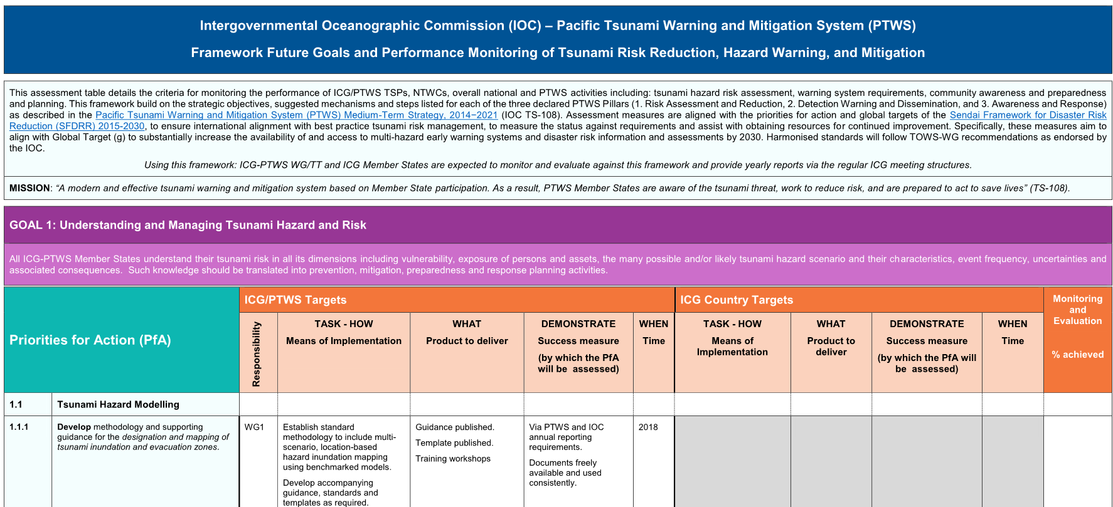
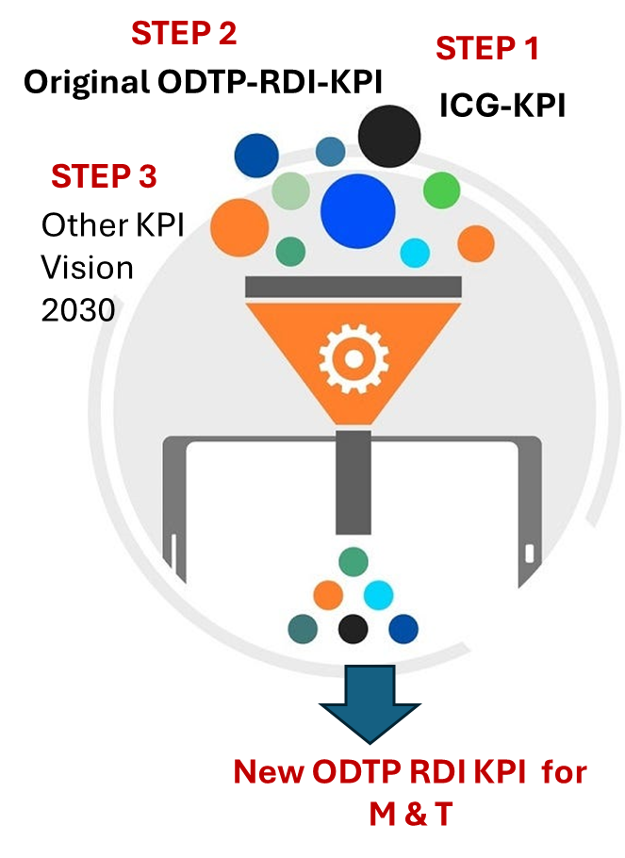
4. UN Ocean Decade Tsunami Programme
The Group recommended the IOC Assembly at its 33rd session in 2025 instruct the regional ICGs:
to develop and adopt a harmonized set of Key Performance Indicators (KPI) based on the harmonised set of Global Key Performance Indicators (GKPI), to support consistent and effective global reporting;
The Scientific Committee of the Ocean Decade Tsunami Programme (ODTP-SC) at its 5th session was held in Paris on January 16-17, 2025. Hosting the ODTP Webinars and a first ODTP Conference was proposed and was approved.
ODTP Webinars 1: June 2025
ODTP Webinars 2: between June and November 2025
ODTP Conference: back-to-back with the IUGG Joint Tsunami Commission (JTC) International Tsunami Symposium (ITS), India in November

Slide 9
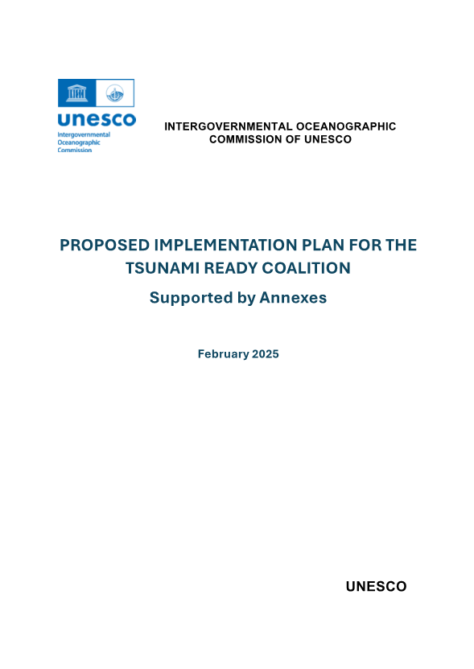

5. Tsunami Ready Recognition Programme
The Group recommended the IOC Assembly at its 33rd Session in 2025
to approve the Tsunami Ready Coalition Implementation Plan including:
• The Coalition mandate and terms of reference,
• The Coalition structure, and
• The identified key Coalition Partners.
The Group recommended the IOC Assembly at its 33rd session in 2025 recommend the regional ICGs:
to prioritize regional Tsunami Ready workshops or summits in 2025 and conduct further workshops or summits before 2030;
The Group requested that Tsunami Information Centres (TIC) continue developing additional tools for the Tsunami Ready Toolkit, including:
• Application Form in official UN languages
• More efficient submission procedures
• Tsunami Ready Training providing detailed implementation guidance

