Slide 1

PTWS
Minimum Competencies for National Tsunami Warning Centers
2024-26 ITIC Training Pilot
PROGRESS REPORT
ICG/PTWS-XXXI, 7-11 April 2025, Beijing, China
Laura Kong, ITIC Director

Slide 2
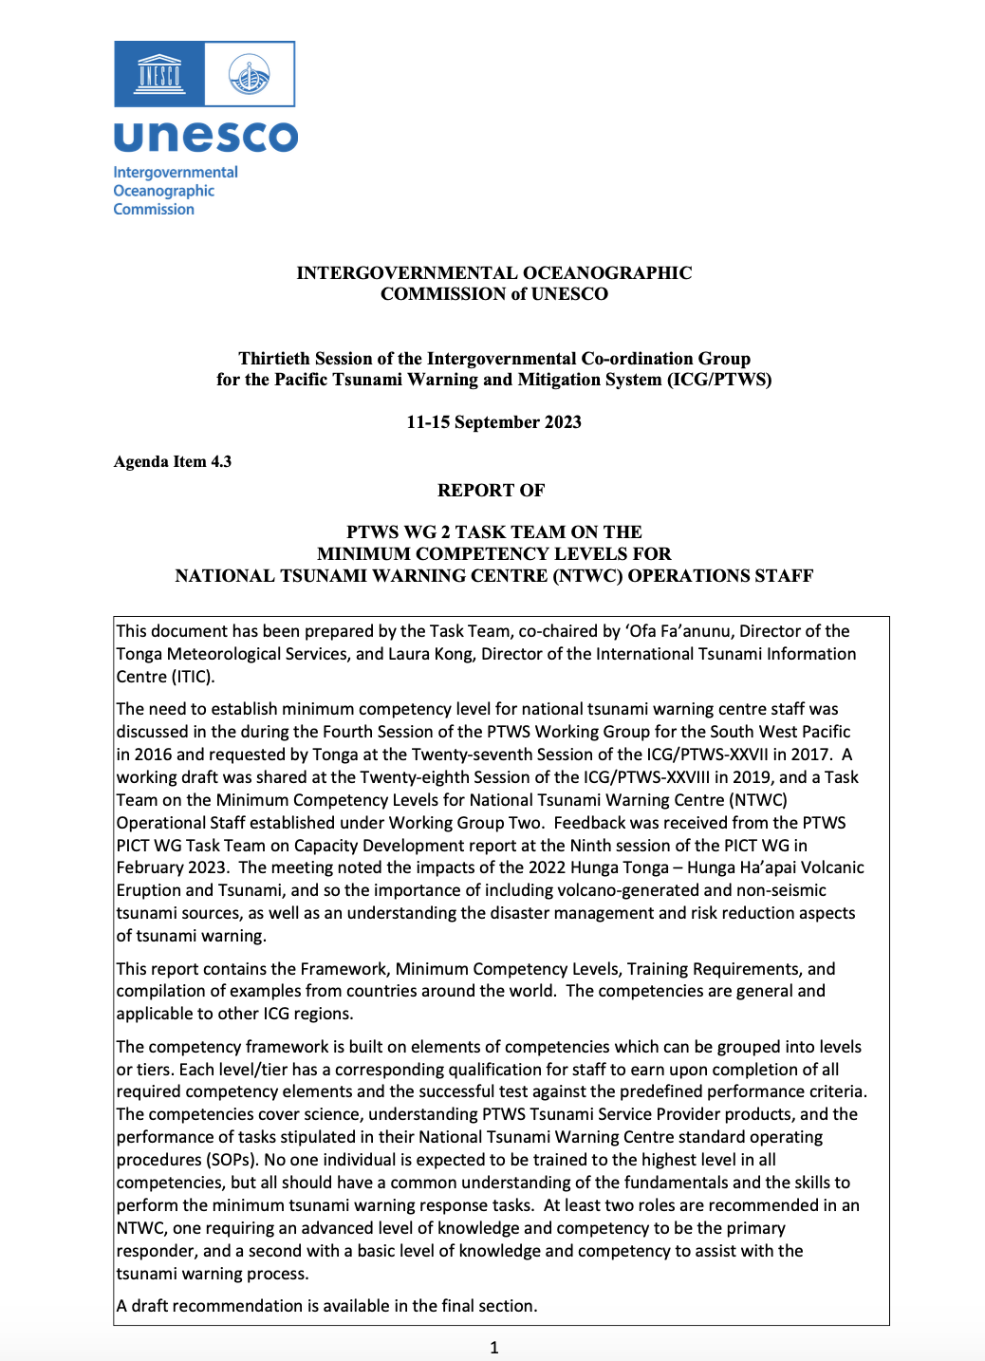
NTWC Minimum Competencies Framework
Minimum Competency Level for National Tsunami Warning Centre (NTWC) Operations Staff
PTWS-XXVII (2017) – PICT identified staff need
PTWS WG 2 (2018, Hawaii) – small group to draft
PTWS-XXVIII (2019) – Incomplete framework, est. WG 2 TT on Minimum Competency Levels for NTWC Operations Staff
Global TOWS WG TT-TWO and DMP (Feb 2022, 2023) – shared progress, interest in global harmonization
PTWS-XXX (2023) – Approved Report of the PTWS WG-2 TT to ICG
  Content – 1. Minimum competency levels, 2. Framework for required competencies (e.g., multi-tiered system with different levels of knowledge and skills required depending on roles), 3. Training required, 4. Document existing schemes

Slide 3
Minimum Competencies – 2 Tiers of NTWC
1. ADVANCED (Comprehensive, Max), 2. CORE (Basic, Min)
KNOWLEDGE Science
    CORE : Basic tsunami science / earthquake source knowledge
    ADVANCED : Adv tsunami science / earthquake source knowledge, tsunami forecast modelling
OPERATIONS competencies
    CORE
    Understand / use TSP text / graphical products, core set of decision support tools. Perform all core NTWC SOPs
    Identify potential regional, distant, and local source tsunami threats
    ADVANCED
    Understand and produce tsunami threat maps
    Explain relationship of tsunami warning products to evacuation maps and routes
    Use a comprehensive set of decision support tools
    Advanced practical seismology (locate / characterise EQs), sea-level observations: measure & interpret records
NATIONAL AGENCY competencies - CORE
    Provide national threat & impact assessment. Liaise with NDMO & response agencies. Monitor public enquiries, provide guidance. Conduct Post-event activities (post-tsunami survey)

Slide 4

PTWS NTWC Minimum Staff Competencies Training - Pilot
PTWS NTWC Minimum Staff Competencies Training
  ITIC create training, with advanced TWC country partners
  Funding: USAID funding (initial only), IOC Ocean Training Interns (Q4 2024)
Series of courses - from self-paced to in-person housed under OTGA
  In order to take next Lesson, must pass previous Lesson and Course. Start with OTGA UNESCO-IOC Tsunami Awareness and Tsunami Ready
  Modules (to be individual OTGA courses, or US COMET MetEd courses)
      Core Science (multiple Lessons)
      Core Knowledge (multiple Lessons)
      Core Agency (multiple Lessons) – National actions
  Final training will be in-person (3-4 weeks at ITIC/PTWC)
Finish Training and pilot in 2026 with 1 small cohort (PIC)

Slide 5

PTWS NTWC Minimum Staff Competencies Training – Project Team
Project Team
  Lead – Laura Kong (ITIC)
  ITIC consultants (Tony Elliott (IOTWMS Secr ret), Ken Gledhill (NZ GNS ret), Marie Eble (NOAA PMEL ret)
  ITIC Interns (Oct–Dec 2024) – Muhammad Harvan (Indonesia BMKG), Taniela Takeifanga (Tonga MS)
  Adv NTWC Countries: Australia (BOM, GA), New Zealand (GNS), USA (PMEL, PTWC), Others welcome
Partner Agencies: OTGA (IOC), UCAR COMET (USA)
Consultation with:
  PTWS PICT WG TT Capacity Development
  PTWS WG 2 on Warning and Dissemination
  TOWS WG TT Tsunami Watch Operations
  Other countries and experts

Slide 6


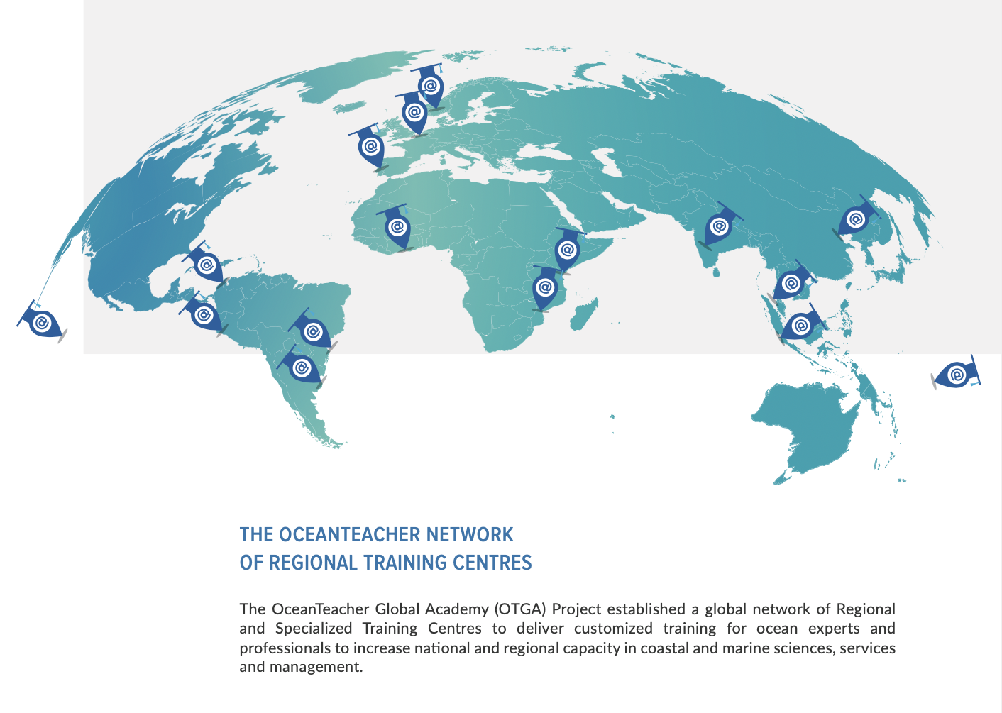
International Tsunami Information Centre (ITIC)

Slide 7
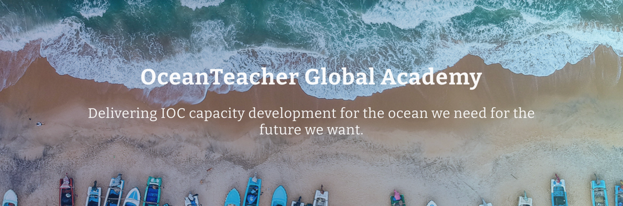
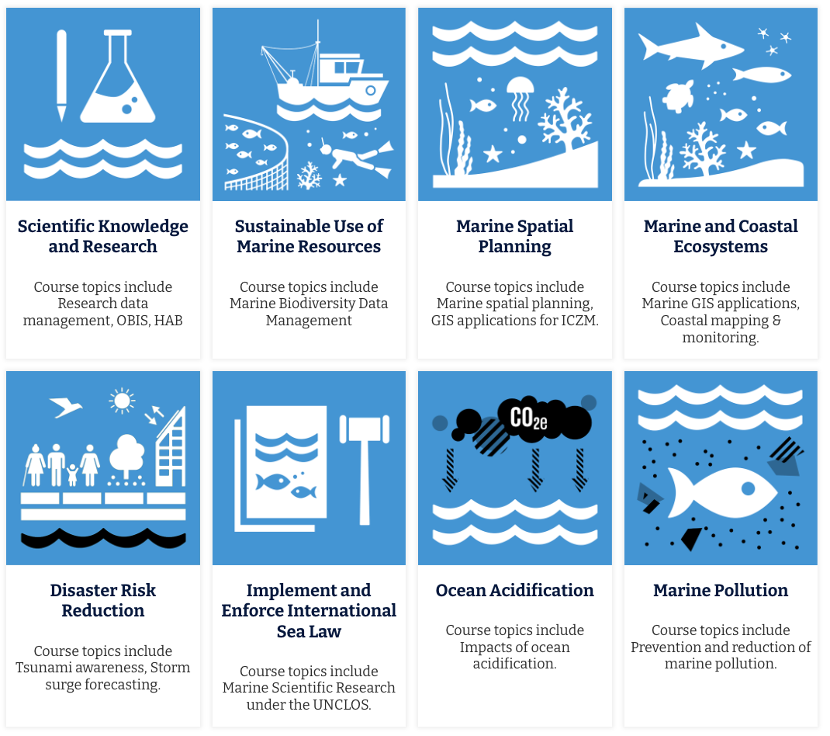
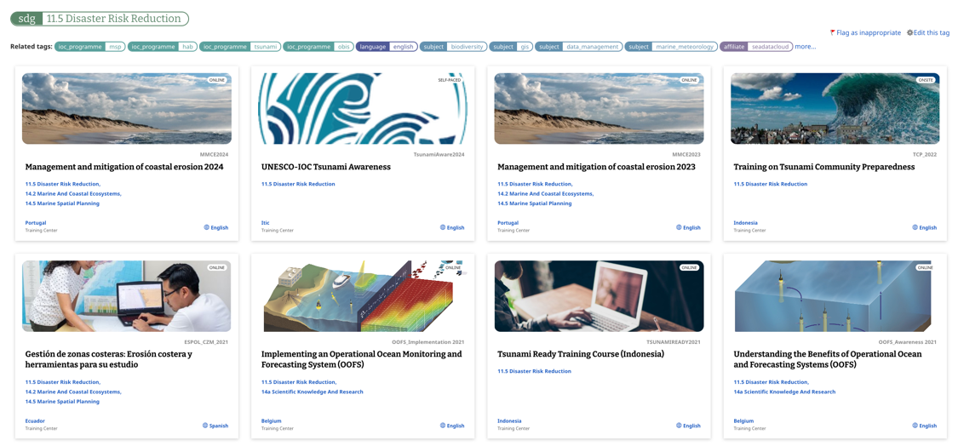
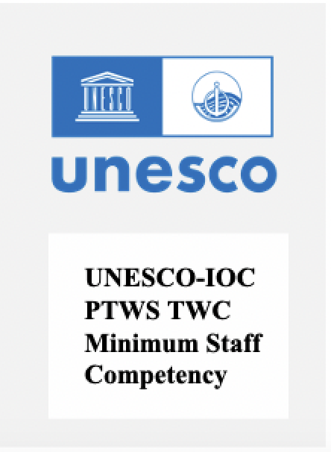

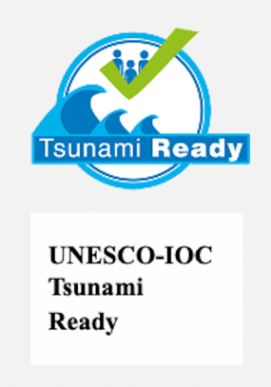

OTGA UNESCO-IOC Tsunami Online Courses
Q2 - 2026
Live 2024
Live 2025
https://classroom.oceanteacher.org/

Slide 8
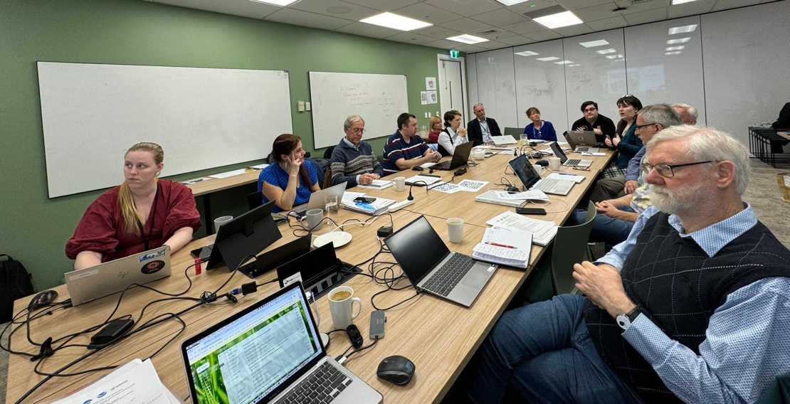
Kick-off Meeting, Wellington, New Zealand
Hosted by NZ National Emergency Management Agency (NEMA), 15-17 July 2024
Attended by project team / reps from BOM, GA, GNS, NEMA, PTWC, and UNESCO-IOC OTGA and TSR Suva
Outcomes:
  Reviewed existing schema and training material from Australia, New Zealand, USA
  Reviewed NTWC Competency Framework and agreed on modules to include
  Obtained agreement from agencies to include their material (formal approval post-mtg)
  Agreed to establish Expert Panel comprising nominated representatives from Australia, New Zealand, USA, plus other experienced TWCs

Slide 9
Overview of Training Programme - OTGA
Prerequisites
Core Science
Hybrid TWC SOP Training
Core Operations
Decision Support Tools
Communicating Threats & Impacts
In Person training
Tsunami Awareness
Tsunami Ready
Knowledge
Tsunami science
Earthquake science
Source material:
BOM
COMET module to be updated and modified
PTWC
Understand and use TSP messages and products
Perform NTWC core activities
Source material:
SOP PPTs
IOC M&Gs
PTWC products training videos
SOP Exercise Documents
TEMPP training material
CISN
Tidetool
IOC SLMF
Websites
TTT
TsuCAT
Others
Putting core operational knowledge into practice
Source material:
COMET Module on NTWC Operations to be developed
Using TWC material from SOP training courses
Focus on use of PTWC (TSP) products
Design and conduct exercises
Cohort of 4-6
Must have completed all pre-requisite courses and hybrid training
Lectures & hands-on TWC operations practicums
Observing PTWC duty staff activities
Simulated Event Exercises

Slide 10
Progress to date
OTGA platform – project team lead
  Core science competencies training material available from BOM, GA, COMET and OTGA Tsunami Awareness course – Review completed and gaps identified
  New module: Basic Tsunami Science knowledge - Development ongoing
  New module: Basic Earthquake Source knowledge - Draft completed
COMET platform – project team working with COMET team
  Existing module update, COMET: “Tsunamis” - include events since 2017 and ensure materials applicable for US domestic and international - Work ongoing, complete Q2 2025.
  New module, COMET: NTWC Decision-making: “Communicating Threats and Impacts during Tsunami Events” – based around COMET’s existing US NTWC, but focus on PTWC Products, with NWPTAC where appropriate (SW Pacific scenario)
  Due to US govt funding situation, active work paused by most of project team – timeline for completion not certain (sometime 2026)

Slide 11

OTGA Core Tsunami Science Competencies
Based on BOM training course supplemented by material from GA, OTGA Tsunami Awareness, COMET and other sources as needed.
Focus on job requirements of TWC staff, i.e, on science needed to support operational decision-making.
BOM course is general entry-level covering tsunami science for duty forecasters at the Bureau National Operations Centre (BNOC). It is focused on the Australian AOR
BOM course covers:
  Generation – 4 lessons
  Propagation – 6 lessons
  Impact – 4 lessons

Slide 12
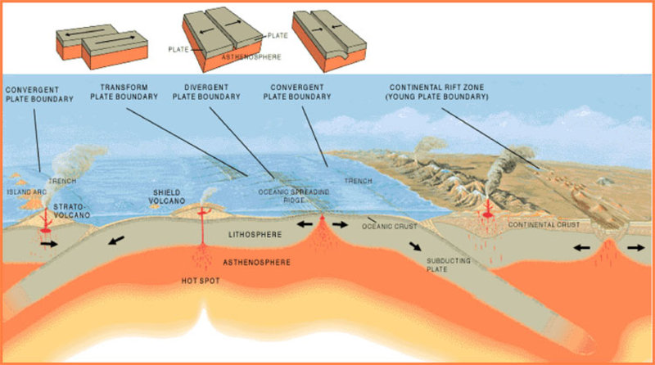
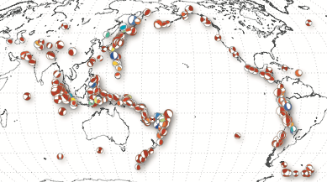
OTGA Core Earthquake Science Knowledge
Draft completed December 2024
Material gathered from COMET, BOM, GA, USGS, IRIS, and OTGA training modules
Covers:
  Plate tectonics
  Fault types
  EQ parameters
  EQ magnitude types
  EQ intensity
  Beachball diagrams
  Tsunamigenic EQs
Currently available in MS Word format
Requires editing and review and conversion to HTML5 format, possibly as PPTs

Slide 13
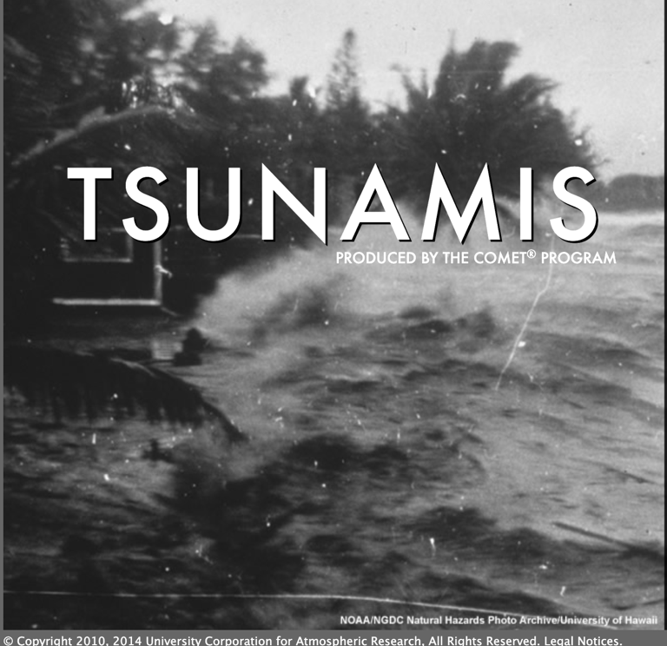
COMET “Tsunamis” course
6 Modules:
  Introduction
  Generation
  Initiation
  Propagation
  Inundation
  Long-term effects
Last updated December 2017
Very good overview of tsunami science but requires general update and inclusion of events such as Palu 2018 tsunami and Hunga Tonga 2022 eruption and tsunami
https://www.meted.ucar.edu/education_training/lessons/831

Slide 14
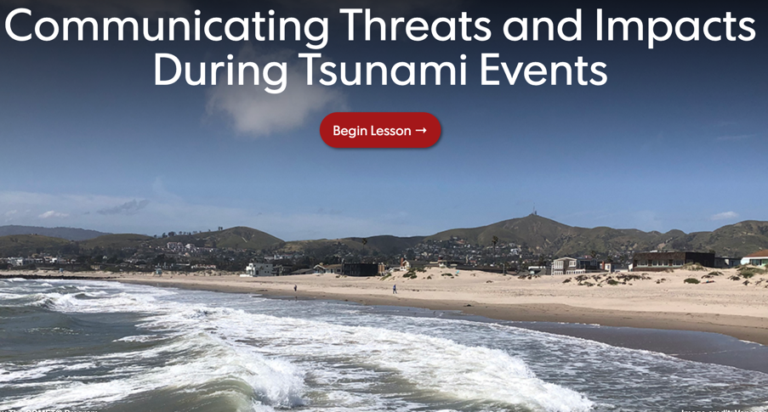
COMET NTWC Operations course
Based on module for US TWC: “Communicating Threats and Impacts During Tsunami Events”
  Introduction
  TWC product alerts
  Local information from WFOs
  Tsunami event exercise
  Summary of promising practices
Launched in July 2022
Current course is US-centric and requires extensive modification to be suitable for a IOC Pacific regional / international audience (TSP products)
Will focus on NTWC SOPs using PTWC messages and products (NWPTAC if needed)
Tsunami event exercise interactive and will be modified for role play as local, regional and distant tsunami TWC operational staff
https://www.meted.ucar.edu/tsunami/tsunami_dss/index.htm

Slide 15
2025 - 2026
ITIC is committed to finish the Training Pilot
Work on updating COMET “Tsunamis” module continues - aim to complete by end of Q2 2025
Work on OTGA Core Tsunami Science module ongoing - aim to complete by end of Q2 2025
Work on COMET NTWC Operations “Communicating Threats and Impacts during Tsunami Events” module - currently paused
Hybrid and in-person training planned for 1st half 2026 – dates depend on progress on pre-requisite modules. Timeline to be revisited at end of Q2 2025.

Slide 16
PTWS
Minimum Competencies for National Tsunami Warning Centers
2024-26 ITIC Training Pilot
THANK YOU!
Laura Kong, ITIC Director

