Slide 1

ICG/PTWS-XXXI, 7-11 April 2025, Beijing, China
PTWS WORKING GROUP 3
ON DISASTER RISK MANAGEMENT AND PREPAREDNESS (WG 3)
Report to ICG/PTWS-XXXI
Co-Chairs:
Ashleigh Fromont, NZ NEMA
Laura Kong, ITIC
Notes:
Note that these are not exhaustive

Slide 2
ICG/PTWS XXXI April 2025
Status of Actions & Decisions – ICG/PTWS-XXX
ICG/PTWS-XXX in September 2023 decided to continue Working Group Three to facilitate and coordinate efforts relating to Disaster Risk Management and Preparedness within the ICG/PTWS (ICG/PTWS-XXX.1)
The Working Group has the following Terms of Reference:
In collaboration with TOWS TT DMP, and organisations such as UNDRR, support the exchange of experiences and information on risk reduction and preparedness actions, and matters related to disaster management
Promote preparedness in coastal communities through education and awareness products and campaigns
Facilitate SOP training across regions to strengthen emergency response capabilities of Member States and their DMOs.
        Develop and promote best practice preparedness material, programmes, and assessment tools
        Develop and promote tsunami risk reduction theory and practice
        Support the ITIC of the ICG.

Slide 3
ICG/PTWS XXXI April 2025
1. Support Exchange of experiences and information on risk reduction and preparedness actions
The Working Group continued to play an active role in the TOWS TT-DMP, with representatives attending in 2024 and 2025.
The TT-DMP discussion
centred around Tsunami Ready, including appreciation of the progress the PTWS has made towards equivalency guidance, the Tsunami Ready Coalition, common TR implementation challenges across ICGs, disability inclusivity in tsunami preparedness, and aligning of monitoring and resources.
began to discuss future governance questions regarding evolving TR at the policy and national levels including mainstreaming into national DRR legislative frameworks, addressing other stakeholders such as schools, critical power and transportation infrastructure, and the private sectors such as the tourist and shipping industry
The TT DMP meetings and discussion continue to provide a valuable mechanism for global coordination and collaboration on similar challenges across ICGs.
Working Group Three recommendation to the ICG/PTWS:
Notes the importance of global awareness and collaboration on challenges and opportunities relating to tsunami disaster management and preparedness, and particularly regarding the implementation of the Tsunami Ready Recognition Programme.
Requests the WG 3 to address in the context of overall tsunami disaster risk reduction the key future governance and Tsunami Ready implementation questions as identified by the TOWS-WG-XVIII TT-DMP, for sharing to the TOWS WG.
Notes:
How should Tsunami Ready evolve at a policy and national level? How can UNESCO-IOC sustainably engage with both Member States and communities?
How Member States adapt/streamline the programme into their national disaster risk reduction legislative framework?
The task team will continue to address these questions, along with the further following in the intersessional period:
How to deal with other interests & complex and particular situations (entire coast, schools etc.?)
How to deal with the interest and needs of critical infrastructure, i.e. airport and port
How to deal with the interest and needs of hazardous vital infrastructure, i.e. industrial zone, power plan
Alignment of Tsunami Ready Evaluation Survey and the Tsunami Event Post Assessment Questionnaire

Slide 4
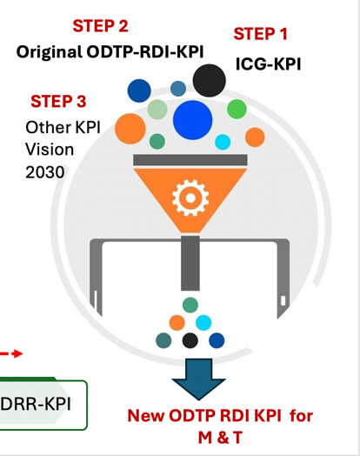
ICG/PTWS XXXI April 2025
1. Global Performance Monitoring Framework
IOC/TRS actively developing: Performance Monitoring and Tracking Framework and Tool for ODTP actions
Tool to closely align with both Monitoring and Evaluation Framework of the UNOD (2021–2030) and Global Tsunami Performance Monitoring Framework. The Pacific/ICG-KPI serves as foundational layer for this tool, with additional layers incorporating KPIs derived from the ODTP RDI and other relevant frameworks.
Tool to be operationalised by Jan 2026. => ICG Member States to monitor and evaluate progress against new global framework and provide reports via ICG meeting structures. To replace current national reporting process.
Continued participation in TOWS and its task teams will allow gaps, opportunities, improvements and successes to be shared.
Working Group Three recommendation to the ICG/PTWS:
Recalling that the ICG/PTWS XXX recommended that the latest version of the Global Performance Monitoring Framework be presented at the next TOWS-WG for endorsement of the global adoption by all ICGs, and for the TOWS-WG TT-DMP to work with the IOC Tsunami Resilience Section (IOC-TSR) to develop the web portal.
Notes that the IOC-TSR Secretariat is actively preparing to develop a Performance Monitoring and Tracking Tool for ODTP actions, with the ICG/PTWS KPI as a foundational layer, and also incorporation KPIs derived from the Ocean Decade Tsunami Programme and other relevant frameworks
Requests Working Group 3 representatives to continue to engage through the TOWS-WG TT-DMP on the Global Performance Monitoring Framework and Tracking Tool, in support of consistent and effective global monitoring.

Slide 5

ICG/PTWS XXXI April 2025
Global Risk Reduction and Preparedness actions:
Tsunami Ready Coalition (1)
As part of the ODTP governance structure, a special Coalition for Tsunami Ready (TRC) was established. The present Chair of the Tsunami Ready Coalition is Dr. Laura Kong, ITIC Director.
TRC Chair, in consultation with the IOC TRS and supported by a technical consultant with extensive PTWS experience, prepared the Tsunami Ready Coalition Implementation Plan (TRC-IP), which was approved by TOWS-WG-XVIII (February 2025)
Mandate (IOC EC(IOC DecA-31/3.4.1), TOWS-WG-XV, ODTP Implementation Plan (IOC TS180):
  The Tsunami Ready Coalition is a collaboration between global, regional, and national stakeholders to advance and sustain the UNESCO-IOC Tsunami Ready Recognition Programme (TRRP), with a specific view on the UN Ocean Decade Tsunami Programme aim of 100% of communities at risk of tsunami are prepared for and resilient to tsunamis by 2030.
Coalition
  Network of critical stakeholders that will advocate for and facilitate support towards the implementation and sustaining of Tsunami Ready through targeted promotion, advocacy, resource mobilization, networking, influence, and advice. Diverse, small by invitation of UNESCO-IOC
Notes:
Indonesia conducted a community drill as part of the Aceh commemorations and WTAD, including exercises in communities that have been recognised as Tsunami Ready.
Malaysia’s events coincided with WTAD and include participation with ASEAN countries as part of a number of projects in the region associated with the commemoration
Washington State’s Great ShakeOut occurred in late October.
A SE Pacific Regional Exercise went ahead in late November, with 4 major drills run in Chile.
New Zealand’s national earthquake drill and tsunami ‘hikoi’ [evacuation walk] was also timed for October.

Slide 6
ICG/PTWS XXXI April 2025
1. Tsunami Ready Coalition (2)
Implementation Plan covers
Establishment, mandate, objectives. Terms of Reference (ToR), action plan, governance, proposed membership and communications plan TRRP
Objectives
1. Raise the Profile of TRRP in Collaboration with Critical Stakeholders
2. Increase Funding Resources for TRRP Implementation
3. Advocate for the conduct of Tsunami Ready Indicator Workshops in the Regions,
4. Effectively Organize the Tsunami Ready Coalition
Working Group Three recommendation to the ICG/PTWS:
Recalling that nearly 70% of the world's historical tsunamis have occurred in the Pacific, with 99% of the tsunami deaths from local and regional tsunamis, thus making tsunami community preparedness, such as through programmes like Tsunami Ready, a high-priority action for saving lives
Notes the approval of the Tsunami Ready Coalition Implementation Plan by the TOWS-XVII WG, towards realizing and sustaining tsunami readiness through targeted promotion, advocacy, resource mobilization, networking, influence, and advice
Requests Working Group 3 to actively support the implementation activities of the Tsunami Ready Coalition
Notes:
Indonesia conducted a community drill as part of the Aceh commemorations and WTAD, including exercises in communities that have been recognised as Tsunami Ready.
Malaysia’s events coincided with WTAD and include participation with ASEAN countries as part of a number of projects in the region associated with the commemoration
Washington State’s Great ShakeOut occurred in late October.
A SE Pacific Regional Exercise went ahead in late November, with 4 major drills run in Chile.
New Zealand’s national earthquake drill and tsunami ‘hikoi’ [evacuation walk] was also timed for October.

Slide 7
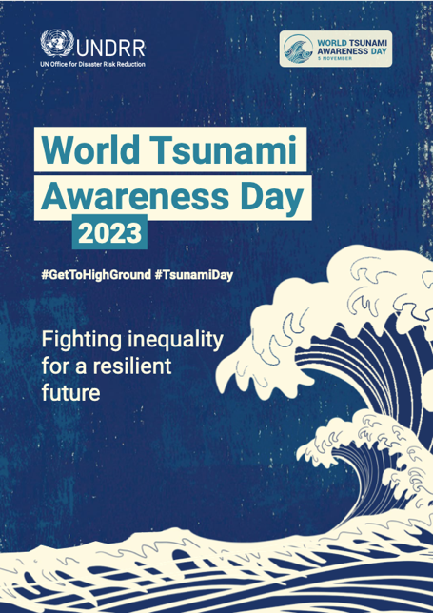


ICG/PTWS XXXI April 2025
2. Promoting Preparedness in coastal communities through education and awareness campaigns - World Tsunami Awareness Day
In 2024, the United Nations Office for Disaster Risk Reduction (UNDRR) was themed around ‘Lessons from the 2004 Indian Ocean Tsunami for the Next Generation’.
This was closely aligned with the International Day for Disaster Risk Reduction. Key WTAD activities include ongoing efforts under the #GetToHighGround initiative, aimed at connecting high level political support to real change making people safer
A number of public events and exercises are being conducted within regions and by Member States in 2024 coinciding with World Tsunami Awareness Day, and the 20th Anniversary commemorations of the Indian Ocean tsunami.
Future themes for World Tsunami Awareness Day were discussed at TOWS TT DMP, including potentially ‘Tsunami Ready’ becoming a permanent theme, similar to Safe Schools and others.
Notes:
Indonesia conducted a community drill as part of the Aceh commemorations and WTAD, including exercises in communities that have been recognised as Tsunami Ready.
Malaysia’s events coincided with WTAD and include participation with ASEAN countries as part of a number of projects in the region associated with the commemoration
Washington State’s Great ShakeOut occurred in late October.
A SE Pacific Regional Exercise went ahead in late November, with 4 major drills run in Chile.
New Zealand’s national earthquake drill and tsunami ‘hikoi’ [evacuation walk] was also timed for October.

Slide 8

Since tsunami do not happen regularly or often, it is essential that there is preparedness beforehand, such as through tsunami exercises of plans and procedures, and evacuation actions by NDMOs to communities.
ICG/PTWS XXXI April 2025
2. Promoting Preparedness in coastal communities through education and awareness campaigns - Exercising
The PTWS Task Team on PacWave24 will report on the outcomes and will also propose Terms of Reference for PacWave26 (ICG/PTWS XXXI agenda item 4.9),
Working Group 3 notes importance of PacWave for disaster management and preparedness, and in particular the ongoing importance to involve NDMOs responsible for emergency response.
Once international alerts sent by TSPs, and NTWCs issue national tsunami warnings, then NDMOs take action to alert tsunami vulnerable coastlines and communities to evacuate.
Since tsunamis do not happen regularly or often, it is essential that there is preparedness beforehand, such as through tsunami exercises of plans and procedures, and evacuation actions by NDMOs to communities.
Working Group 3 recommendation to the ICG/PTWS:
Notes the importance of PacWave exercises with regard toward improving disaster management and preparedness, and in particular the ongoing effort to involve NDMOs.

Slide 9
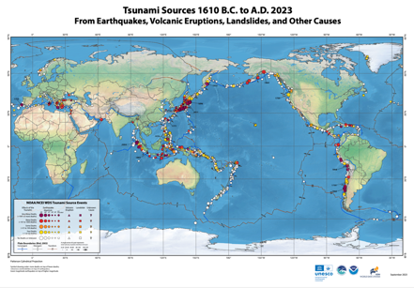
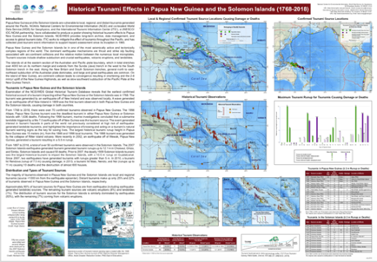

ICG/PTWS XXXI April 2025
3. Training & Awareness Products
ITIC continues to provide significant effort and leadership for tsunami risk management and preparedness in the Pacific.
Much of the coordinated effort of Working Group 3 for SOP training facilitation, strengthening emergency response capability, best practice programmes, materials and assessment tools, and preparedness promotion, is facilitated through the activities of the ITIC. OceanTeacher Global Academy (OTGA) online self-paced training available for Tsunami Awareness (2024) and Tsunami Ready (2025);TWC Minimum Staff Competency Training panned for 2026.
It will be important for the PTWS, through Working Group 3 and other mechanisms, continue to support.
5. Support the ITIC of the ICG (ITIC activities reported under Agenda 3.6)
PTWS Member State sharing of best practice materials and tools enables global sharing through inclusion in ITIC and IOC presentations, reports, guidelines, and videos
Working Group 3 recommendation to the ICG/PTWS:
Appreciates and thanks the ongoing significant effort and leadership provided by the ITIC for tsunami preparedness in the Pacific, including through SOP training, online training under the OceanTeacher Global Academy, and creation and distribution awareness products.

Slide 10
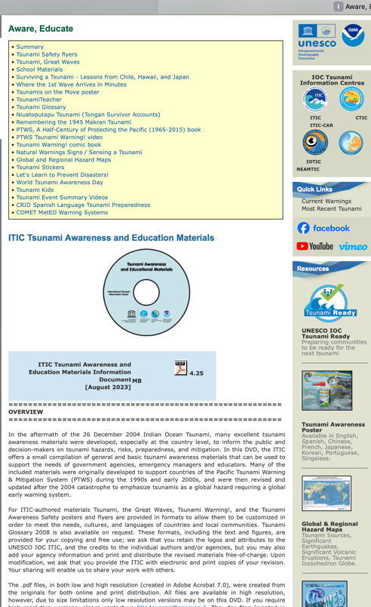
ICG/PTWS XXXI April 2025
4. Promotion of best practice preparedness material
The Group sees value in an effort to collate guidance and material on certain topics for reference for member states, to enable the spread of best practice and reduce duplication of effort – either at a global scale or material specific to the Pacific.
Would be beneficial to create a mechanism for Member States to share links to their to best practice guidance proactively. Previously been recommended but lacked mechanism
This would ideally have two components:
A mechanism for Member States to share relevant documentation & resources for collation
A landing page for people to access those resources.
Early investigation indicated that OceanExpert doclist may be an appropriate mechanism to support this, however, further work is required in order to scope and test usability for this purpose.
Working Group Three recommendation to the ICG/PTWS:
Requests that Working Group 3 and the ITIC continue to explore mechanisms with the Secretariat for Member States to share materials, in order to better facilitate the collection and accessibility of best practice resources on disaster management and preparedness topics.
Welcomes the ITIC offer to host an interim repository, and requests PTWS Member States to share their best practice awareness and preparedness material, programs and assessment tools with the ITIC to compile and maintain for the PTWS.

Slide 11
ICG/PTWS XXXI April 2025
6. Governance
NDMO participation and involvement in the PTWS is essential to achieve UNOD goals and achieve end to end tsunami resilience.
The Working Group welcomes suggestions from the PTWS Steering Committee and Member States on ways to facilitate this and would like to encourage more member states to provide nominations to the working group, particularly from NDMOs.
The Working Group proposes to amend to the Terms of Reference for the Working Group for the next intersessional period, namely:
      Mandating the Working Group to support the implementation of the Tsunami Ready Coalition, noting that these efforts will extend past 2030, and require global collaboration and coordination support;
      Recognising the significance of the Pacific Tsunami Preparedness Capacity Assessment for the forward work programme of the PTWS, and ensuring that this contributes to the design and prioritisation of Working Group 3 activities

Slide 12
ICG/PTWS XXXI April 2025
6. Governance (PTWS WG 3 Recommendation - 1)
Working Group Three recommendation to the ICG/PTWS:
Recalling that nearly 70% of the world's historical tsunamis have occurred in the Pacific, with 99% of the tsunami deaths from local and regional tsunamis, thus making tsunami community preparedness, such as through programmes like Tsunami Ready, a high-priority action for saving lives,
Notes the report of Working Group 3 (Disaster Management & Preparedness)
Notes the importance of encouraging more NDMO participation and involvement in PTWS discussions and governance mechanisms, especially given the nature of the UN Ocean Decade Goals and their connection with disaster management and preparedness.
Notes the approval of the Tsunami Ready Coalition Implementation Plan by the TOWS-XVII WG, towards realizing and sustaining tsunami readiness through targeted promotion, advocacy, resource mobilization, networking, influence, and advice
Notes the importance of PacWave exercises with regard toward improving disaster management and preparedness, and in particular the ongoing effort to involve NDMOs to prepare and respond.

Slide 13
ICG/PTWS XXXI April 2025
6. Governance (PTWS WG 3 Recommendation - 2)
Requests Working Group 3 to actively support the implementation activities of the Tsunami Ready Coalition
Requests the Working Group 3 to address key future governance and Tsunami Ready implementation questions as identified by the TOWS-WG-XVII Task Team on Disaster Management and Preparedness, for sharing to the TOWS WG.
Requests that Working Group 3 and the ITIC continue to explore mechanisms with the Secretariat for Member States to share materials, in order to better facilitate the collection and accessibility of best practice resources on disaster management and preparedness topics.
Welcomes the ITIC offer to host an interim repository, and requests PTWS Member States to share their best practice awareness and preparedness material, programs and assessment tools with the ITIC to compile and maintain for the PTWS.
Appreciates and thanks the ongoing significant effort and leadership provided by the ITIC for tsunami preparedness in the Pacific, including through SOP training, online training under the OceanTeacher Global Academy, and creation and distribution awareness products.
Encourages Member States to provide nominated representatives, particularly from national disaster management organisations, to WG 3 Disaster Management and Preparedness to support an active work programme for this working group

Slide 14
ICG/PTWS XXXI April 2025
6. Governance (PTWS WG 3 Recommendation - 3)
Continues Working Group 3 to facilitate the coordination of efforts relating to Disaster Risk Management and Preparedness within the ICG/PTWS with revised Terms of Reference:
Working Group on Disaster Risk Management and Preparedness Terms of Reference
In collaboration with TOWS TT DMP, and organisations such as UNDRR, support the exchange of experiences and information on risk reduction and preparedness actions, and matters related to disaster management
Support the implementation activities of the Tsunami Ready Coalition
Promote preparedness in coastal communities through education and awareness products and campaigns
Facilitate SOP training across regions to strengthen emergency response capabilities of Member States and their DMOs.
Develop and promote best practice preparedness material, programmes, and assessment tools
Develop and promote tsunami risk reduction theory and practice
Review and advocate for the filling of gaps in Pacific Tsunami Risk Management and Preparedness identified from the 2025 PTWS Tsunami Preparedness Capacity Assessment
Support the ITIC of the ICG.

